Slide 1
Calibration and Stability Analysis of a Multi-Camera System onboard a high Vibration Platform
Mohammed D. Aldosari, Meghdad Hasheminasab, Tian Zhou, Euimyoung Kim, and Ayman Habib
Digital Photogrammetry Research Group
Lyles School of Civil Engineering
Purdue University
Webpage: http://purdue.edu/CE/DPRG
Jan 29, 2019

Slide 2
Smart Agriculture
Smart agriculture is quite important for:
  Increasing crop yield under diminishing resources
  Predicting crop yield
  Reducing the impact of agriculture on the environment (e.g., nitrogen-based fertilizers – cost & environmental impacts)
Remote sensing systems onboard space borne, airborne, and wheel-based platforms play a key role in smart agriculture, in general, and precision agriculture, in particular.
Genotype & phenotype correlation is a key factor in crop yield maximization.

Slide 3
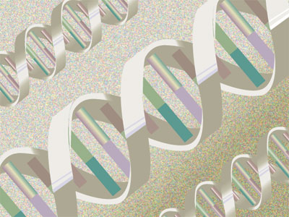
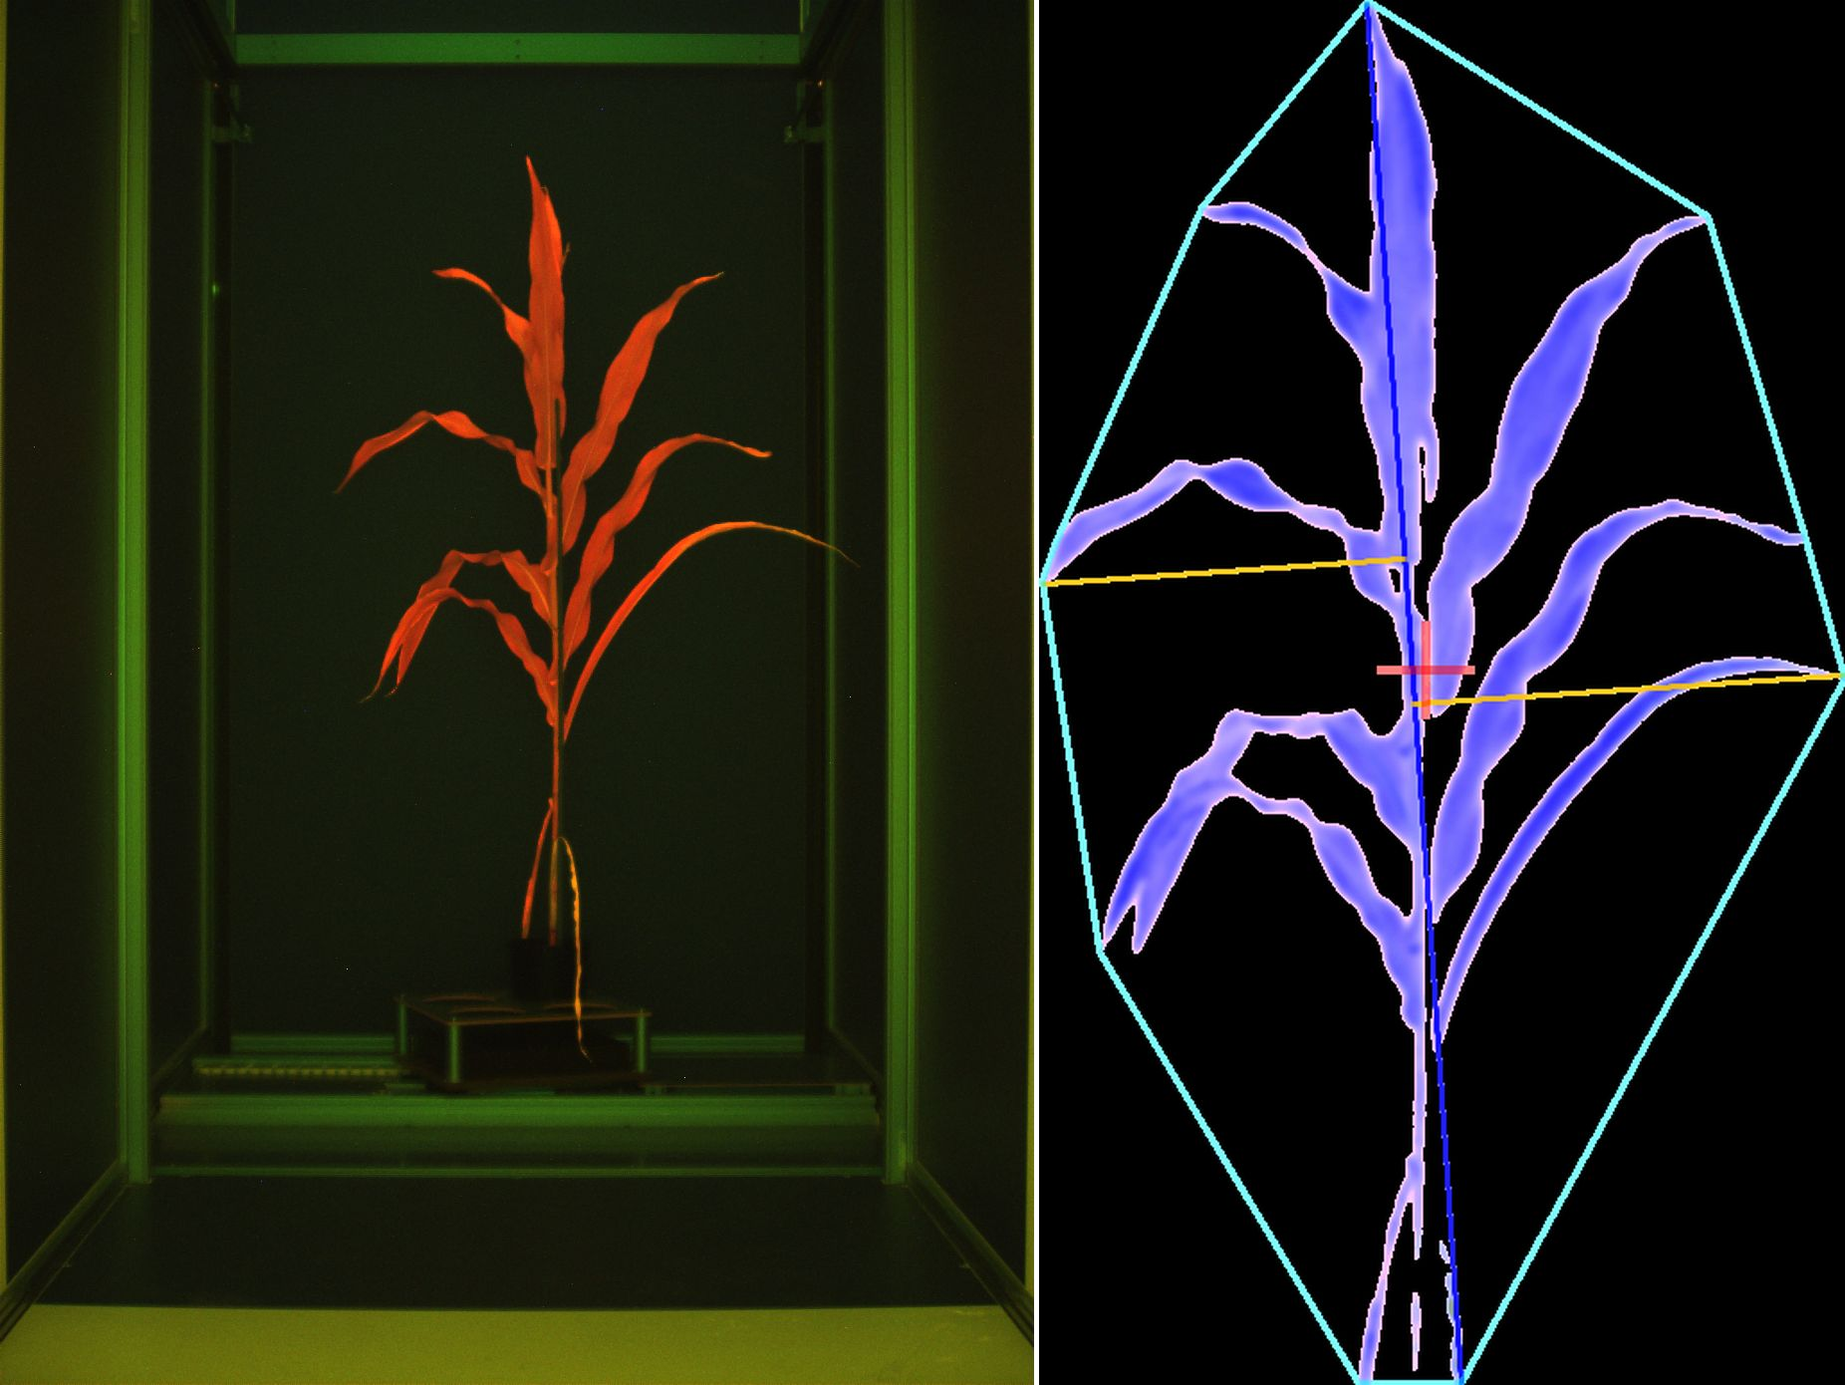
Genotype Vs. Phenotype
Genotype: Genetic constitution (make up) of an individual plant
Phenotype: The physical appearance of a plant because of its genetic makeup (genotype)

Slide 4
Genotype Vs. Phenotype
Correlating plant genotypic and phenotypic traits are important.
  Increasing crop yield
    While considering diminishing agricultural land & water resources
    Increasing biomass for biofuel generation
    Modifying plant structure for high-density planting (e.g., leaf structure manipulation)
  Increasing plant resistance to drought
  Increasing plant resistance to disease and pests
  Reducing plant requirement for nitrogen-based fertilizers
Gene sequencing is affordable & quick.

Slide 5
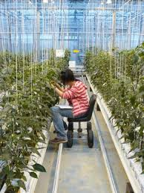
Genotype Vs. Phenotype
Current plant phenotyping activities are:
  Time & labor consuming
  Error prone
  Destructive
  Restricted to green houses and small areas
Phenotyping is the bottle neck in advancing crop yield maximization through gene sequencing.
Remote-sensing systems are promising tools for large scale, high throughput phenotyping at the field level.

Slide 6
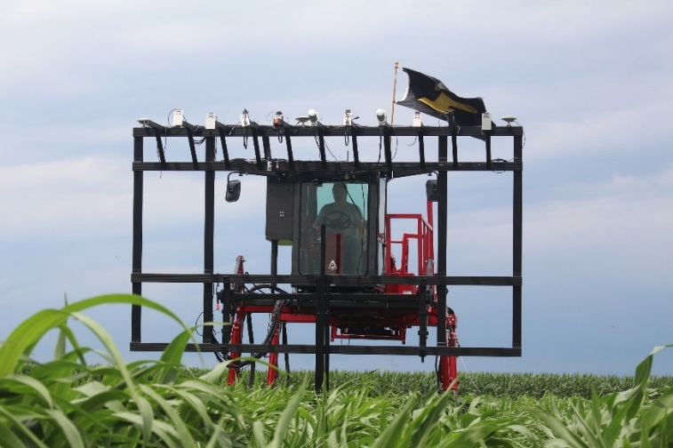
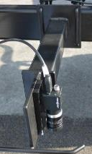
Mobile Mapping System: PhenoRover Platform
MMS: PhenoRover

Slide 7
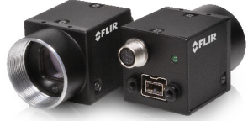
Mobile Mapping Systems for Phenotyping
For proximal remote sensing, we have to rely on stereo-cameras with narrow angular field of view (FLIR Flea-2G).
Calibration of a multi-camera system with narrow angular field of view is a challenging task.
Vibration of the platform might also affect the stability of the estimated system calibration parameters.

Slide 8
System Specifications (PhenoRover)
Camera: FLIR Flea-2G*
Max. image resolution: 2448 x 2048 pixels
Pixel size: 3.45 µm
Focal Length : 12.5 mm
Angular field of view: 41º
Drive Configuration
Boom altitude: 3.5 – 5 m
Driving Speed: 1.5 mile/hour
Image frame rate: a stereo-pair is captured at 1 frame/sec
Right Camera (Flea95)
Left Camera (Flea34)
z
z
x
x
y
y
x
x
Left Camera
(Flea 34)
Driving
Direction
Right Camera
(Flea 95)
*https://www.ptgrey.com/flea2g-5-mp-color-firewire-1394b-sony-icx655-camera

Slide 9
Problem Statement and Objectives
Problem:
Calibration is a challenging task for cameras with narrow angular field of view (FOV)
The PhenoRover is subject to severe vibrations due to the size of the boom and operational environment.
Objectives:
Multi-camera system calibration
  Internal characteristics of the cameras (IOPs)
  Mounting parameters among the cameras (lever arm and boresight angles)
Stability analysis of the multi-camera system

Slide 10
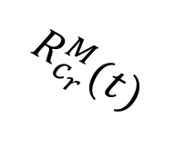






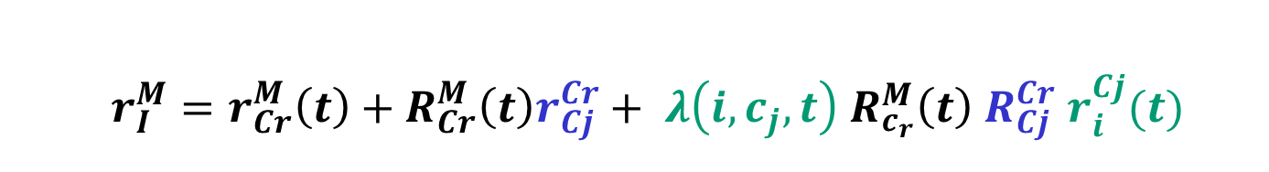






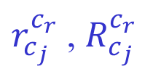
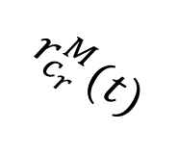
Mathematical Model: Modified Collinearity Equations
$${Z_{c}}_{j}$$
$${Z_{c}}_{r}$$
Flea 95
$${X_{c}}_{r}$$
Reference camera
Flea 34
$${X_{c}}_{j}$$
$r_{c_{j}}^{c_{r}}$ , $R_{c_{j}}^{c_{r}}$
$${Y_{c}}_{r}$$
$${Y_{c}}_{j}$$
$$R_{c_{r}}^{M}(t)$$
Z_{M}
Image point $i$
$$r_{i}^{Cr}(t)$$
Y_{M}
$$r_{i}^{Cj}(t)$$
Image point $i$
$$r_{c_{r}}^{M}(t)$$
X_{M}
Mapping Frame
$$r_{I}^{M}$$
$$I$$
$$r_{I}^{M}=r_{Cr}^{M}\left(t\right)+R_{Cr}^{M}\left(t\right)r_{Cj}^{Cr}+ {λ\left(i,c_{j},t\right) R}_{c_{r}}^{M}\left(t\right) R_{Cj}^{Cr} r_{i}^{Cj}(t)$$

Slide 11
Collected Datasets
June 28th, 2017
  22 images
July 6th, 2017
  26 images
August 2nd, 2017
  28 images
September 11th, 2017
  34 images
Test field includes 36 signalized targets
  Some distances between the targets are measured to define the scale.

Slide 12
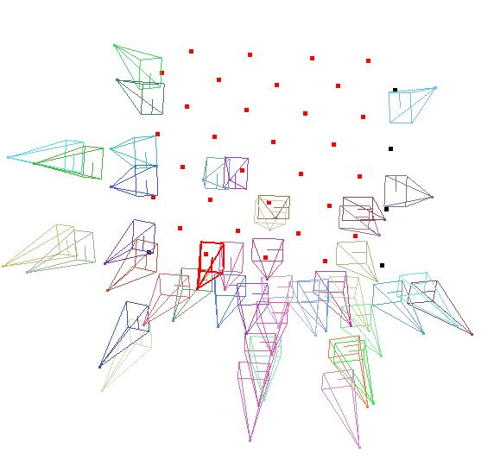
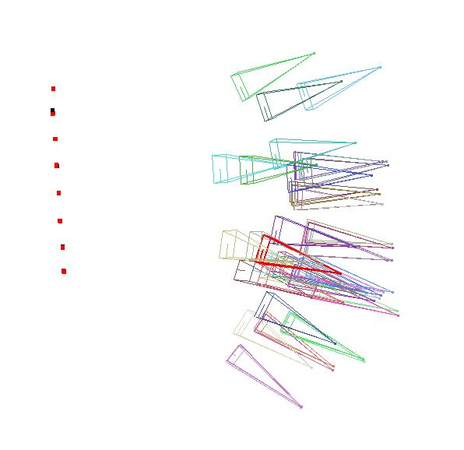
System Calibration Data Acquisition
Imaging configuration example
Same configuration is used for the different dates

Slide 13
Sample Images with Automatically Measured Targets
June 28, 2017
July 6, 2017
August 2, 2017

Slide 14
Results: Estimated IOPs
Interior Orientation Parameters (IOPs)
Date | Camera | x_{p} (mm±mm) | y_{p} (mm±mm) | c (mm±mm) | k₁ (mm⁻²±mm⁻²)
June 28th | Flea 34 | 0.220 ± 0.006 | 0.286 ± 0.009 | 13.040 ± 0.014 | -2.297E-03 ± 2.55E-05
 | Flea 95 | -0.259 ± 0.008 | 0.265 ± 0.009 | 13.002 ± 0.014 | -2.230E-03 ± 2.77E-05
July 6th | Flea 34 | 0.293 ± 0.008 | 0.118 ± 0.010 | 12.968 ± 0.014 | -2.232E-03 ± 2.45E-05
 | Flea 95 | -0.173 ± 0.007 | 0.137 ± 0.010 | 12.930 ± 0.014 | -2.107E-03 ± 2.71E-05

Slide 15
Results: Estimated IOPs
Interior Orientation Parameters (IOPs)
Date | Camera | x_{p} (mm±mm) | y_{p} (mm±mm) | c (mm±mm) | k₁ (mm⁻²±mm⁻²)
Aug. 2nd | Flea 34 | 0.249 ± 0.006 | 0.228 ± 0.008 | 12.991 ± 0.014 | -2.1056E-03 ± 2.31E-05
 | Flea 95 | -0.177 ± 0.007 | 0.298 ± 0.008 | 13.020 ± 0.015 | -2.1342E-03 ± 2.45E-05
Sep. 11th | Flea 34 | 0.210 ± 0.008 | 0.189 ± 0.012 | 12.981 ± 0.016 | -2.0781E-03 ± 3.12E-05
 | Flea 95 | -0.055 ± 0.010 | 0.232 ± 0.013 | 12.940 ± 0.017 | -2.0966E-03 ± 3.42E-05

Slide 16



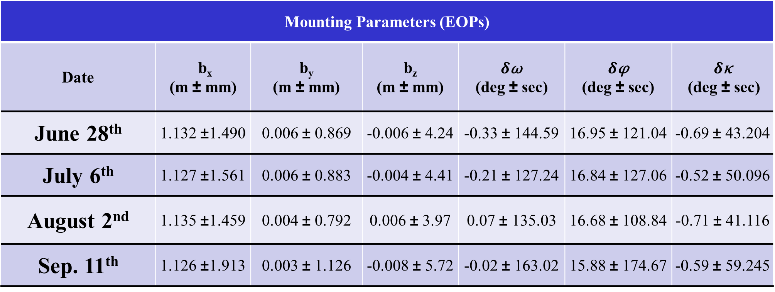






Results: Estimated Mounting Parameters
Mounting Parameters (EOPs)
Date | b_{x} (m ± mm) | b_{y} (m ± mm) | b_{z} (m ± mm) | $δ$ω (deg ± sec) | $δ$φ (deg ± sec) | $δ$κ (deg ± sec)
June 28th | 1.132 ±1.490 | 0.006 ± 0.869 | -0.006 ± 4.24 | -0.33 ± 144.59 | 16.95 ± 121.04 | -0.69 ± 43.204
July 6th | 1.127 ±1.561 | 0.006 ± 0.883 | -0.004 ± 4.41 | -0.21 ± 127.24 | 16.84 ± 127.06 | -0.52 ± 50.096
August 2nd | 1.135 ±1.459 | 0.004 ± 0.792 | 0.006 ± 3.97 | 0.07 ± 135.03 | 16.68 ± 108.84 | -0.71 ± 41.116
Sep. 11th | 1.126 ±1.913 | 0.003 ± 1.126 | -0.008 ± 5.72 | -0.02 ± 163.02 | 15.88 ± 174.67 | -0.59 ± 59.245
Left Camera
Flea-34
$$Z_{m}$$
$$Y_{m}$$
$$R_{Cl}^{m}$$
$$\vec{r_{Cl}^{m}}$$
$$X_{m}$$
$$\vec{r_{Cr}^{Cl}}$$
$$R_{Cr}^{Cl}$$
Right Camera
Flea-95
$$r_{Cr}^{Cl}$$
$$R_{Cr}^{Cl}$$

Slide 17
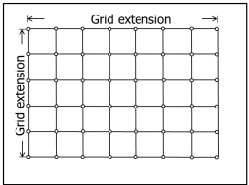
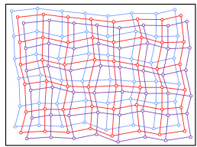
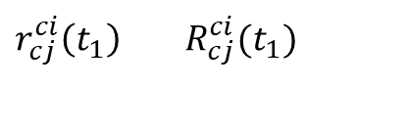
System Stability Analysis Procedure: Initial Steps
1. Define synthetic regular grid in the image space for a given camera (reference camera)
c_{i} (t₁)
$r_{cj}^{ci}\left(t_{1}\right)$ $R_{cj}^{ci}(t_{1})$
c_{j} (t₁)
2. Use the IOPs at t₁ to remove the distortions at the grid vertices and compute object space coordinates by forward projection at different depth levels
Original grid vertex
Distortion-free grid vertex
Forward Projection
Backward Projection
IOP_{i} (t₁)
IOP_{j} (t₁)
3. Compute the image space coordinates by backward projection using the IOPs and mounting parameters at t₁ for the other camera
M1
Depth
Range
Levels
M2
M3
Habib, Ayman, Ivan Detchev, and Eunju Kwak. "Stability analysis for a multi-camera photogrammetric system." Sensors 14, no. 8 (2014): 15084-15112.

Slide 18



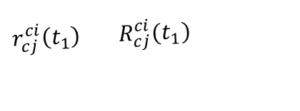


Stability Analysis Procedure – 1st Approach
1st Approach: : Combination of Forward and Backward Projections
$r_{cj}^{ci}\left(t_{1}\right)$ $R_{cj}^{ci}(t_{1})$
C_{j} (t₁)
1. For the first camera (c_{i}), use the IOPs at t₁ to compute object space coordinates by forward projection at different depth levels
c_{i} (t₁)
$r_{cj}^{ci}\left(t_{2}\right)$ $R_{cj}^{ci}(t_{2})$
C_{j} (t₂)
${[x}_{m}^{c_{i}}\left(t_{1}\right)$ , $y_{m}^{c_{i}}\left(t_{1}\right)$]
${[x}_{m}^{c_{j}}\left(t_{1}\right)$ , $y_{m}^{c_{j}}\left(t_{1}\right)$]
2. Compute the image space coordinates for the other cameras (c_{j}) by backward projection using their IOPs and mounting parameters – for two different time epochs (t_{1,} t₂ )
${[x}_{m}^{c_{j}}\left(t_{2}\right)$ , $y_{m}^{c_{j}}\left(t_{2}\right)$]
Forward Projection
IOP_{i} (t₁)
IOP_{j} (t₁)
Backward Projection
Backward Projection
Original grid vertex
IOP_{j} (t₂)
Distortion-free grid vertex
3. Compute RMSE for:
${δx}_{m}= x_{m}^{c_{j}}\left(t_{1}\right)$ - $x_{m}^{c_{j}}\left(t_{2}\right)$
${δy}_{m}= y_{m}^{c_{j}}\left(t_{1}\right)$ - $y_{m}^{c_{j}}\left(t_{2}\right)$
The smaller the RMSE is, the better.
For a stable system, the RMSE should be within the noise level.
M
X_{M}, Y_{M}, Z_{M}

Slide 19

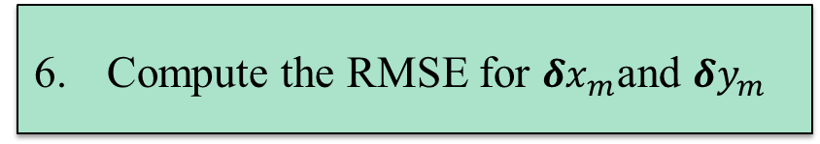
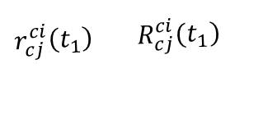



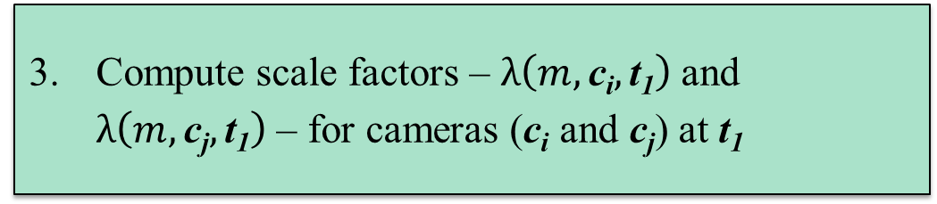




Stability Analysis Procedure – 2nd Approach
2nd Approach: Object Space Parallax in Image Units
$r_{cj}^{ci}\left(t_{1}\right)$ $R_{cj}^{ci}(t_{1})$
C_{j} (t₁)
c_{i} (t₂)
$r_{cj}^{ci}\left(t_{2}\right)$ $R_{cj}^{ci}(t_{2})$
C_{j} (t₂)
c_{i} (t₁)
Forward projection using the scale factors and IOPs/mounting parameters at t₂ → Discrepancy vector (D_{m})
Forward projection to compute the object space coordinates from camera (c_{i}) using IOPs at t₁
Backward projection to compute the image space coordinates for camera (c_{j}) using IOPs and mounting parameters at t₁
${[x}_{m}^{c_{j}}\left(t_{1}\right)$ , $y_{m}^{c_{j}}\left(t_{1}\right)$]
${[x}_{m}^{c_{i}}\left(t_{2}\right)$ , $y_{m}^{c_{i}}\left(t_{2}\right)$]
${[x}_{m}^{c_{j}}\left(t_{2}\right)$ , $y_{m}^{c_{j}}\left(t_{2}\right)$]
${[x}_{m}^{c_{i}}\left(t_{1}\right)$ , $y_{m}^{c_{i}}\left(t_{1}\right)$]
Z
IOP_{i} (t₂)
Forward Projection
Forward Projection
IOP_{i} (t₁)
IOP_{j} (t₁)
Scale the Discrepancy vector to the image space:
$δx_{m}=D_{x_{m}} \frac{C_{avg}}{Z}$
$δy_{m}=D_{y_{m}} \frac{C_{avg}}{Z}$
Forward Projection
Backward Projection
IOP_{j} (t₂)
Compute scale factors – $λ\left(m,\text{c}\text{i},\text{t}\text{1}\right)$ and $λ\left(m,\text{c}\text{j},\text{t}\text{1}\right)$ – for cameras (c_{i} and c_{j}) at t₁
D_{m}
$$D_{y_{m}}$$
Object Space
decomposition plane
$$D_{x_{m}}$$
M
The smaller the RMSE is, the better.
For a stable system, the RMSE should be within the noise level.
(b)
(a)
6. Compute the RMSE for $δx_{m}$and $δy_{m}$

Slide 20







Stability Analysis Procedure – 3rd Approach
3rd Approach: Variation in the Normalized Image Coordinates
1. Forward projection to compute the object space coordinates from camera (c_{i}) using IOPs at t₁
2. Backward projection to compute the image space coordinates for camera (c_{j}) using IOPs and mounting parameters at t₁
3. For conjugate points at t₁ compute the normalized image coordinates from cameras (c_{i}) and (c_{j}) using IOPs at t₁
$$c_{i}(t1)$$
$r_{cj}^{ci}\left(t_{1}\right)$ $R_{cj}^{ci}(t_{1})$
$$c_{j}(t1)$$
${[x}_{m}^{c_{j}}\left(t_{1}\right)$ , $y_{m}^{c_{j}}\left(t_{1}\right)$]
${[x}_{m}^{c_{i}}\left(t_{1}\right)$ , $y_{m}^{c_{i}}\left(t_{1}\right)$]
Normalization plane
$$m^{c_{i}^{n}}(t1)$$
$$m^{c_{j}^{n}}(t1)$$

Slide 21
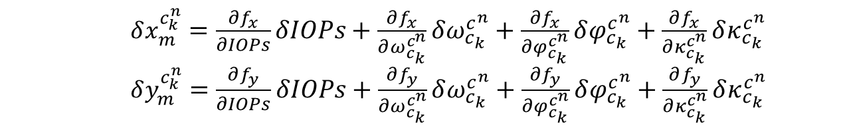
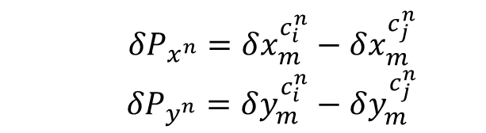

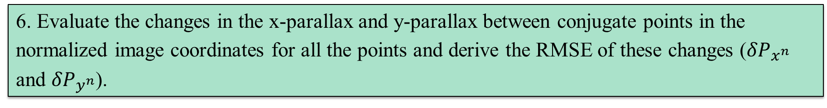
Stability Analysis Procedure – 3rd Approach (cont’d)
4. Given that the normalized image coordinates are function of IOPs, orientation of the cameras, orientation of the baseline, and the image coordinates, bias impact analysis can be performed.
$x_{m}^{c_{k}^{n}}=f_{x}(x,y,IOPs,ω_{c_{k}}^{c^{n}}$,$φ_{c_{k}}^{c^{n}}$,$κ_{c_{k}}^{c^{n}}$)
$y_{m}^{c_{k}^{n}}=f_{y}(x,y,IOPs,ω_{c_{k}}^{c^{n}}$,$φ_{c_{k}}^{c^{n}}$,$κ_{c_{k}}^{c^{n}}$)
k: refers to cameras i and j
5. The variations in the IOPs and mounting parameters from two sets of system calibration parameters (t₁ and t₂) are used to estimate changes in the normalized image coordinates.
$δx_{m}^{c_{k}^{n}}=\frac{∂f_{x}}{∂IOPs}δIOPs+\frac{∂f_{x}}{∂ω_{c_{k}}^{c^{n}}}δω_{c_{k}}^{c^{n}}+\frac{∂f_{x}}{∂φ_{c_{k}}^{c^{n}}}δφ_{c_{k}}^{c^{n}}+\frac{∂f_{x}}{∂κ_{c_{k}}^{c^{n}}}δκ_{c_{k}}^{c^{n}}$
$δy_{m}^{c_{k}^{n}}=\frac{∂f_{y}}{∂IOPs}δIOPs+\frac{∂f_{y}}{∂ω_{c_{k}}^{c^{n}}}δω_{c_{k}}^{c^{n}}+\frac{∂f_{y}}{∂φ_{c_{k}}^{c^{n}}}δφ_{c_{k}}^{c^{n}}+\frac{∂f_{y}}{∂κ_{c_{k}}^{c^{n}}}δκ_{c_{k}}^{c^{n}}$
k: refers to cameras i and j
6. Evaluate the changes in the x-parallax and y-parallax between conjugate points in the normalized image coordinates for all the points and derive the RMSE of these changes (${δP}_{x^{n}}$ and ${δP}_{y^{n}}$).
The smaller the RMSE is, the better.
For a stable system, the RMSE should be within the noise level.
${δP}_{x^{n}}=δx_{m}^{c_{i}^{n}}−δx_{m}^{c_{j}^{n}}$
${δP}_{y^{n}}=δy_{m}^{c_{i}^{n}}−δy_{m}^{c_{j}^{n}}$

Slide 22
System Stability Analysis Results
Stability Analysis
 | Approach 1 |  | Approach 2 |  | Approach 3
 | RMSE_{x} pixel | RMSE_{y} pixel | RMSE_{x} pixel | RMSE_{y} pixel | RMSE_{x} pixel | RMSE_{y} pixel
Data: June _July | 22.48 | 44.25 | 1.74 | 4.29 | 1.79 | 3.36
Total RMSE | 49.63 |  | 4.63 |  | 3.81
Data June _Aug. | 5.82 | 13.31 | 2.85 | 6.58 | 2.90 | 2.91
Total RMSE | 14.53 |  | 7.17 |  | 4.11
Data: June_Sep. | 6.55 | 25.85 | 1.21 | 9.67 | 1.24 | 9.93
Total RMSE | 26.67 |  | 9.75 |  | 10.01
Data: July_Aug. | 16.83 | 31.08 | 1.74 | 4.10 | 1.76 | 3.73
Total RMSE | 35.34 |  | 4.45 |  | 4.13
Data: July_Sep. | 28.60 | 18.51 | 1.69 | 6.87 | 1.67 | 8.98
Total RMSE | 34.07 |  | 7.07 |  | 9.13
Data: Augt._Sep | 12.02 | 12.57 | 2.14 | 3.27 | 2.14 | 12.16
Total RMSE | 17.39 |  | 3.91 |  | 12.35

Slide 23
Conclusions and Recommendations for Future Work
The developed approaches consider the cameras of a multi-camera system two cameras at a time.
The 1st approach ignores variations in the IOPs for the first camera between t₁ and t₂.
The 2nd and 3rd approaches consider both variations in the IOPs and mounting parameters for both cameras at t₁ and t₂.
However, the 3rd approach does not consider variations in the magnitude of the base line between the two time epochs.
The second approach is the recommended approach for multi-camera system stability analysis (considering two cameras at a time).
For stable system, the RMSE of the evaluated discrepancies should be close to zero or within the noise level for the system to be deemed stable.

Slide 24
Conclusions and Recommendations for Future Work
For the investigated system, the stability analysis measure ranges from 4 to 10 pixels (short term to long term).
Vibrations have an impact on the stability of the system calibration parameters for the investigated system.
If this level of accuracy (4 to 10 pixels) is tolerable for the application at hand, one can consider the system to be stable.
Current research is focusing on the analysis of stability of a multi-camera system while considering more than two cameras at the same time (i.e., considering all the cameras simultaneously).

Slide 25


Thank you!
Acknowledgement
The information, data, or work presented herein was funded in part by the Advanced Research Projects Agency-Energy (ARPA-E), U.S. Department of Energy, under Award Number DE-AR0000593. The views and opinions of authors expressed herein do not necessarily state or reflect those of the U.S. Government or any agency thereof.

