Slide 1
Workflows for image orthorectification in desktop, cloud, and web environments
Peter Becker
Product Manager - Imagery

Slide 2
Orthorectification Processing
Issues to consider
Type of source data
Satellite, Aerial frame camera, Aerial scanned film, Drone
Where is the source data hosted?
Local vs. Cloud
Where will the output products be used?
Local vs. Services
What affects the accuracy requirements?
Direct Georeferencing vs Measuring ground control
Are the orthos to be used for visualization or spectral analysis?
Which mode of ortho will meet my requirements?
DTM orthomosaic
DSM orthomosaic
Dynamic orthomosaic
Image Space (not an ortho)

Slide 3
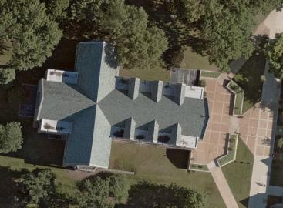
DTM Orthomosaic
Uses DTM for height + seamline mosaicking
Profile
View
Advantages
Simple processing based on DTM
Minimal loss of clarity
Disadvantages
Features not on terrain are offset
Horizontal layover (buildings, trees)
Some ground regions may be obscured
Visible breaks/blending may appear across seamlines
Artifacts on steep slopes / bridges
Ortho
Building Roof
Building Side

Slide 4
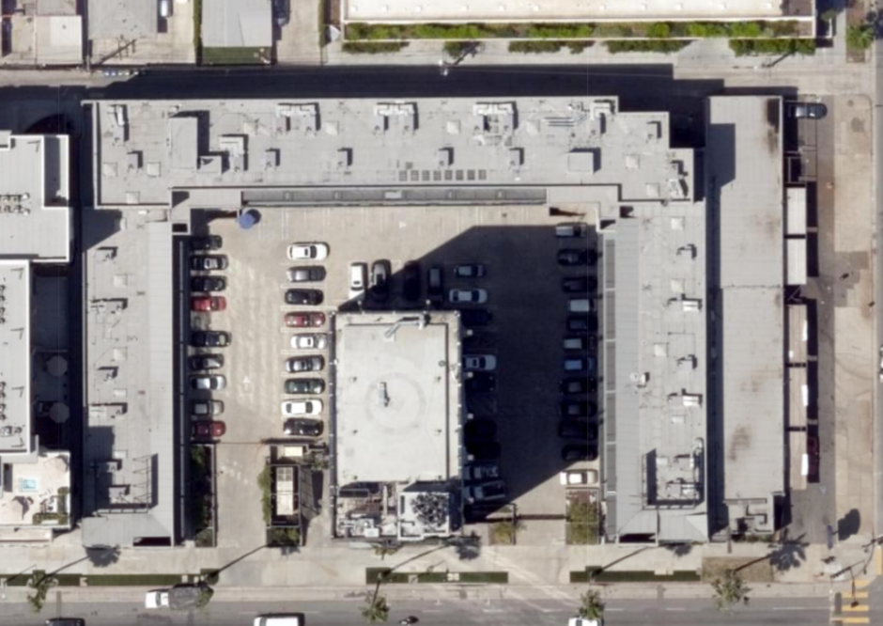
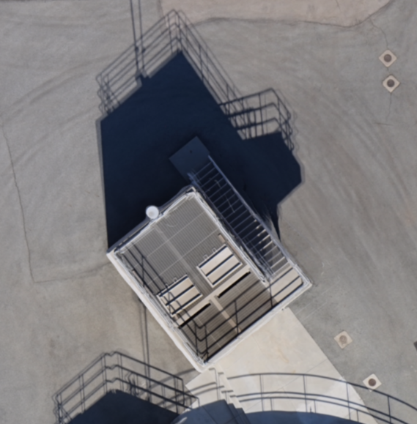
DSM | ‘True’ Orthomosaic
Uses DSM|Mesh for height + blend multiple images
Profile
View
Advantages
Top of building/objects in correct place
No horizontal layover
Good for general use
Disadvantages
Pixels near vertical edges sometimes blurred
Image clarity typically reduced on non modelled objects (eg poles, trees)
Duplicate features/shadows on moving objects
Creates issues for different analytics
Not see under overhangs of buildings
Ortho
Building Roof

Slide 5
Dynamic Orthomosaic
DTM based ortho, with dynamic view selection (closest to nadir)
Advantages
Seamlines minimized (mostly eliminated)
Horizontal layover used to advantage
Maximum visibility between buildings
“Top Up” orientation
Enable vertical mensuration
Image clarity:
Very good, minimal smearing
Maximized in image space view
No loss of image content
Fastest mode from capture to exploitation
Profile
View
Ortho 1
See East edge of building
Disadvantages
Digital only (not feasible in printed maps)
Features not on terrain are offset
Artifacts on steep slopes / bridges
Additional storage for all overlaps
Building Roof
Building Side
Ortho 2
See West edge of building

Slide 6
Image Space
Do not Orthorectify Image
Transform GIS features into image coordinate system
Profile
View
Advantages
Seamlines not required (single image view)
Natural view perspective aids image interpretation
Image clarity maximized – non-modified raw image
Vertical measurements via photogrammetric model
Image
View
Disadvantages
Not a mosaic – Limited view to single image
All vectors (3D) need to be transformed into image space
Building Roof
Building Side
Top Up View

Slide 7
Examples/Issue of a DSM/True orthomosaic vs Dynamic orthomosaic
And take height measurements
With dynamic orthomosaics user can control source image

Slide 8
Orthorectification workflows and products
Oriented
Drone
Aerial
Satellite
Oriented Imagery
Drone2Map
(Desktop)
Ortho Mapping
ArcGIS Pro | Ortho Maker
Desktop | Web App
Image Space
DSM Orthomosaic
3D Mesh
DTM & Dynamic Orthomosaic + Image Space
ArcGIS Online
ArcGIS Enterprise
Image Server
Desktop, Web, Mobile

