Slide 1
Camera Self-Calibration in UAV Photogrammetry: When is it Viable?
Prof. Clive Fraser
Dept. of Infrastructure Engineering University of Melbourne, Australia
ASPRS Annual Conference and International Lidar Mapping Forum, Denver, January 27-31, 2019

Slide 2
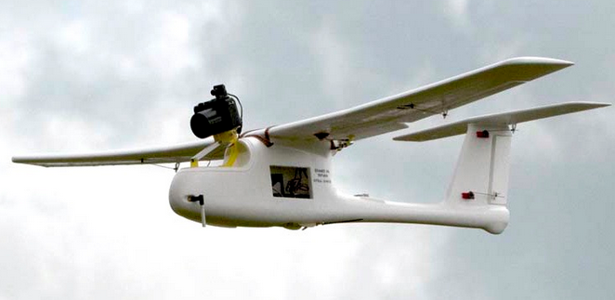
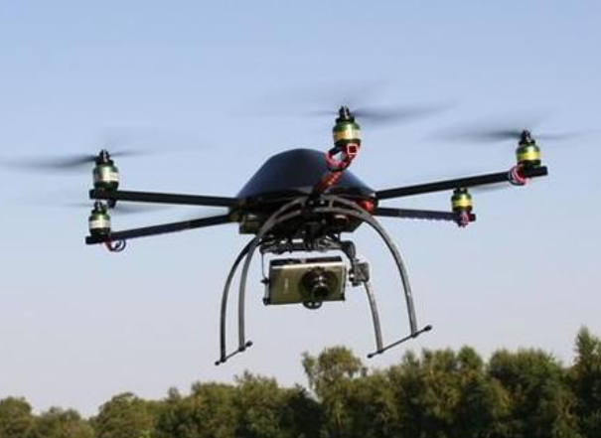
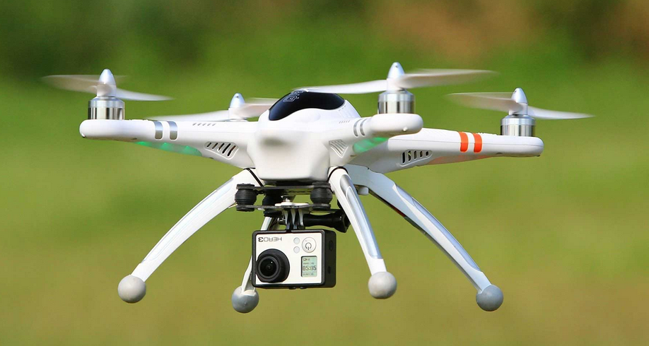
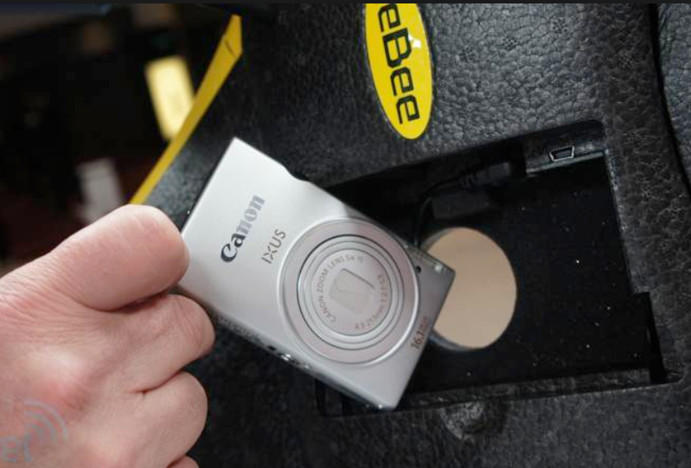
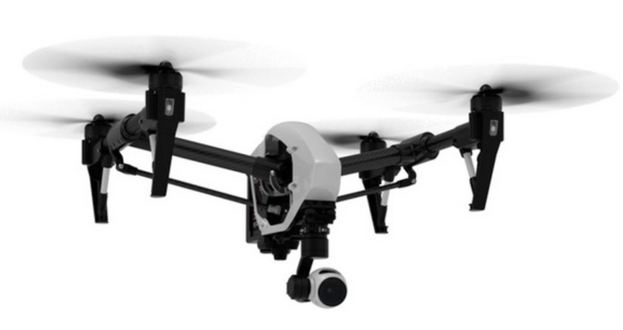
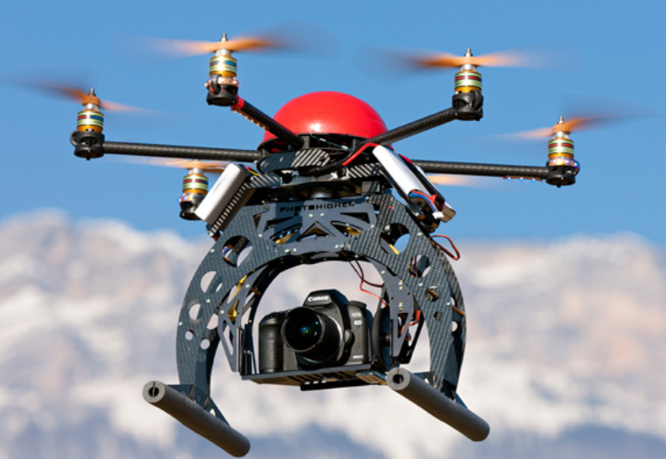
Cameras for Drones/UAS/UAVs
Vary from off-the-shelf point & shoot, to zoom compact, mirrorless, super-zoom, DSLRs and numerous specially designed cameras
Universal requirement for photogrammetric applications: cameras must be calibrated

Slide 3
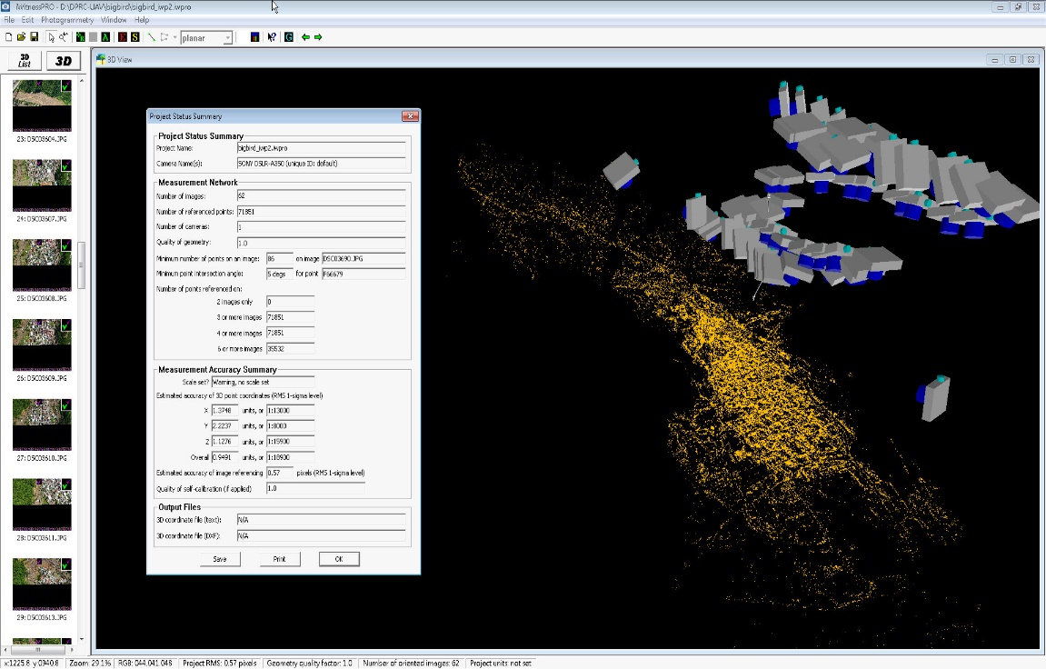
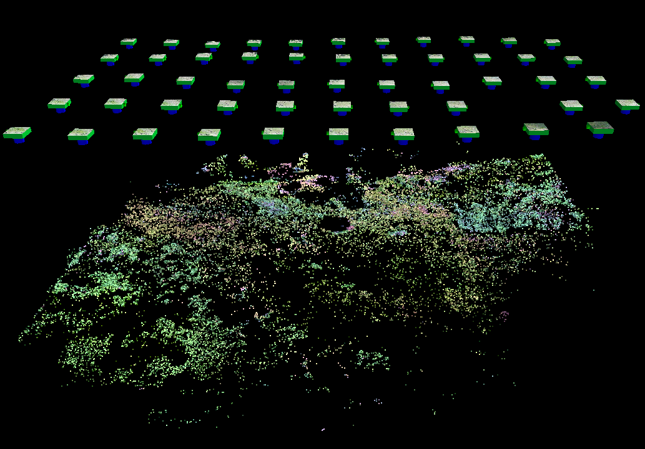
UAVs for Spatial Information Generation
Networks can be regular or irregular
Photogrammetric processing must accommodate every configuration

Slide 4
Sensor Calibration, Orientation & 3D Object reconstruction
Initial Network Relative Orientation
(A)
Manual to Semi-Automated Image Measurement
(B)
Automatic, using coded targets
(C)
Automatic with no targets (SfM approach)
Bundle adjustment (+self-calibration) for Refined Network Relative/Exterior Orientation
UAVs/Drones
Bundle Adjustment with Self-Calibration
Subsequent Determination of 3D Points (generally with final Bundle Adjustment)
(A)
Manual or semi-automated referencing or measurement of targetted or untargetted points
(B)
Automatic 3D coordinates for targetted points
(C)
Automatic generation of dense point cloud – no targets
(SfM or FBM approach)

Slide 5
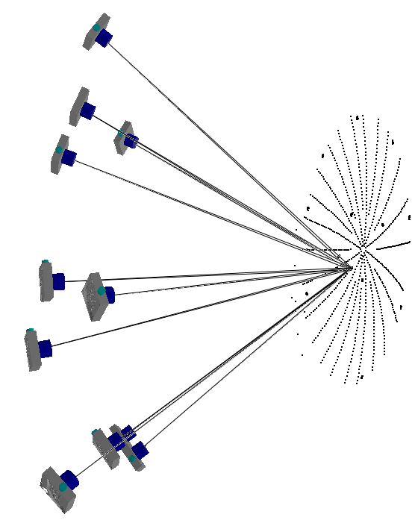
Network Geometry for Self-Calibration
Attributes of successful self-calibration networks, when there is no ground or camera station positional control:
Multi-image, convergent network
Orthogonal camera roll angles
Depth in the object space (not mandatory, but very desirable)
Highly redundant network (all pts >6 ray)
High image measurement accuracy (targets: σ_{xy} to 0.03 pixel for monochrome CCD & generally 0.1 pixel for colour; targetless: σ_{xy} to 0.3 pixel for FBM/SfM)
Plus
Unifocal lens (desirable), fixed focus
Stable interior orientation

Slide 6
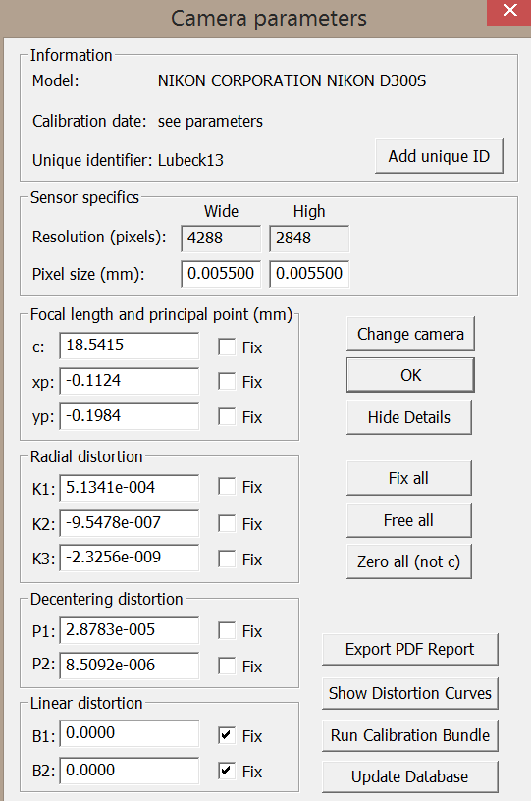
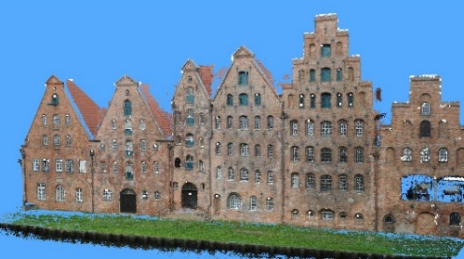
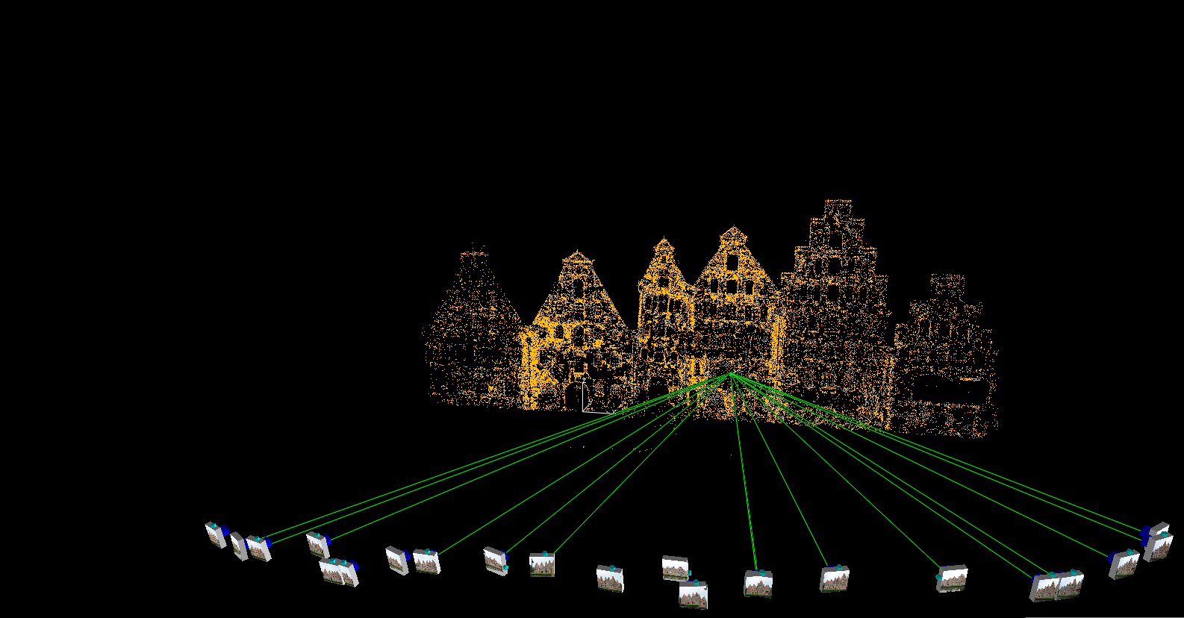
FBM/SfM-Based Orientation with Free-Network Self-Calibration
SfM-based approach affords massive redundancy to compensate for potential modest loss in geometric strength
Salzspeicher network: 23 images, 46,000 points, RMS v_{xy} = 0.25 pixel

Slide 7
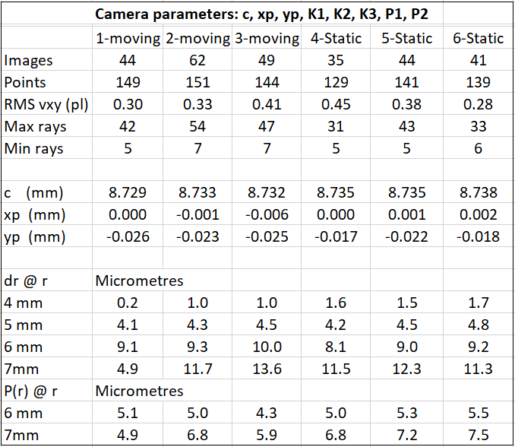
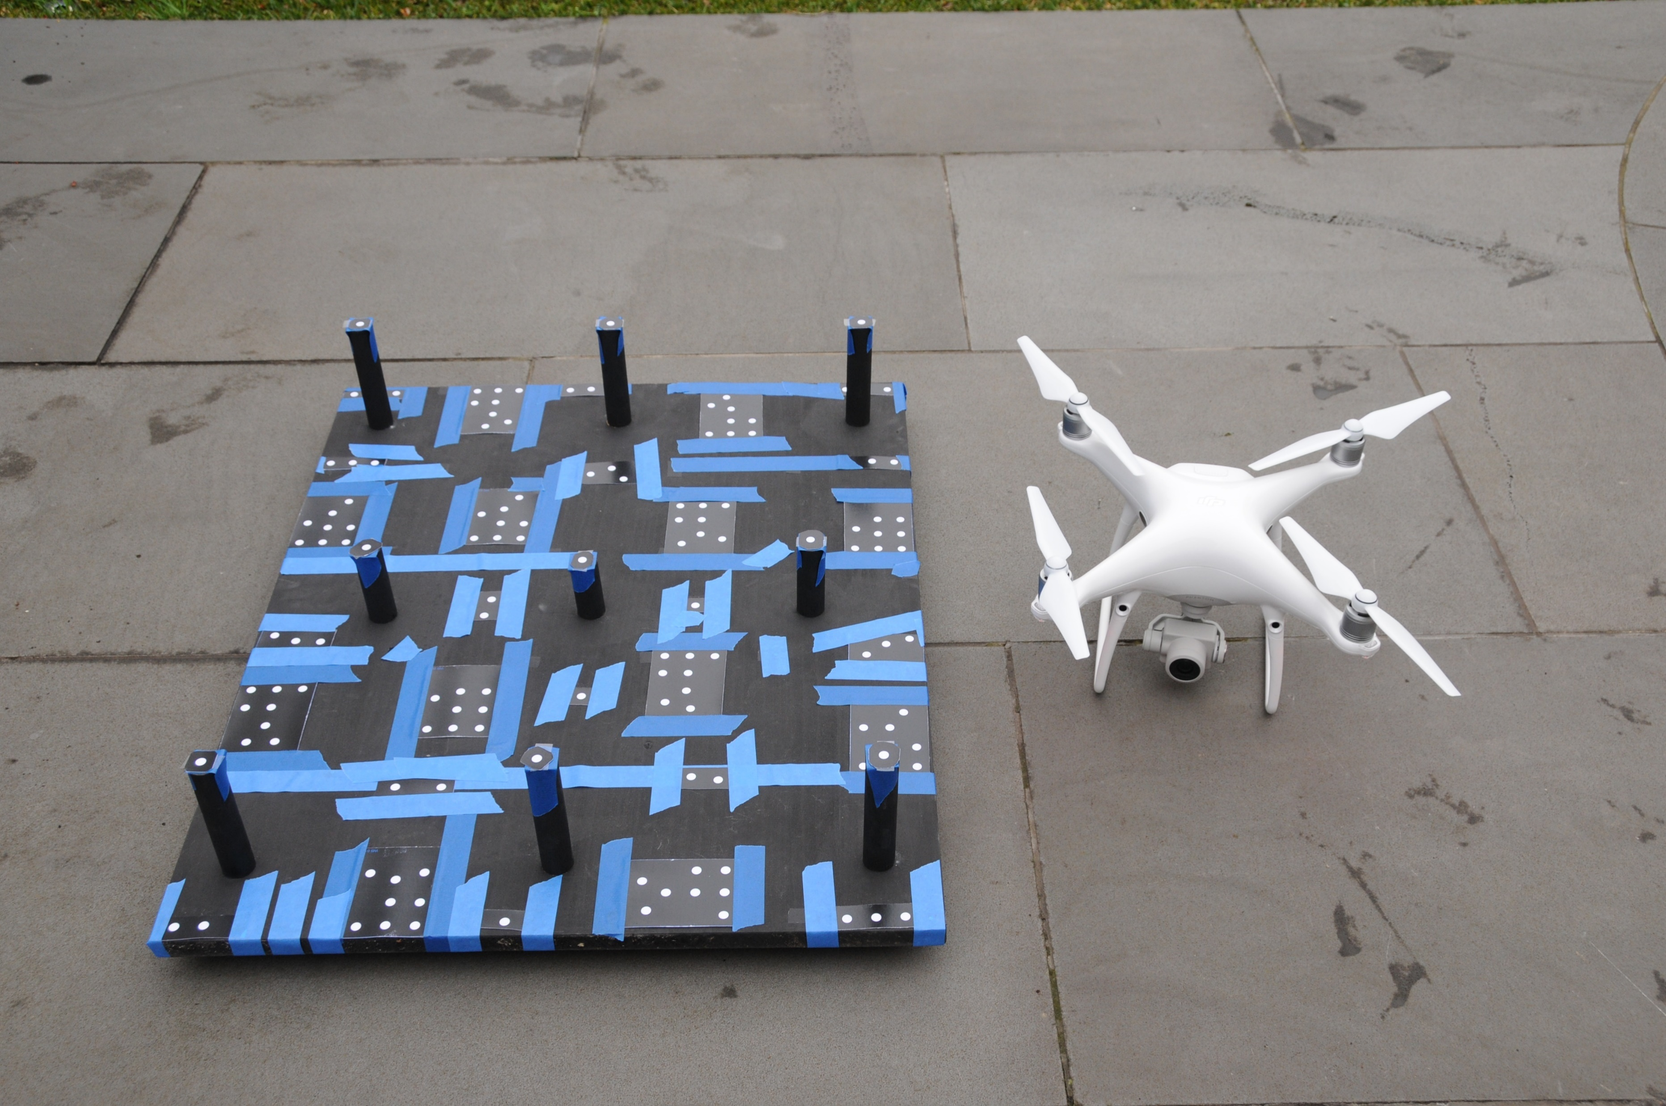
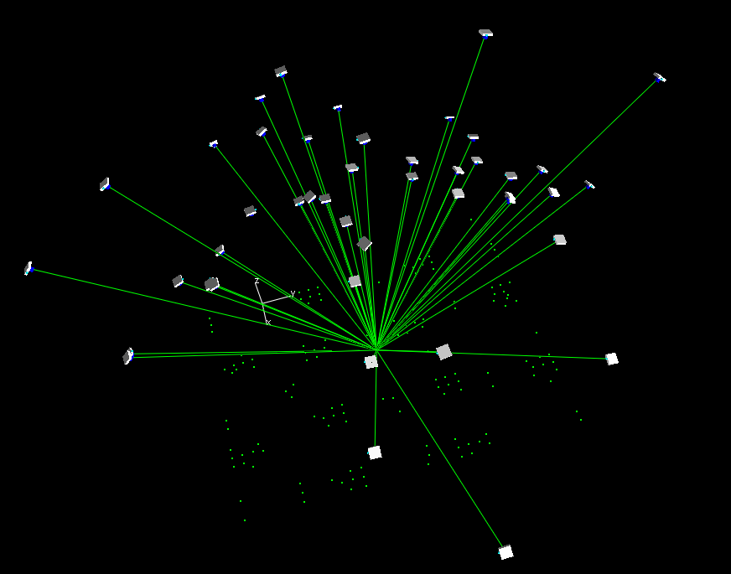
On-Ground Calibration via Free-Network Self-Calibration
A very feasible approach for short focal length UAS cameras
Results of 6 separate self-calibrations of a 20mpixel Phantom P4P camera
Note high level of calibration stability of the Phantom 4 PRO camera

Slide 8
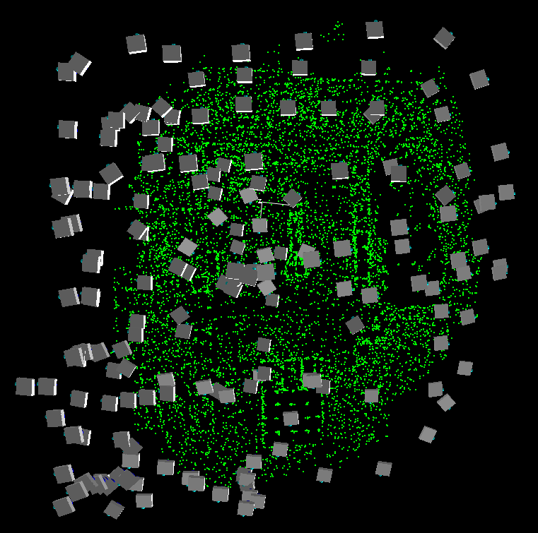
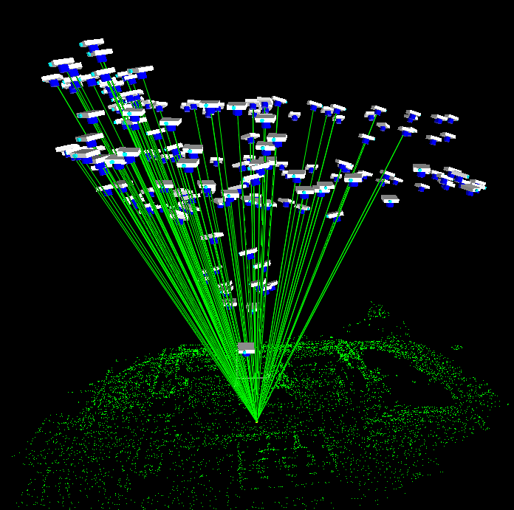
Unordered UAV Networks for Free-Network Self-Calibration
176-ray point
UAV image block, 344 images & 9700 points, all pts in >4 images; most in >20.
Limited convergence, limited depth in obj. space, RMS vxy=0.4pl
Strong self-calibration achieved

Slide 9
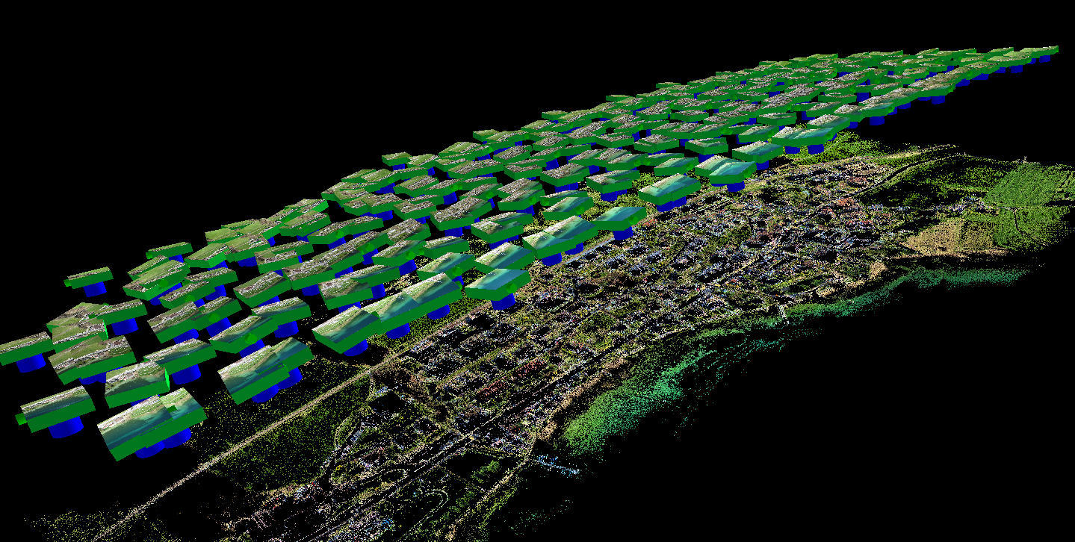
‘Standard’ UAV Network, OK for Free-Net Self-Calibration?
No!
Self-calibration of IO not feasible; lens distortion possibly OK, depending upon overlap
Essential Requirement :
Maximise Scale Variation both within & between Images
In order to
Minimize Projective Coupling between Calibration & Exterior Orientation Parameters:
‘Regular’ block of 297 images & 480,000 points, 68K pts in >6 images; many in >10.
No convergence, no orthogonal roll, limited depth in obj. space, RMS vxy=0.8pl

Slide 10
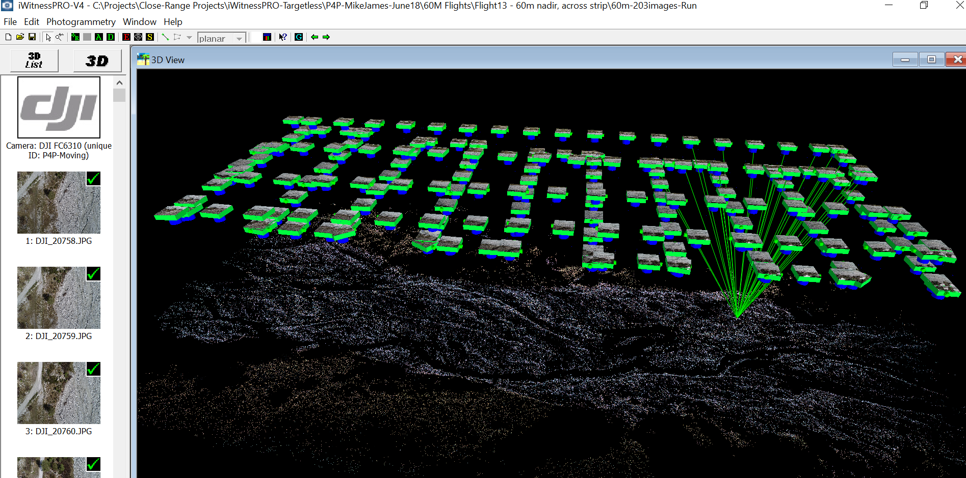
Self-Calibration very Problematic in a ‘Standard’ UAV Network Requires both GCPs & Camera Stn Positional Constraints
Regular block of 203 images & 183,000 points, 95K pts in >6 images; 3K in >20.
No convergence, no orthogonal roll, limited depth in obj. space, RMS vxy=0.36pl
Control to support camera self-calibration comprised both GCPs & Camera Stn GPS posn’s
Note: usually one of two aims being pursued through self-calibration:
i) provide systematic error compensation, not necessarily camera calibration per se
ii) to provide a scene-independent calibration of the camera(s)

Slide 11
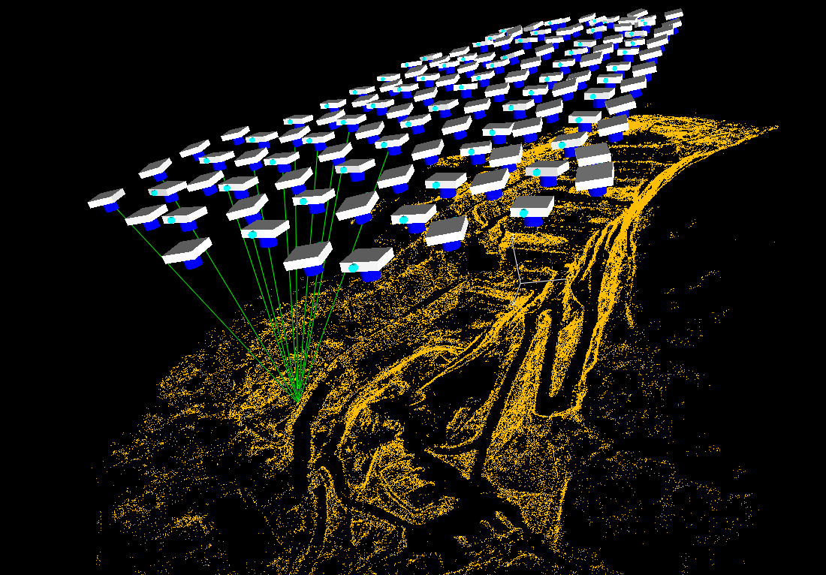
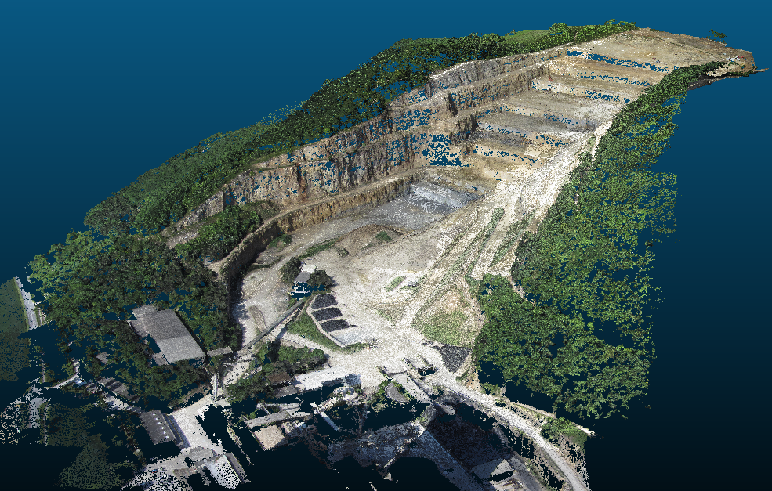
Geometric Attributes of UAV Networks for Self-Calibration
Case 1: ‘Standard’ aerial block with large depth variation in object space
18 million points in cloud
Oriented UAV image block of 127 images & 180,000 points, 31K pts in >6 images; many in >10.
No convergence, no orthogonal roll, but very significant depth in obj. space (H-h varies from 130m to 290m, so scale varies within some images by 50% from the mean), RMS vxy=0.45pl
Full self-calibration of IO & lens distortion feasible, good precision & low projective couplings
(no need for object space control)

Slide 12
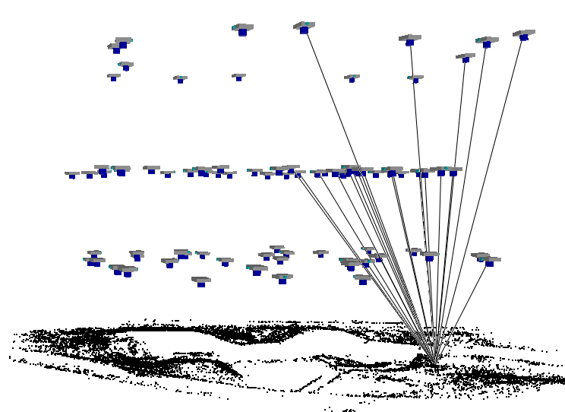
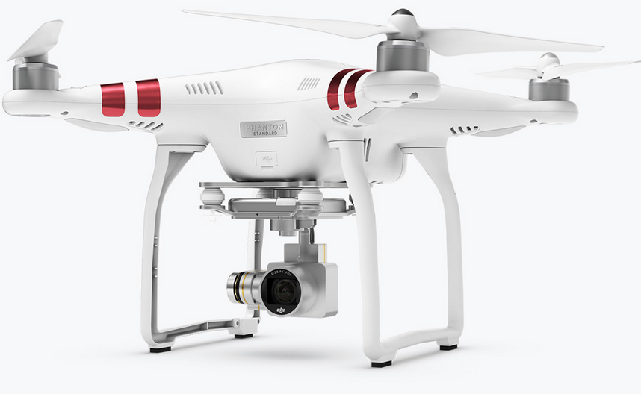
Geometric Attributes of UAV Networks for Self-Calibration
Case 2: Mixed range network (scale variation between images, not within)
H = 30m
H = 20m
H = 10m
UAV image block of 84 images & 30,000 pts in >6 images; many in >10.
No convergence, no roll, but significant scale diff. between 3 flying heights, RMS vxy=0.8pl
Full self-calibration of IO & lens distortion feasible, but strong projective coupling between principal distance & camera stn Z coord. (ideal example of where in-air & on-ground GPS constraints should apply)

Slide 13
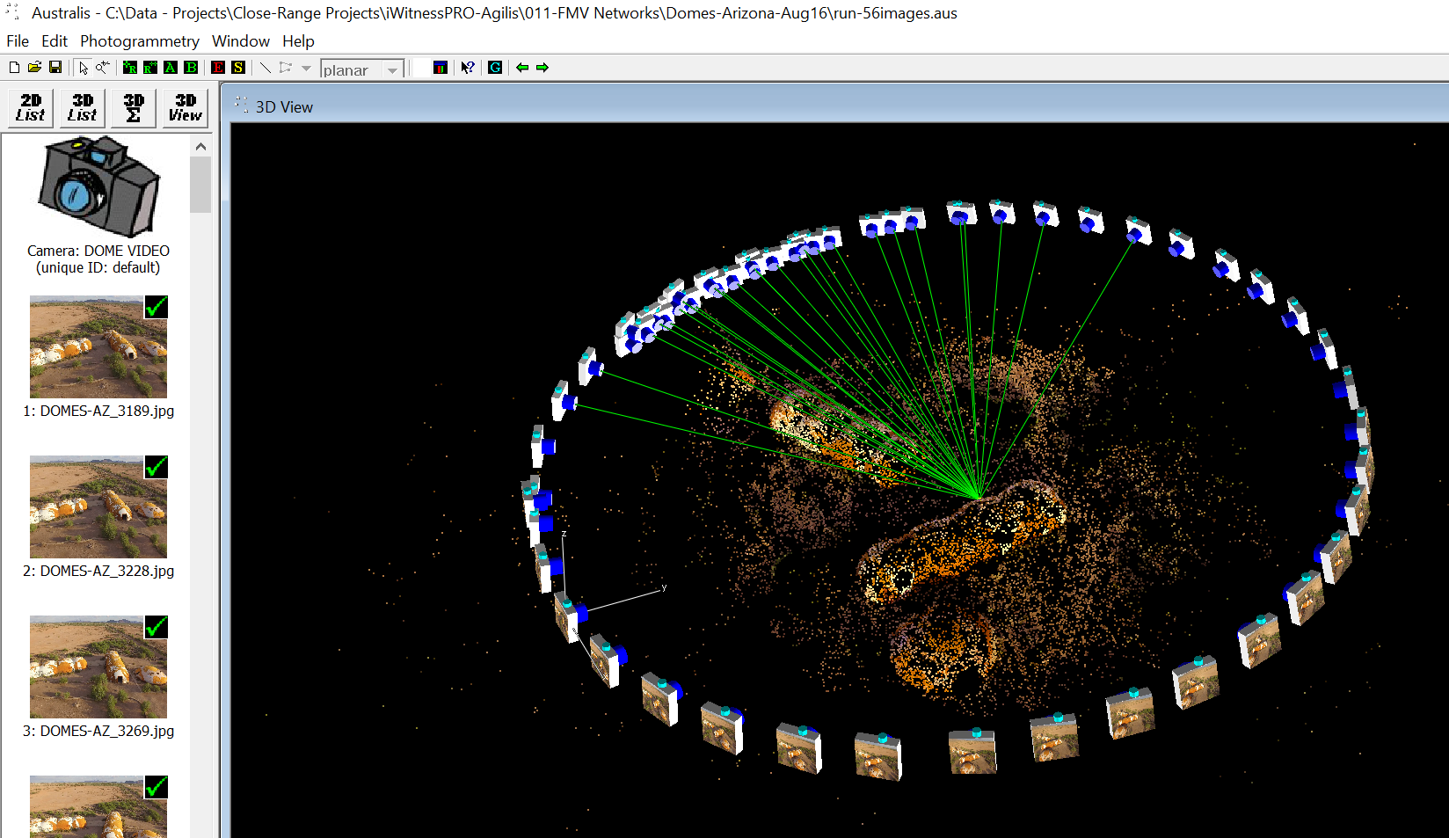
Geometric Attributes of UAV Networks for Self-Calibration
Case 3: Highly overlapping oblique imagery of a 3D object scene (images from FMV)
UAV image block of 56 images & 28K points, 200 with >6 rays, RMS vxy=0.44pl
No convergence, no roll, but significant scale diff. within each image, and 3D
Full self-calibration of IO & lens distortion feasible, moderate precision with moderate projective couplings (espec. related to IO/EO and decentring distortion)
(no requirement for object space control)

Slide 14
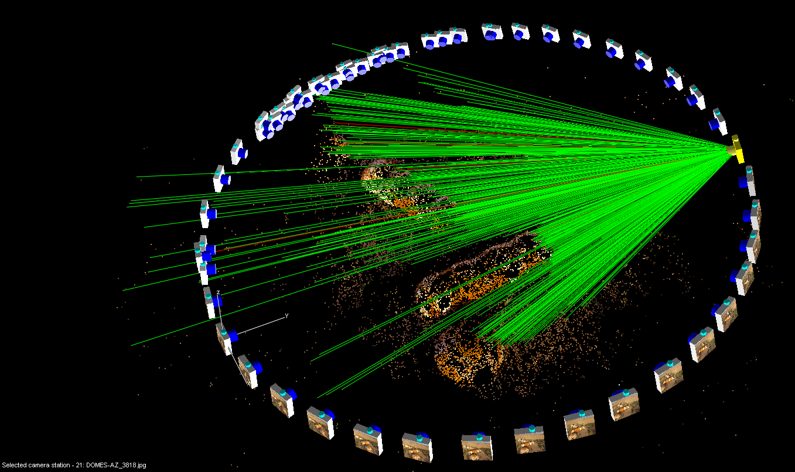
Geometric Attributes of UAV Networks for Self-Calibration
Case 3: Highly overlapping oblique imagery of a 3D object scene (images from FMV)
UAV image block of 56 images & 28K points, 200 with >6 rays, RMS vxy=0.44pl
No convergence, no roll, but significant scale diff. within each image, and 3D
Full self-calibration of IO & lens distortion feasible, moderate precision with moderate projective couplings (espec. related to IO/EO and decentring distortion)
(no requirement for object space control)

Slide 15
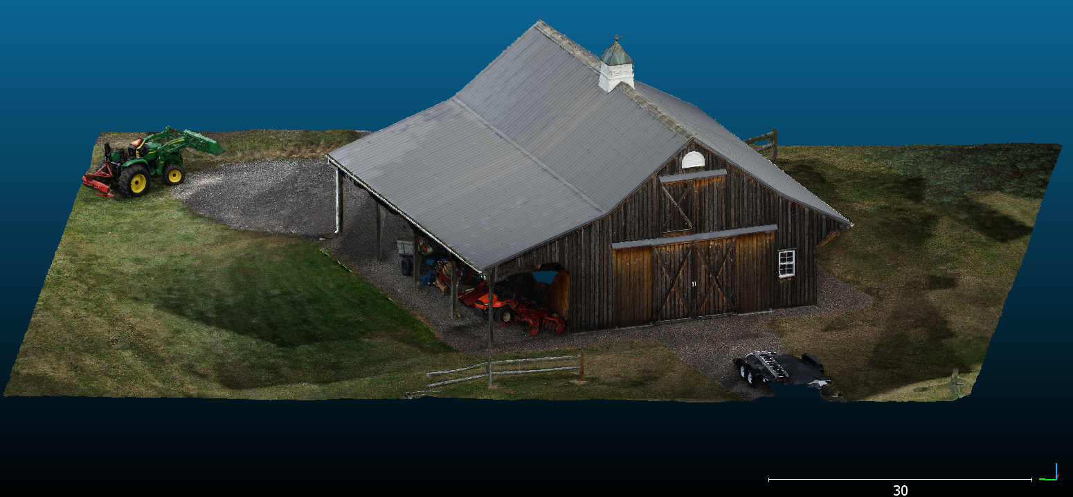
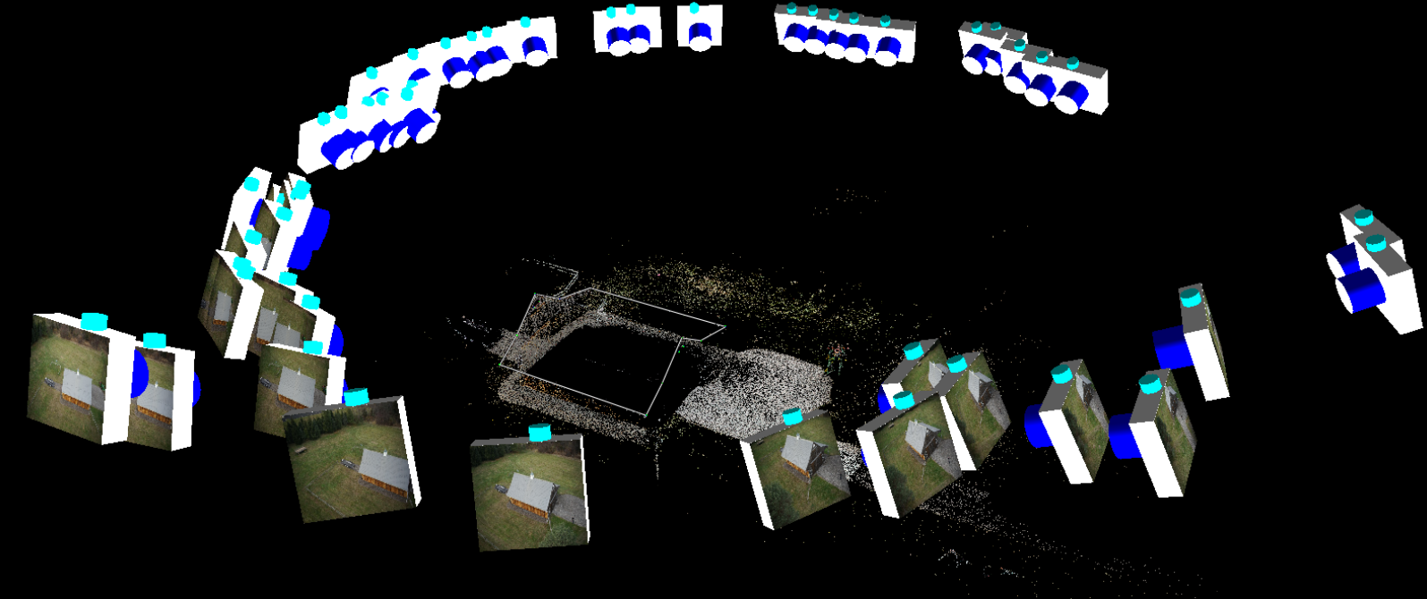
Geometric Attributes of UAV Networks for Self-Calibration
Case 4: Network for 3D reconstruction of a historic barn
UAV image network of 49 images & 50K points, 6000 with >6 rays, RMS vxy=0.3pl
No convergence, no roll, but significant scale diff. within each image
Full self-calibration of IO & lens distortion feasible, moderate precision with moderate projective couplings (no necessity for object space control)

Slide 16
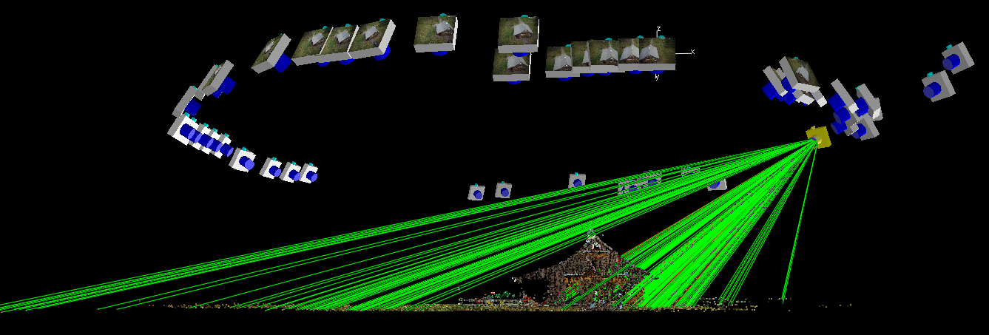
Geometric Attributes of UAV Networks for Self-Calibration
Case 4: Network for 3D reconstruction of a historic barn
Self-calibration OK due to substantial variation in image scale within each image, but note projective linkage between principal point & elevation angle/Z
Recovery of IO is moderately strong (sigmas of a few micrometers)

Slide 17
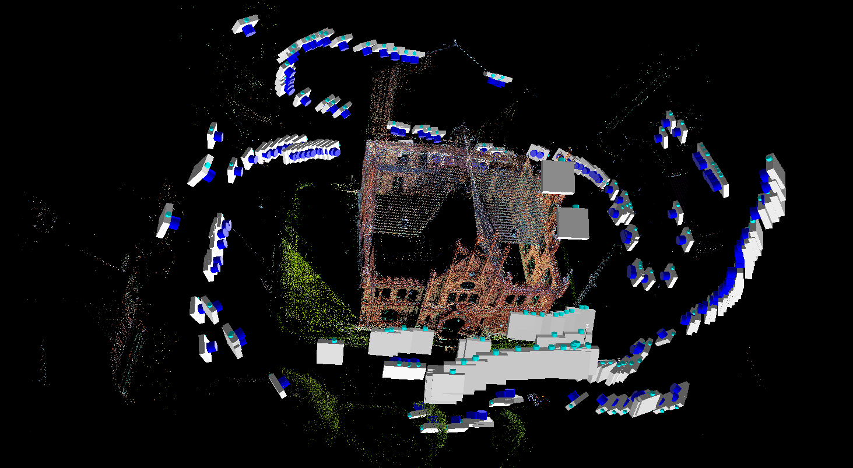
Geometric Attributes of UAV Networks for Self-Calibration
Case 5: 2-camera ISPRS benchmark network
UAV image block of 224 images & >150K points, RMS vxy=0.4pl
‘Accidental’ convergence, no roll & limited scale variation within the images
Full self-calibration feasible but not strong, high projective coupling espec. between IO & EO
(Camera roll would dramatically improve accurate IO recovery)

Slide 18
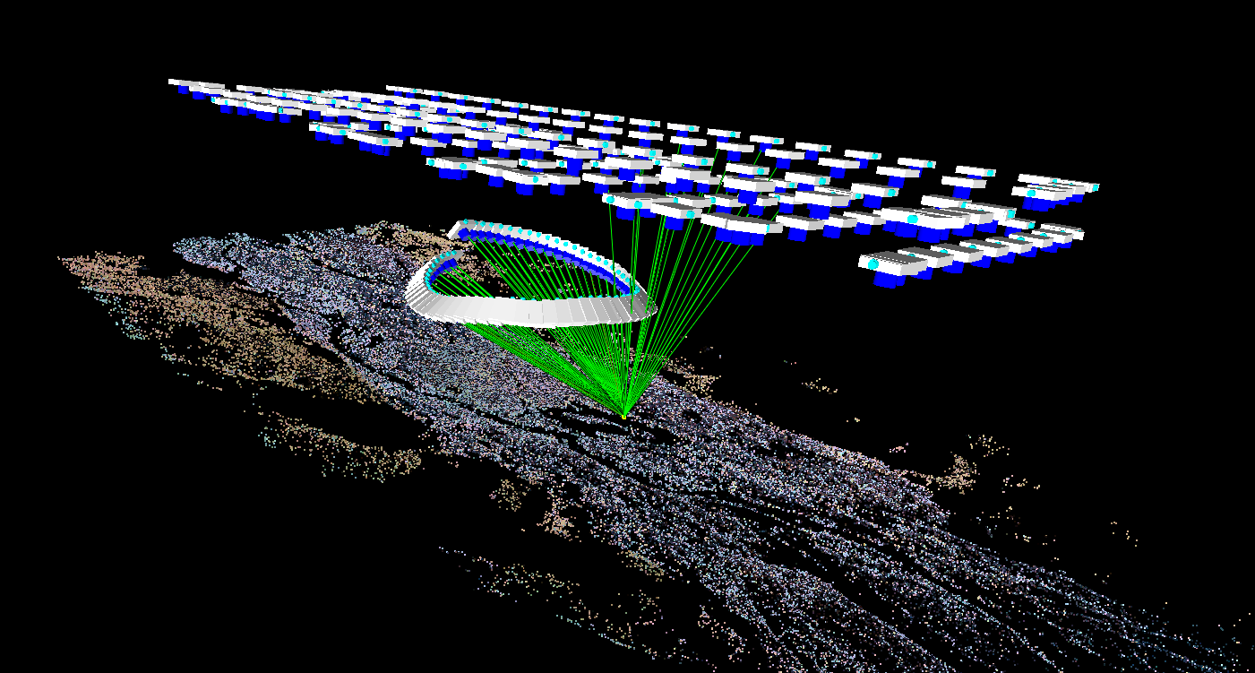
Geometric Attributes of UAV Networks for Self-Calibration
Case 6: P4P Block with additional convergent images
UAV image block of 266 images (203 nadir & 66 convergent) & 270K points, RMS v_{xy}=0.39pl
Many points meas. in >50 images)
Supports strong self-calibration

Slide 19
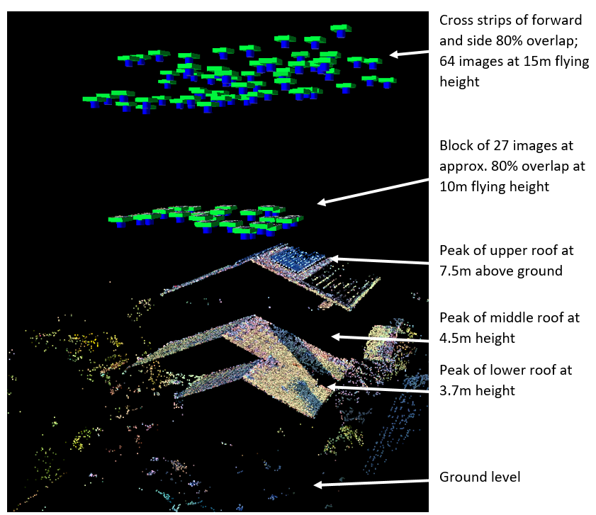
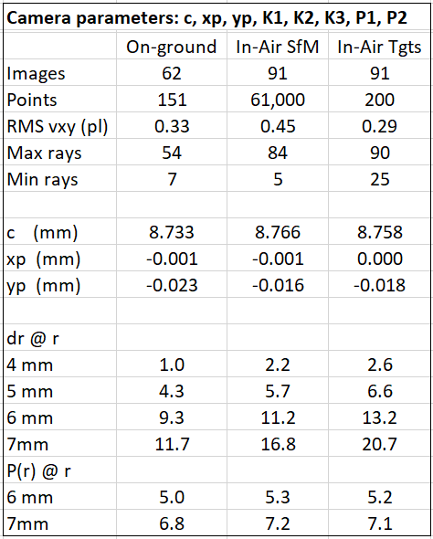
In-air versus on-ground calibration via self-calibration of P4P
Recall importance of image scale variation
Obj XYZ discrepancies: <1mm in XY, 3mm in Z for tgts, 5mm for SfM

Slide 20
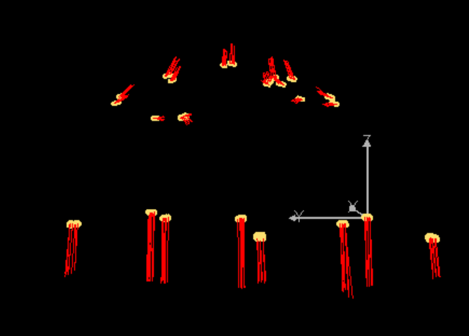
Affine distortion in object space – a problem?
Differential scale difference between XY and Z
length of vectors at ground level is 6 – 9mm

Slide 21
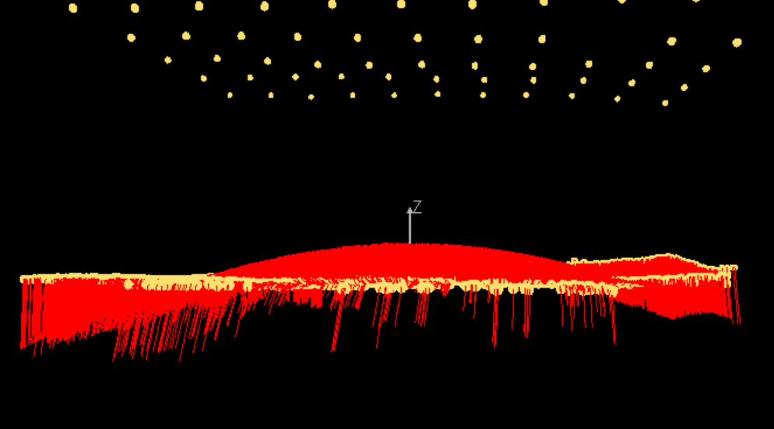
Not just an IO issue! Self-calibration of radial distortion only is also not recommended in blocks of imagery with moderate overlap!
Flying Ht= 35m
53 images
32,000 pts
RMSvxy = 0.51 pl
σXY= 4mm
σZ= 10mm
1m
Should not constrain GPS cam. stn coords since accuracy too low (0.5m RMS)
Result: classical doming of terrain, Z-discrepancy range of -0.9m to +0.51m

Slide 22
Constraints in Bundle Adjustment of UAV Image Blocks
PURPOSE: To remove both datum & configuration defects
Precision → Weights
Image coord. obs. σ_{xy} → P
GCPs σ_{XYZ} → P2
GPS camera stns. σ_{X}^{c}_{Y}^{c}_{Z}^{c} → P1
Bundle Adjustment Normal Equations

Slide 23
Relative Magnitude of Constraints
Image coord. obs. σ_{xy} → P
GCPs σ_{XYZ} → P2
GPS camera stns. σ_{X}^{c}_{Y}^{c}_{Z}^{c} → P1
Consider the case: σ_{xy}* ≈ σ_{XYZ} ≈ σ_{X}^{c}_{Y}^{c}_{Z}^{c}
Where: σ_{xy}* = Scale No. * σ_{xy}
Example: If H=60m, f = 8.8mm, pixel size = 2.4 μm & σ_{xy} = 0.4 pixel,
then σ_{xy}* = (60m/8.8mm) * (0.4*2.4μm) ≈ 7mm
Consider the number of constraints in FBM/SfM Bundle Adjustment
σ_{xy}* σ_{XYZ} σ_{X}^{c}_{Y}^{c}_{Z}^{c}
10,000s - 100,000s 10s 100s -1000s
The relative magnitudes of σ_{XYZ} & σ_{X}^{c}_{Y}^{c}_{Z}^{c} against σ_{xy}* are critically important in self-calibration within UAV image networks

Slide 24
GCP & Cam. Stn. Constraints in UAV Image Blocks
Two options for removal of the configuration defect to support self-calibration:
Utilise a network geometry that supports constraint-free self-calibration (especially of c, x_{p}, y_{p})
And/or
Impose object-space constraints σ_{XYZ} & σ_{X}^{c}_{Y}^{c}_{Z}^{c} << σ_{xy}* such that projective coupling of IO & EO parameters is sufficiently suppressed, and imposed ‘control’ leads to a BA normal equation matrix of full rank
The a priori weighting (ie standard errors) assigned to GCPs and Camera Station GPS observations is very important for camera self-calibration

Slide 25
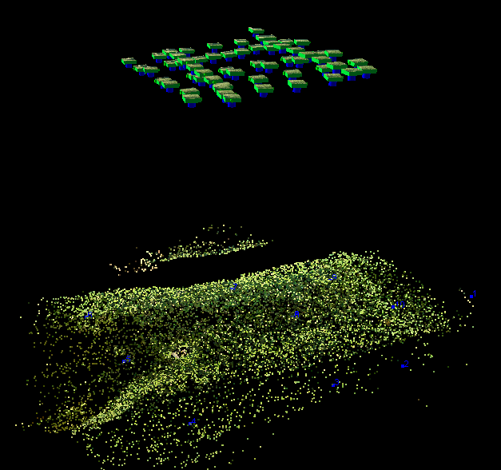
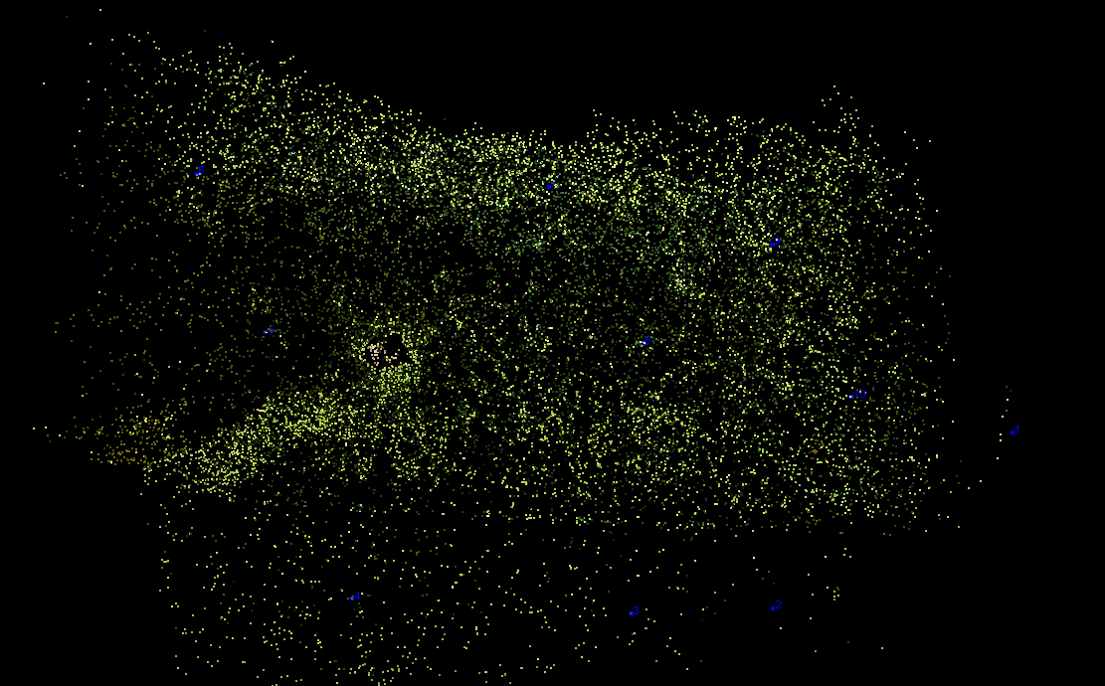
Example of Impact of Weighting on Perturbed GCPs
ΔZ errors resulting from BA with different assigned weights
UAV Network has 59 images & 21,000 object points, GSD = 0.016m
Sigmas of Camera Station GPS data set at 0.02m (residuals at 0.05 - 0.1m level)
Mean std error from Free-Network BA: σ_{XY} = 0.006m, σ_{Z} = 0.022m
Total of 10 GCPs/checkpoints (shown; 3 featured in following table)
Took ‘near perfect’ solution & perturbed the Z-coordinate of each GCP from 5 to 10 times σ_{Z} , ie from 0.10m to 0.20m
Wanted to assess impact of GCP weights on the recovery of Z perturbations

Slide 26
Example of Impact of Weighting on Perturbed GCPs
ΔZ errors resulting from BA with diff. weights
GCP Std. Errors (σ_{GCP}) (m) | RMS v_{xy} (pixel) | ΔZ GCP 1 Intro. Error DZ=-0.15 | ΔZ GCP 2 Intro. Error DZ=+0.20 | ΔZ GCP 3 Intro. Error DZ=-0.20 | All points RMSE XY | All points RMSE Z
0.01 | 0.33 | -0.02 | 0.01 | -0.01 | 0.001 | 0.003
0.005 | 0.33 | -0.02 | 0.01 | -0.01 | 0.001 | 0.003
0.001 | 0.33 | -0.12 | 0.12 | -0.16 | 0.002 | 0.004
0.0001 | 0.33 | -0.15 | 0.18 | -0.22 | 0.002 | 0.006
GCPs have no practical impact upon BA until assigned σ_{GCPs} << σ_{xy}*
(ie weighted constraints must be very tight to enforce fit to control!)
Especially important consideration if self-calibration is to be applied

Slide 27
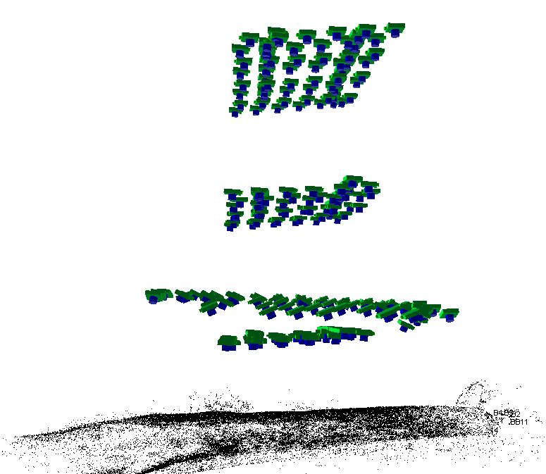
Example Multi-level UAV Network Geometry suited to Self-Calibration in the Absence of GCPs
H-h = 105m
66 nadir images
UAV camera: Sony A6000
H-h = 68m (GSD = 16mm)
59 nadir images
H-h = 40m
68 convergent images
H-h = 30m
52 nadir images
20,000 – 80,000 FBM points
10 GCPs to ‘few cm’ accuracy

Slide 28
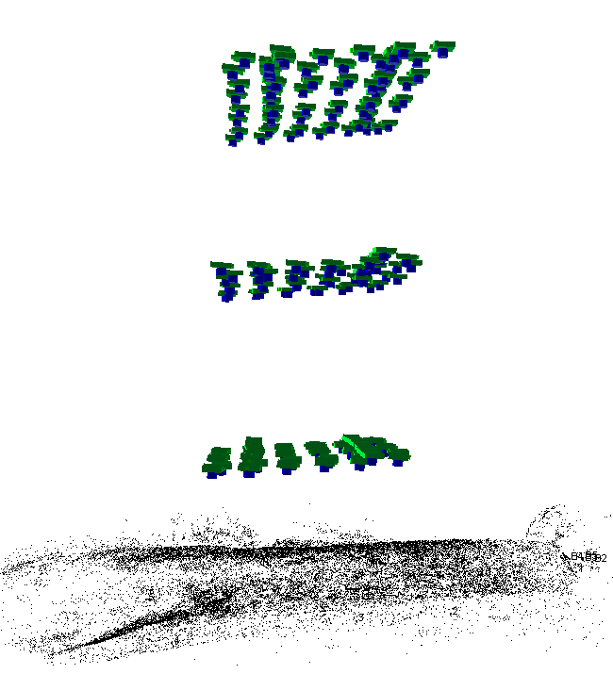
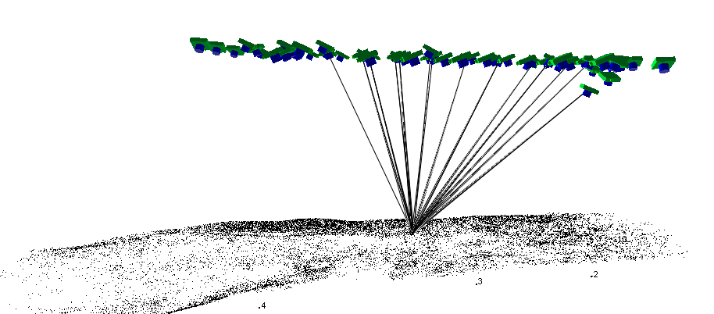
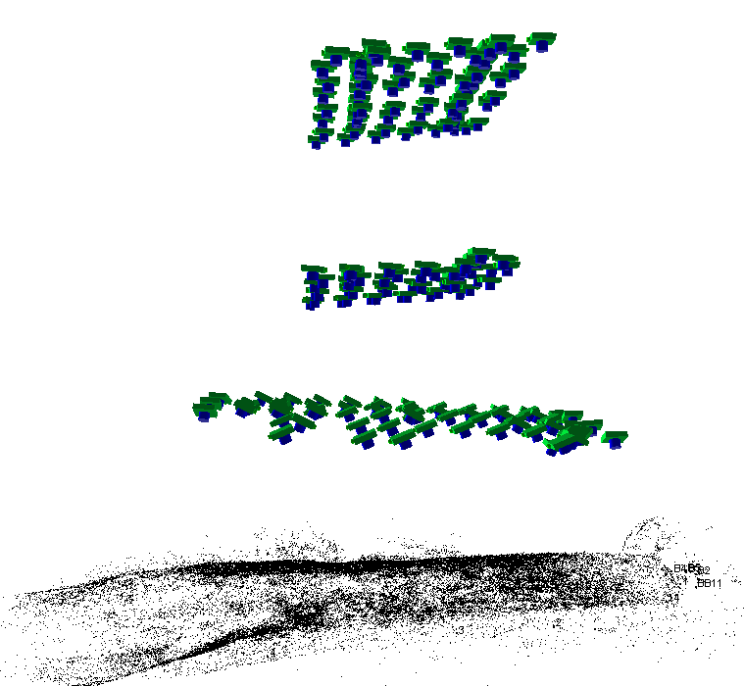
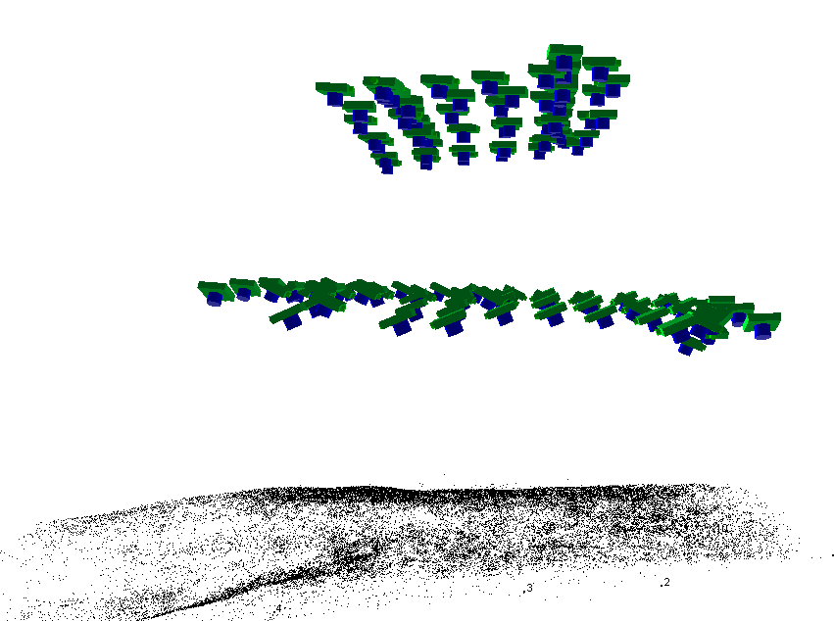
Number of Viable Self-Calibration Configurations
3-level nadir
H-h = 105m
Convergent imaging
Nadir + convergent

Slide 29
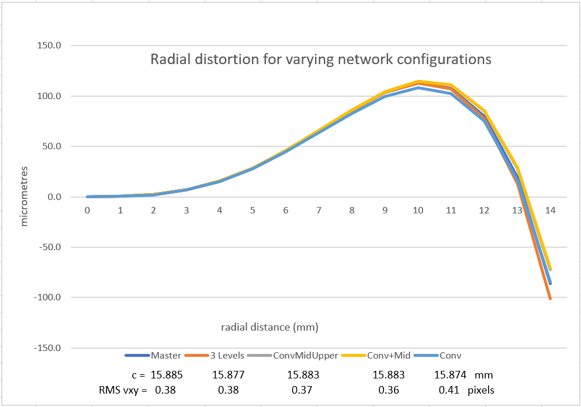
Self-Calibration Results for A600 from 5 Networks

Slide 30
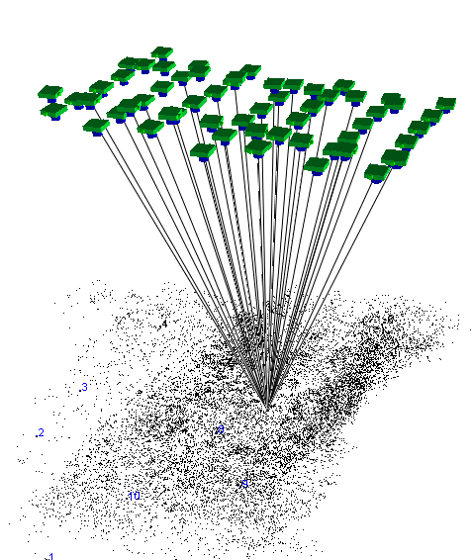
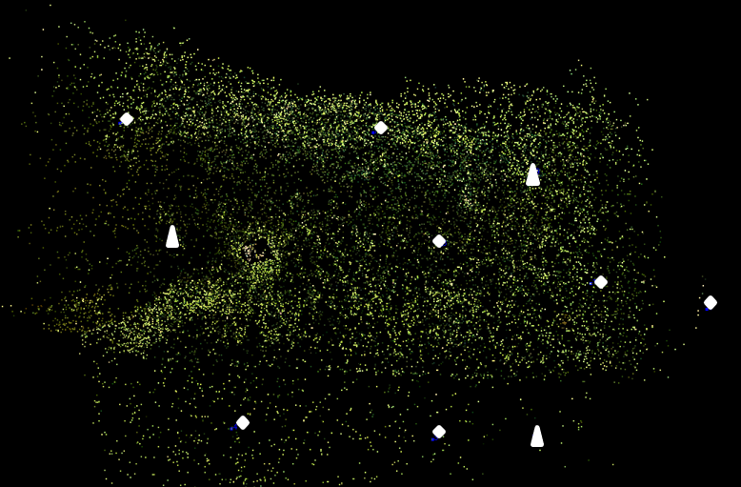
Consider Self-Calibration from Single Ht Mission via CONTROL
59 images, 21,000 points,
GSD = 0.016m, σ_{xy}* = 0.006m
Camera Station GPS (σ_{X}^{c}_{Y}^{c}_{Z}^{c} = 0.02m)
10 GCPs
Many pts in >30 images
GCPs

Slide 31
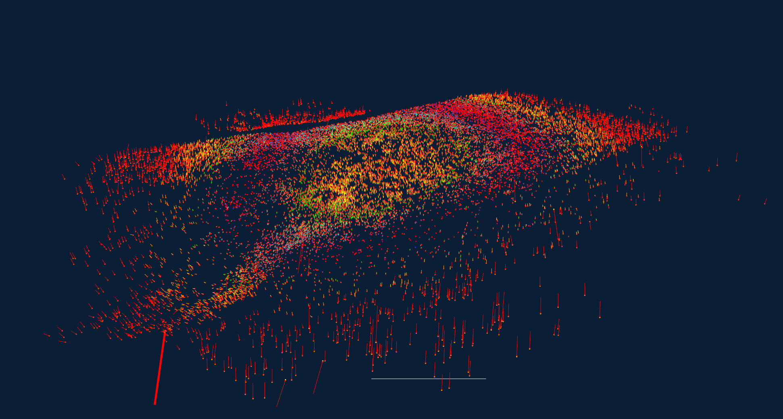
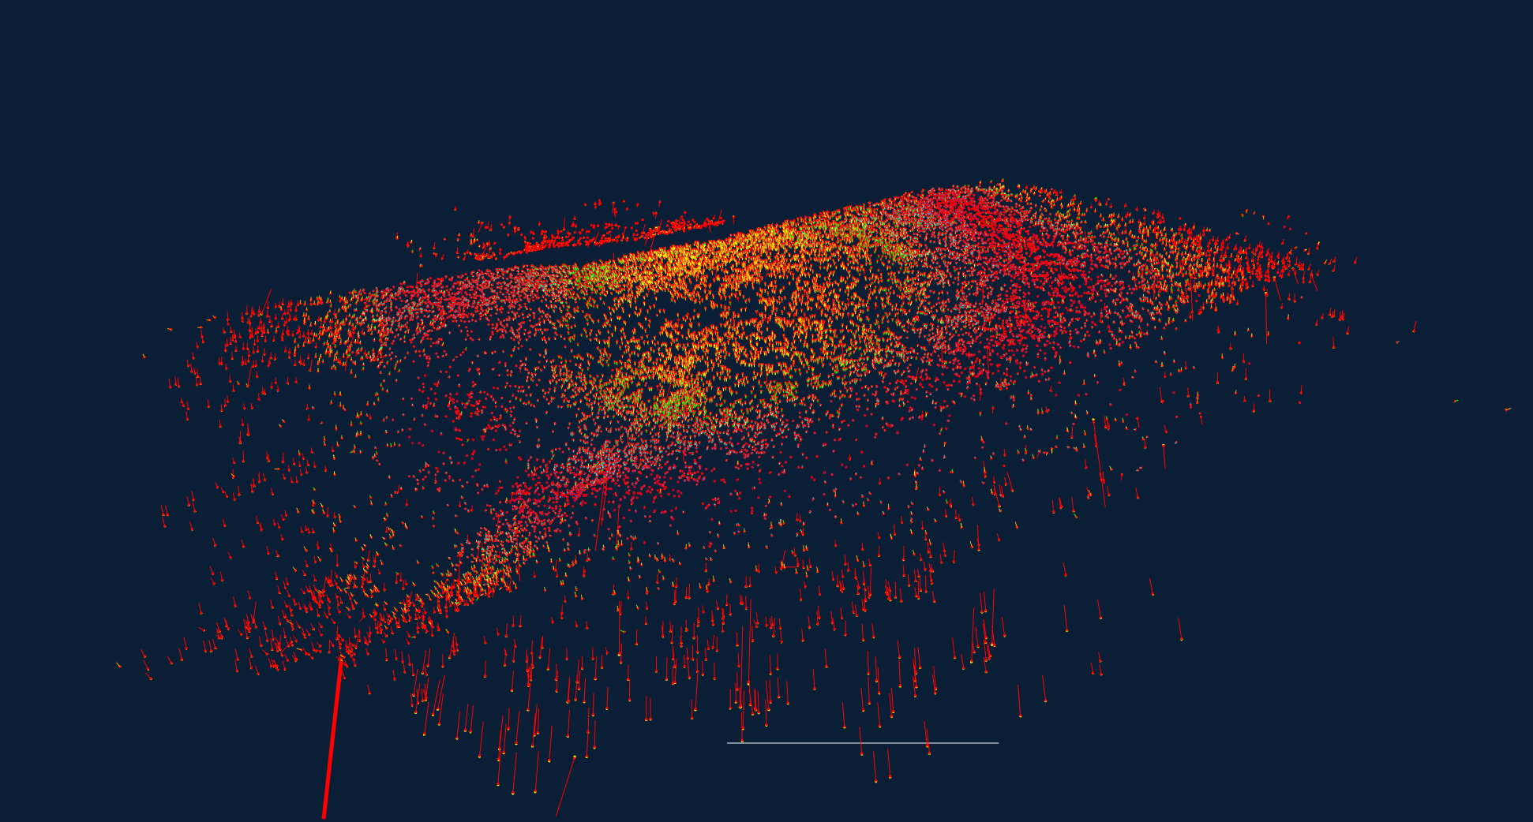
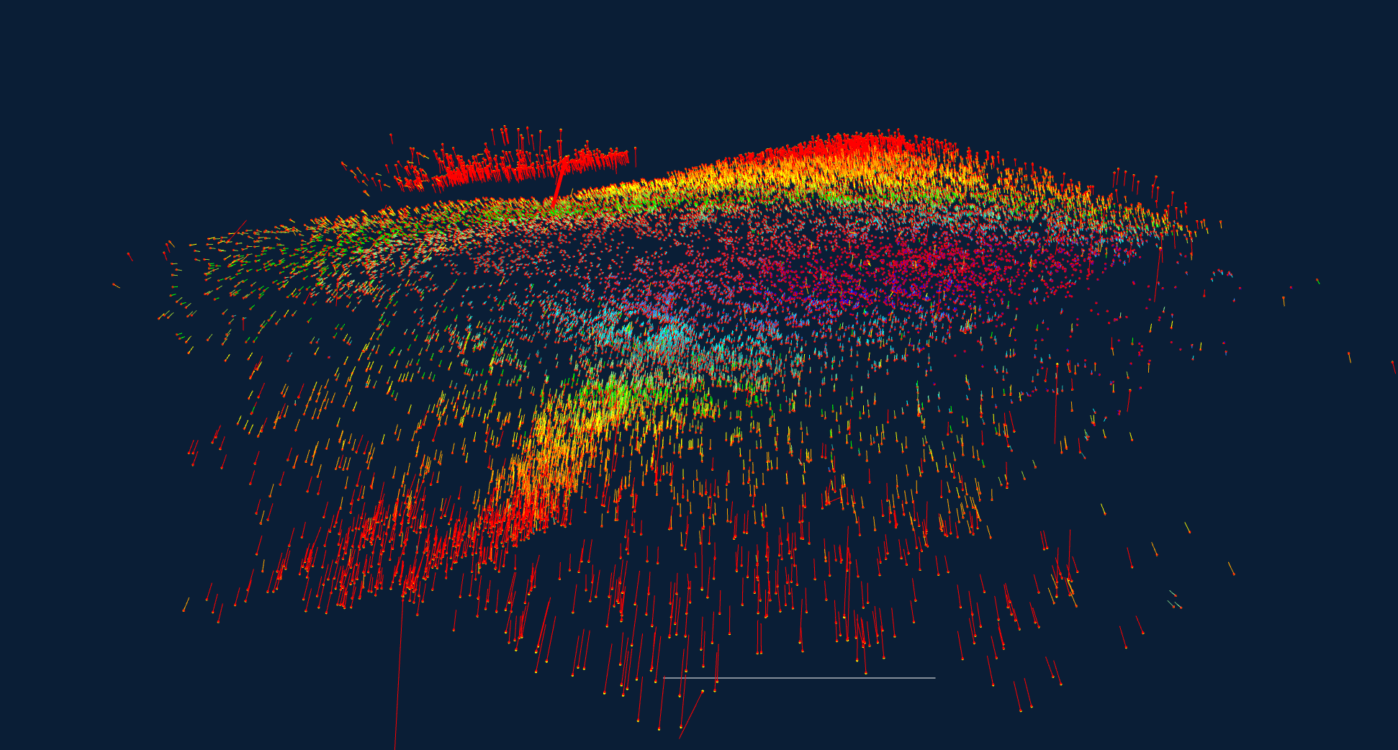
Network bias & shape distortion with varying σ_{GCP} values (1)
Design Accuracy: σ_{XY} = 0.006, σ_{Z} =0.023
σ_{GCP} =0.0001 | X (m) | Y (m) | Z (m)
Posn. Bias | 0 | 0 | 0
RMS Posn. Discrepancy | 0.003 | 0.003 | 0.013
σ_{GCP} = 0.001 | X (m) | Y (m) | Z (m)
Posn. Bias | 0 | -0.001 | -0.002
RMS Posn. Discrepancy | 0.003 | 0.003 | 0.010
σ_{GCP} = 0.005 | X (m) | Y (m) | Z (m)
Posn. Bias | 0.002 | -0.008 | -0.003
RMS Posn. Discrepancy | 0.004 | 0.009 | 0.016
GCPs

Slide 32
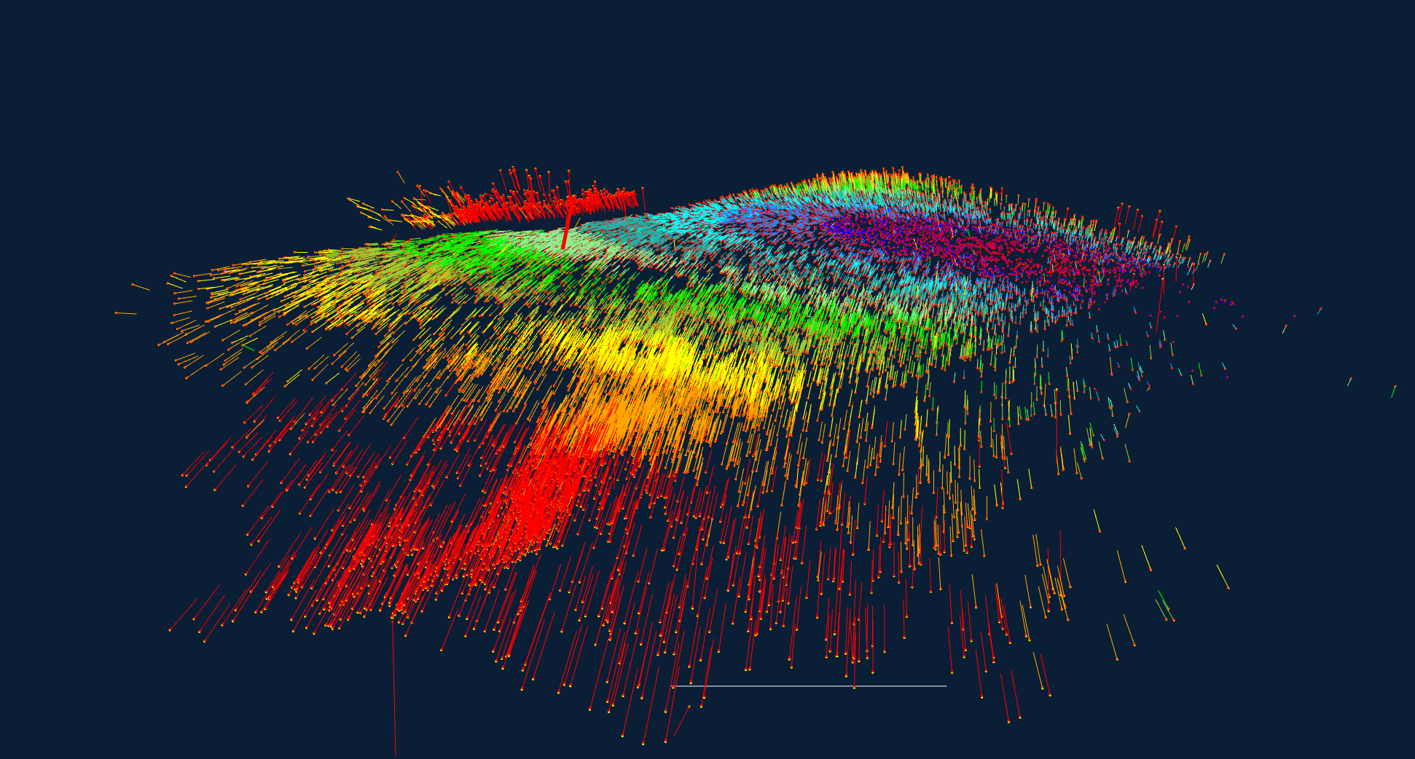
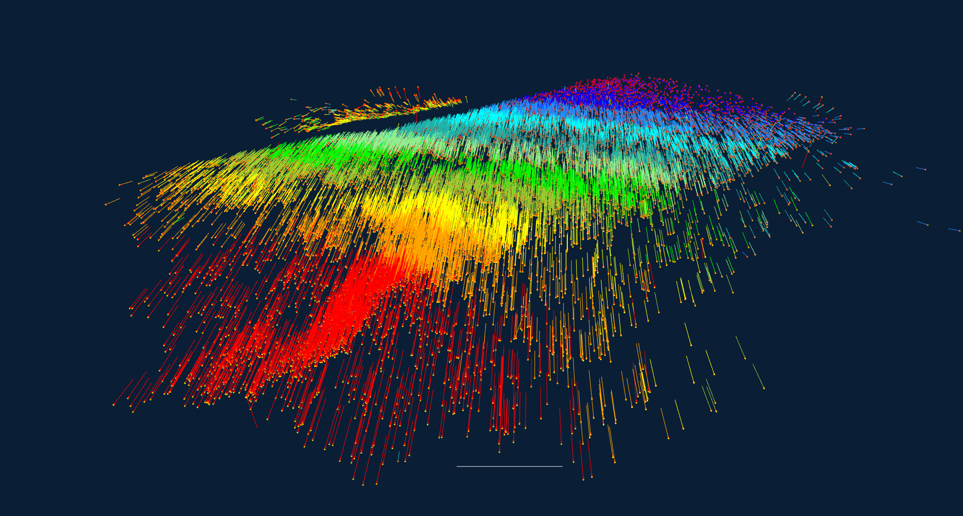
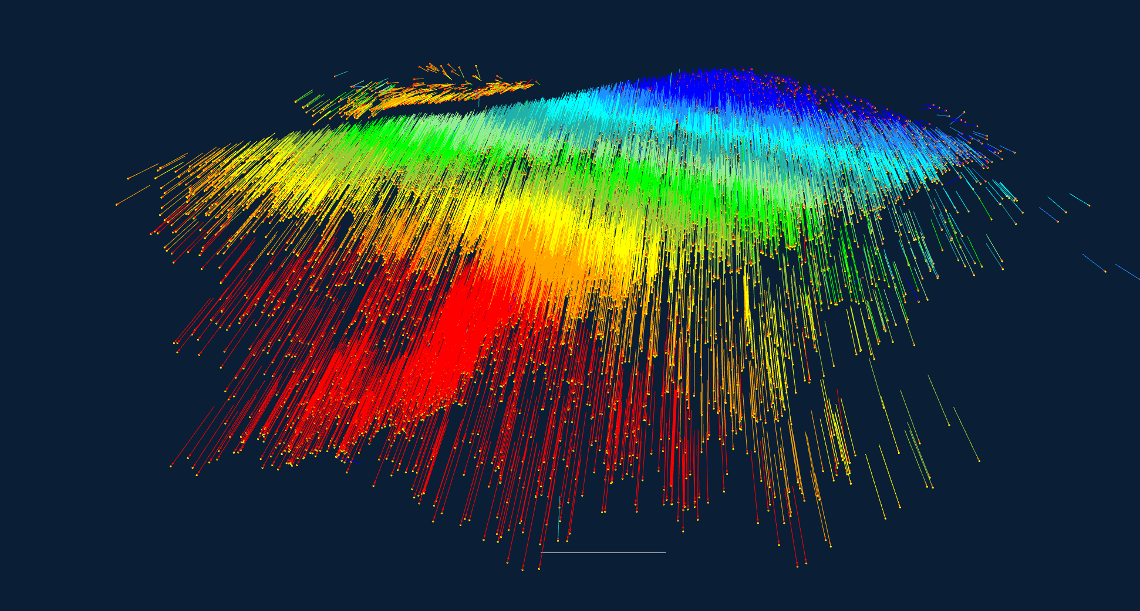
Network bias & shape distortion with varying σ_{GCP} values (2)
Design Accuracy: σ_{XY} = 0.006, σ_{Z} =0.023
σ_{GCP} =0.01 | X (m) | Y (m) | Z (m)
Posn. Bias | -0.002 | -0.015 | 0.014
RMS Posn. Discrepancy | 0.008 | 0.018 | 0.026
σ_{GCP} = 0.025 | X (m) | Y (m) | Z (m)
Posn. Bias | 0 | -0.017 | 0.072
RMS Posn. Discrepancy | 0.025 | 0.036 | 0.078
σ_{GCP} = 0.05 | X (m) | Y (m) | Z (m)
Posn. Bias | 0.004 | -0.019 | 0.157
RMS Posn. Discrepancy | 0.049 | 0.067 | 0.162
GCPs

Slide 33
Concluding Remarks
The network geometry rules regarding self-calibration apply to UAV/UAS networks – there are no shortcuts!
Consider comprehensive pre-calibration & assessment of calibration stability; multi-scale networks preferred over constrained single-scale
Not only IO calibration is problematic for near-nadir UAS networks w/o EO constraints; self-calibration of radial distortion also a problem
GPS camera stn. constraints in self-calibration are generally useful in UAS networks only when GPS accuracy is cm level – not yet the norm
Biases & distortions in point positioning are not necessarily removed through the use of moderately to tightly constrained GCPs
Covariance matrices only realistic when datum & configuration defects removed – helped by control σ_{XYZ} & σ_{X}^{c}_{Y}^{c}_{Z}^{c} << σ_{xy}*
Object point biases & distortions can be >> magnitude indicated by object point XYZ sigmas

Slide 34
Concluding Remark
Thank You
To ensure successful self-calibration: Maximise image scale variation within and between images forming the network … and utilise roll angle variation

