Slide 1
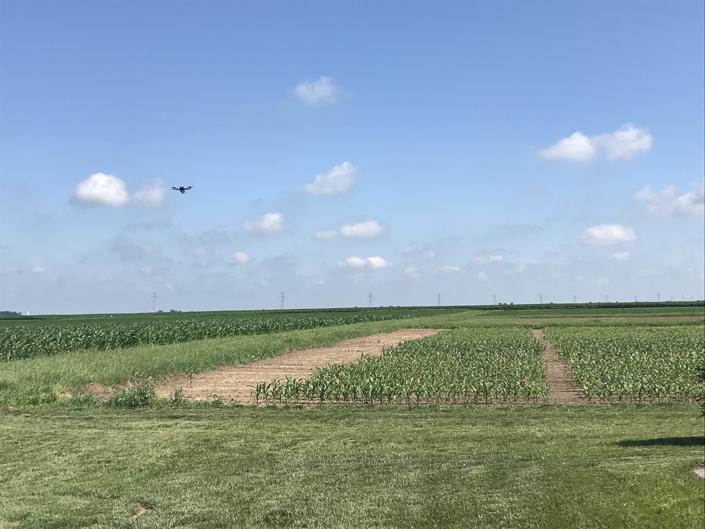
Implementation of GNSS/INS-assisted Structure from Motion for a Thermal Camera onboard Unmanned Aerial System
Meghdad Hasheminasab, Tian Zhou, Lisa Laforest, Evan Flatt, and Ayman Habib
Digital Photogrammetry Research Group
Lyles School of Civil Engineering
Purdue University
Webpage: http://purdue.edu/CE/DPRG

Slide 2
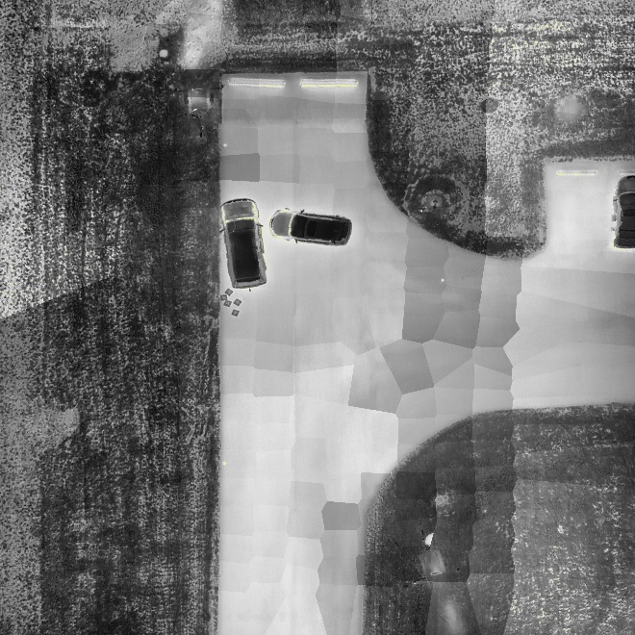
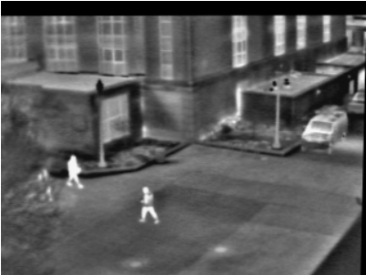
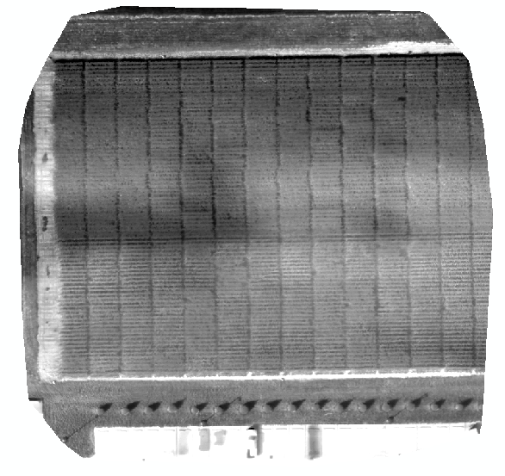

Introduction
Thermal imaging sensors and their applications
Precision agriculture: Plant disease detection, estimating crop yield, improving land cover classification, etc.
To achieve these goals, generating precise orthophotos is a key step.
What are the challenges towards orthophoto generation from thermal images?
high
Crash scene reconstruction
Public safety [1]
Precision agriculture
low
[1]:Leykin, A., & Hammoud, R. (2006, June). Robust multi-pedestrian tracking in thermal- visible surveillance videos. In Computer Vision and Pattern Recognition Workshop, 2006. CVPRW'06. Conference on (pp. 136-136). IEEE.
Notes:
Thermal imaging systems usually detect radiation in the long-infrared range of the electromagnetic spectrum (9-14 um) and produce image of that radiation.

Slide 3
Aerial Triangulations: Conventional Framework
Aerial Triangulation
IOPs, EOPs, DSM
Orthophoto
Several commercial packages for AT:
Conventional Structure from Motion (SfM) strategy:
Pix4D
PhotoScan
DronDeploy
…
Provide precise products when using RGB images
8-point
8-point normalized
5-point (Nister)
…
Global Bundle Adjustment with System Calibration
+
Georeferencing Control
Final Products:
DSM,
Orthophoto
Calibration Parameters
…
Input Image Dataset
Image Matching
Automated Relative Orientation
+
Mismatch Removal
Exterior Orientation Recovery
SIFT
SURF
…
RANSAC
Epipolar Geometry
…
Incremental Strategy
Global Strategy

Slide 4
Aerial Triangulation: RGB vs. Thermal
Image matching: RGB images vs. thermal images
Can we separate “Matching” & “ROPs Estimation” steps?
Poor Matching
(wrong & insufficient matches)
Poor Relative Orientation
Poor 3D Reconstruction

Slide 5
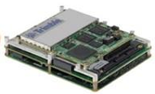







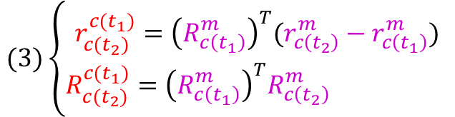




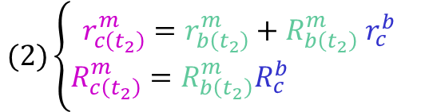


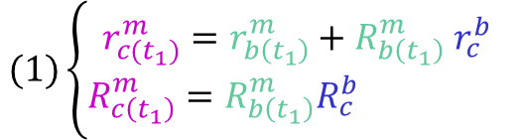







GNSS/INS-assisted SfM
Estimation of Relative Orientation Parameters using GNSS/INS information
Key factors: mounting parameters, system synchronization
$$(1)\left\{\begin{aligned}r_{c(t_{1})}^{m}=r_{b\left(t_{1}\right)}^{m}+R_{b\left(t_{1}\right)}^{m}{ r}_{c}^{b} \\ R_{c\left(t_{1}\right)}^{m}=R_{b\left(t_{1}\right)}^{m}R_{c}^{b} \end{aligned}\right.$$
Calibration information
GNSS/INS Information
EOPs information
ROPs information (unknown)
Time $t_{1}$
$$(2)\left\{\begin{aligned}r_{c\left(t_{2}\right)}^{m}=r_{b\left(t_{2}\right)}^{m}+R_{b\left(t_{2}\right)}^{m}{ r}_{c}^{b} \\ R_{c\left(t_{2}\right)}^{m}=R_{b\left(t_{2}\right)}^{m}R_{c}^{b} \end{aligned}\right.$$
$$r_{c}^{b}$$
$$R_{c}^{b}$$
$$R_{c (t2)}^{c (t1)}$$
$$r_{c (t2)}^{c (t1)}$$
$$(3)\left\{\begin{aligned}r_{c(t_{2})}^{c(t_{1})}={\left(R_{c\left(t_{1}\right)}^{m}\right)}^{T}(r_{c\left(t_{2}\right)}^{m}−r_{c\left(t_{1}\right)}^{m}) \\ R_{c(t_{2})}^{c(t_{1})}={\left(R_{c\left(t_{1}\right)}^{m}\right)}^{T}R_{c\left(t_{2}\right)}^{m} \end{aligned}\right.$$
$$r_{b\left(t_{1}\right)}^{m}$$
$$r_{c\left(t_{1}\right)}^{m}$$
$$R_{b\left(t_{1}\right)}^{m}$$
$$R_{c\left(t_{1}\right)}^{m}$$
$$r_{c}^{b}$$
$$Z_{m}$$
$$r_{b\left(t_{2}\right)}^{m}$$
$$R_{c}^{b}$$
$$Y_{m}$$
$$R_{b\left(t_{2}\right)}^{m}$$
$$R_{c\left(t_{2}\right)}^{m}$$
$$r_{c\left(t_{2}\right)}^{m}$$
$$X_{m}$$
Time $t_{2}$

Slide 6

GNSS/INS-assisted SfM: Workflow
SIFT
Workflow
Prior Knowledge about Object Space
Incremental Strategy
Image Matching
Global Bundle Adjustment with System Calibration
+
GNSS/INS Data
Final Products:
DSM,
Orthophoto
Calibration Parameters
…
Input Image Dataset
Mismatch Removal
Exterior Orientation Recovery
Relative Orientation Recovery
PC1
PC2
GNSS/INS Data
+
System Calibration
Left Image point
Right Image point
Mismatch Removal
DSM generated from the prior knowledge regarding the object space
×
$$δz$$
✓
Ground point
×

Slide 7
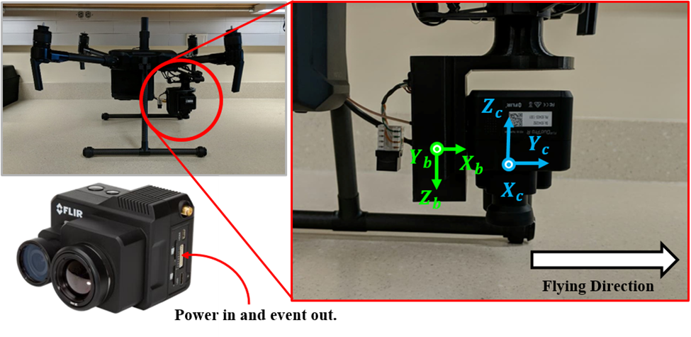



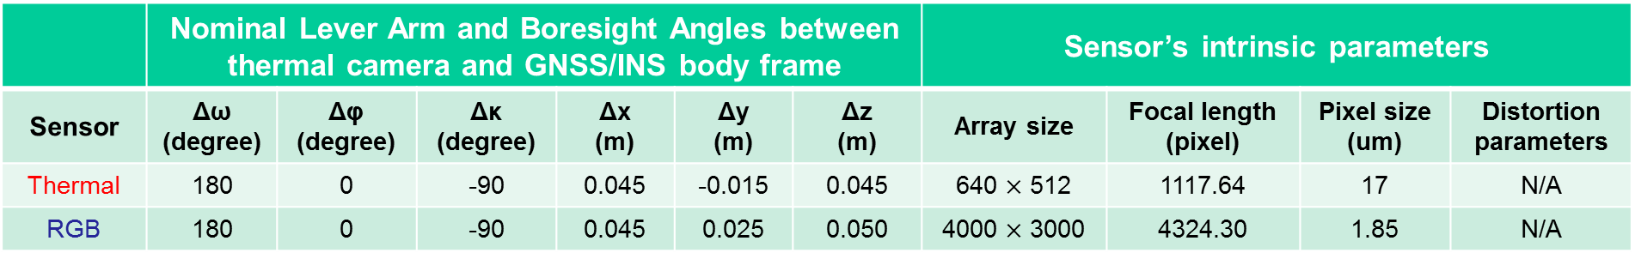



DJI M200 Platform
$$X_{b}$$
Body Frame
$$Y_{b}$$
$$Z_{b}$$
FLIR Duo Pro R
$$Y_{c}$$
Flying Direction
Camera Frame
$$X_{c}$$
RGB sensor
$$Z_{c}$$
Thermal sensor
 | Nominal Lever Arm and Boresight Angles between thermal camera and GNSS/INS body frame |  |  |  |  |  | Sensor’s intrinsic parameters
Sensor | Δω (degree) | Δφ (degree) | Δκ (degree) | Δx (m) | Δy (m) | Δz (m) | Array size | Focal length (pixel) | Pixel size (um) | Distortion parameters
Thermal | 180 | 0 | -90 | 0.045 | -0.015 | 0.045 | 640 $×$ 512 | 1117.64 | 17 | N/A
RGB | 180 | 0 | -90 | 0.045 | 0.025 | 0.050 | 4000 $×$ 3000 | 4324.30 | 1.85 | N/A
manual measurements and system setups
provided by the manufacturer

Slide 8
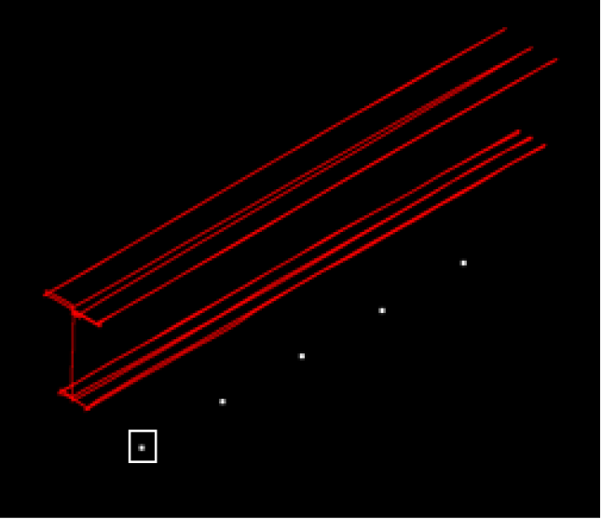
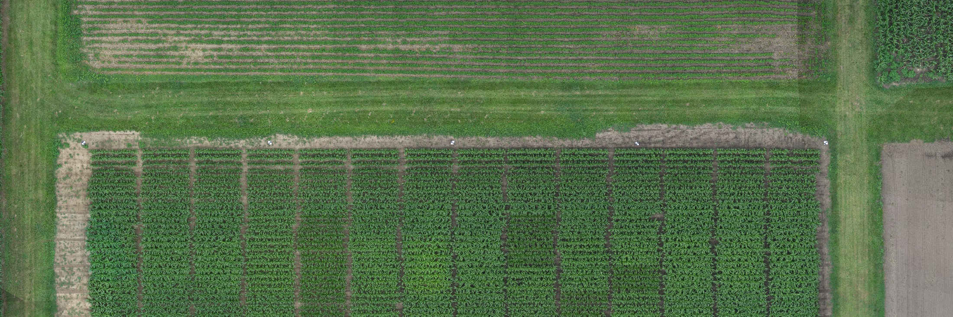
Flight Parameters & Area of Study
Date | Field | Flying Height | Flying Speed | GSD Thermal | GSD RGB | Overlap Thermal_RGB | Side-lap Thermal_RGB | Number of Flight Lines | Number of Images
20180725 | 9D ACRE | 20 m | 2.7 m/s | 1.8 cm | 0.5 cm | 70%_80% | 70%_80% | 6 | 284
 |  | 40 m | 5.4 m/s | 3.6 cm | 1 cm |  |  | 6 | 164
20180914 | 9D ACRE | 20 m | 2.7 m/s | 1.8 cm | 0.5 cm | 70%_80% | 70%_80% | 6 | 294
 |  | 40 m | 5.4 m/s | 3.6 cm | 1 cm |  |  | 6 | 168
20m flight trajectory
40m flight trajectory
Ground Targets

Slide 9
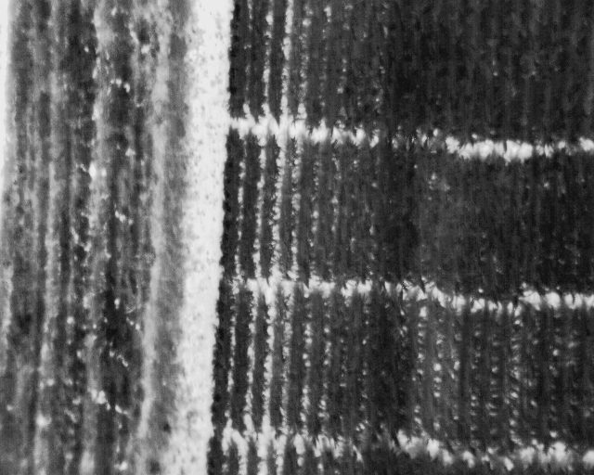
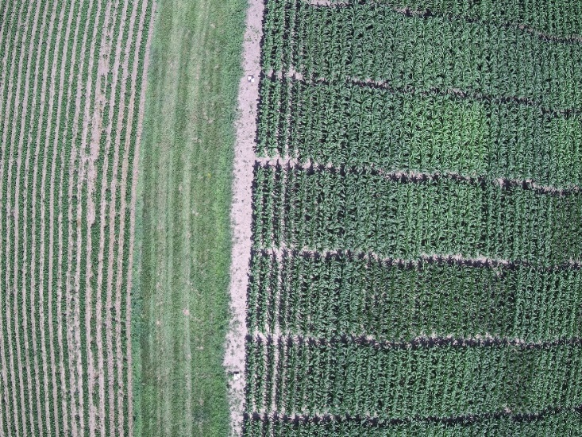
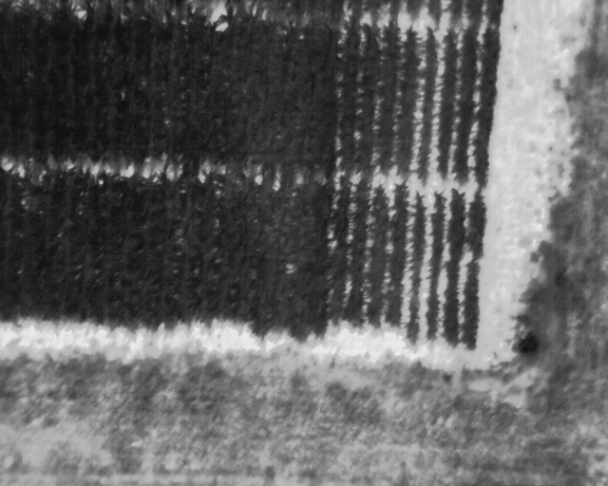
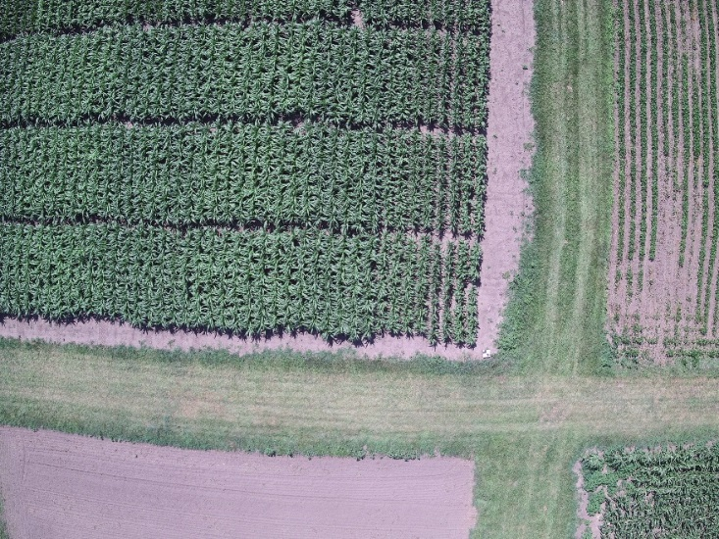
Hypotheses
RGB and Thermal cameras capture images simultaneously.
GNSS/INS event marker coincides with the exposure time for both cameras.

Slide 10
Problem Statement & Proposed Solution
Problems:
  By analyzing the generated orthophoto, a time delay between when the images are captured and when the event marker is recorded was discovered.
  RGB & Thermal camera images are not captured at the same time.
  Time delay leads to inaccurate calibration parameters and poor orthophotos and reconstruction of object space.
Proposed Solution:
  Solve for the time delay as an unknown in bundle adjustment process.

Slide 11


















Collinearity Equations
Collinearity equations while considering GNSS/INS information:
2. GNSS/INS
body frame
$$z_{b}$$
$$R_{c}^{b}$$
3. Image sensor
$$y_{b}$$
$$z_{c}$$
$$y_{c}$$
$$r_{i}^{c} =\frac{1}{λ(i,c,t)}R_{b}^{c} \left[R_{m}^{b\left(t\right)}\left[r_{I}^{m}− r_{b\left(t\right)}^{m}\right]− r_{c}^{b}\right]$$
$$x_{b}$$
PC
$$r_{c}^{b}$$
$$xc$$
$$r_{i}^{c}$$
$$R_{b(t)}^{m}$$
Image point $i$
$$r_{b(t)}^{m}$$
$$Z_{m}$$
Object point I
$$Y_{m}$$
1. Mapping Frame
$$X_{m}$$
Question:
What parameters will be affected by existence of a time delay in the system?
$$r_{b(t)}^{m}$$
$$R_{b(t)}^{m}$$

Slide 12
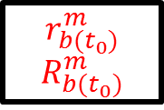

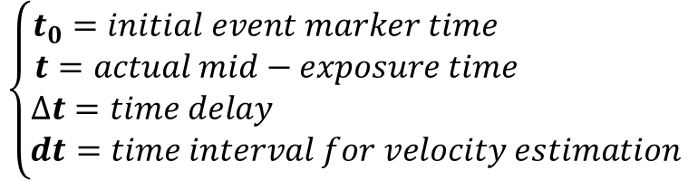
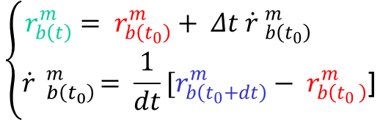




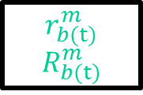

Modified Collinearity Equations, $r_{b\left(t\right)}^{m}$
$$\left\{\begin{aligned}t_{0}=initial event marker time \\ t=actual mid−exposure time \\ ∆t=time delay \\ dt=time interval for velocity estimation\end{aligned}\right.$$
$$t_{0}$$
$$t$$
$$t_{0}+dt$$
$$∆t$$
Flight Trajectory
$$dt$$
$$\left\{\begin{aligned}r_{b\left(t\right)}^{m}= r_{b\left(t_{0}\right)}^{m}+ Δt \dot{r} _{b\left(t_{0}\right)}^{m} \\ \dot{r} _{b\left(t_{0}\right)}^{m}= \frac{1}{dt}[r_{b\left(t_{0}+dt\right)}^{m}− r_{b\left(t_{0} \right)}^{m}\text{]}\end{aligned}\right.$$
$$r_{b(t_{0})}^{m}$$
$$R_{b(t_{0})}^{m}$$
$$t=t_{0}^{ }+Δt$$
$$r_{b(t)}^{m}$$
$$R_{b(t)}^{m}$$

Slide 13


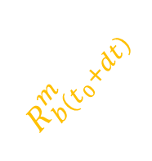
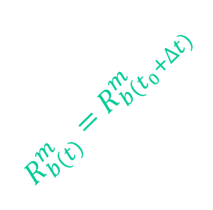








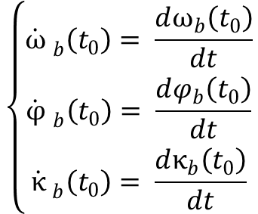


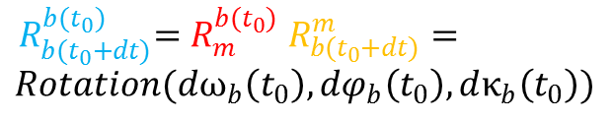





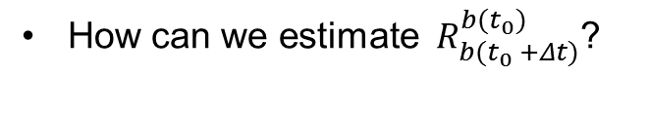
Modified Collinearity Equations, $R_{b\left(t\right)}^{m}$
$$R_{b(t)}^{m}{= R}_{b(t_{0})}^{m}{ R}_{b(t_{0} +Δt)}^{b(t_{0})}$$
$$z_{b(t_{0}+∆t)}$$
$$z_{b(t_{0}+dt)}$$
How can we estimate ${ R}_{b(t_{0} +Δt)}^{b(t_{0})}$?
$$y_{b(t_{0}+∆t)}$$
$$z_{b(t_{0})}$$
$$y_{b(t_{0}+dt)}$$
$$y_{b(t_{0})}$$
$$x_{b(t_{0}+∆t)}$$
$${ R}_{b(t_{0}+dt)}^{b(t_{0})}=R_{m}^{b(t_{0})} R_{b(t_{0}+dt)}^{m}=$$
$$Rotation(dω_{b}\left(t_{0}\right),dφ_{b}\left(t_{0}\right),dκ_{b}\left(t_{0}\right))$$
$$x_{b(t_{0})}$$
$$x_{b(t_{0}+dt)}$$
$$R_{b\left(t_{0}+∆t\right)}^{b(t_{0})}$$
Trajectory
$$\left\{\begin{aligned}\dot{ω} _{b}^{ }\left(t_{0}\right)= \frac{dω_{b}\left(t_{0}\right)}{dt} \\ \dot{φ} _{b}^{ }\left(t_{0}\right)= \frac{dφ_{b}\left(t_{0}\right)}{dt} \\ \dot{κ} _{b}^{ }\left(t_{0}\right)= \frac{dκ_{b}\left(t_{0}\right)}{dt}\end{aligned}\right.$$
$$R_{b\left(t_{0}+dt\right)}^{b(t_{0})}$$
Angular
Velocity
$$R_{b(t_{0})}^{m}$$
$${R_{b(t)}^{m}=R}_{b(t_{0}+∆t)}^{m}$$
$$R_{b\left(t_{0}+dt\right)}^{m}$$
$$Z_{m}$$
$$Y_{m}$$
$${ R}_{b(t0+Δt)}^{b(t0)}=Rotation\left(\dot{ω} _{b\left(t_{0}\right)}^{ }Δt, \dot{φ} _{b\left(t_{0}\right)}^{ }Δt, \dot{κ} _{b\left(t_{0}\right)}^{ }Δt\right)$$
$$X_{m}$$
$$r_{i}^{c} =\frac{1}{λ(i,c,t)}R_{b}^{c} \left[R_{b(t_{0})}^{b(t_{0}+Δt)}{ R}_{m}^{b(t_{0})}\left(r_{I}^{m}− r_{b\left(t_{0}\right)}^{m}− \dot{r} _{b\left(t_{0}\right)}^{m}Δt\right)− r_{c}^{b}\right]$$
Modified Collinearity Equations:
$$r_{i}^{c} =\frac{1}{λ(i,c,t)}R_{b}^{c} \left[R_{m}^{b\left(t\right)}\left[r_{I}^{m}− r_{b\left(t\right)}^{m}\right]− r_{c}^{b}\right]$$
Collinearity Equations:

Slide 14
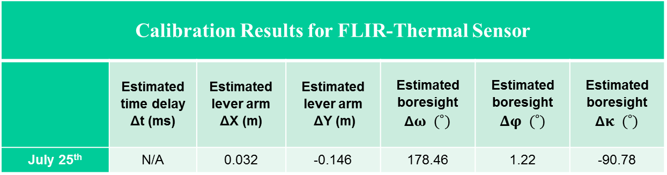
Calibration Results: Thermal Camera
Ground targets are considers as tie points.
Estimated system parameters: boresight angles, lever arm
Calibration Results for FLIR-Thermal Sensor
 | Estimated time delay Δt (ms) | Estimated lever arm ΔX (m) | Estimated lever arm ΔY (m) | Estimated boresight Δ$ω (˚)$ | Estimated boresight $Δφ (˚)$ | Estimated boresight Δ$κ (˚)$
July 25th | N/A | 0.032 | -0.146 | 178.46 | 1.22 | -90.78
Statistics on five check points on orthophoto for FLIR-Thermal sensor*
 | Mean-X/Y (m) | Standard Deviation- X/Y(m) | RMSE- X/Y (m)
July 25th | N/A | N/A | N/A
* Check targets could not be identified in the generated orthophoto.

Slide 15
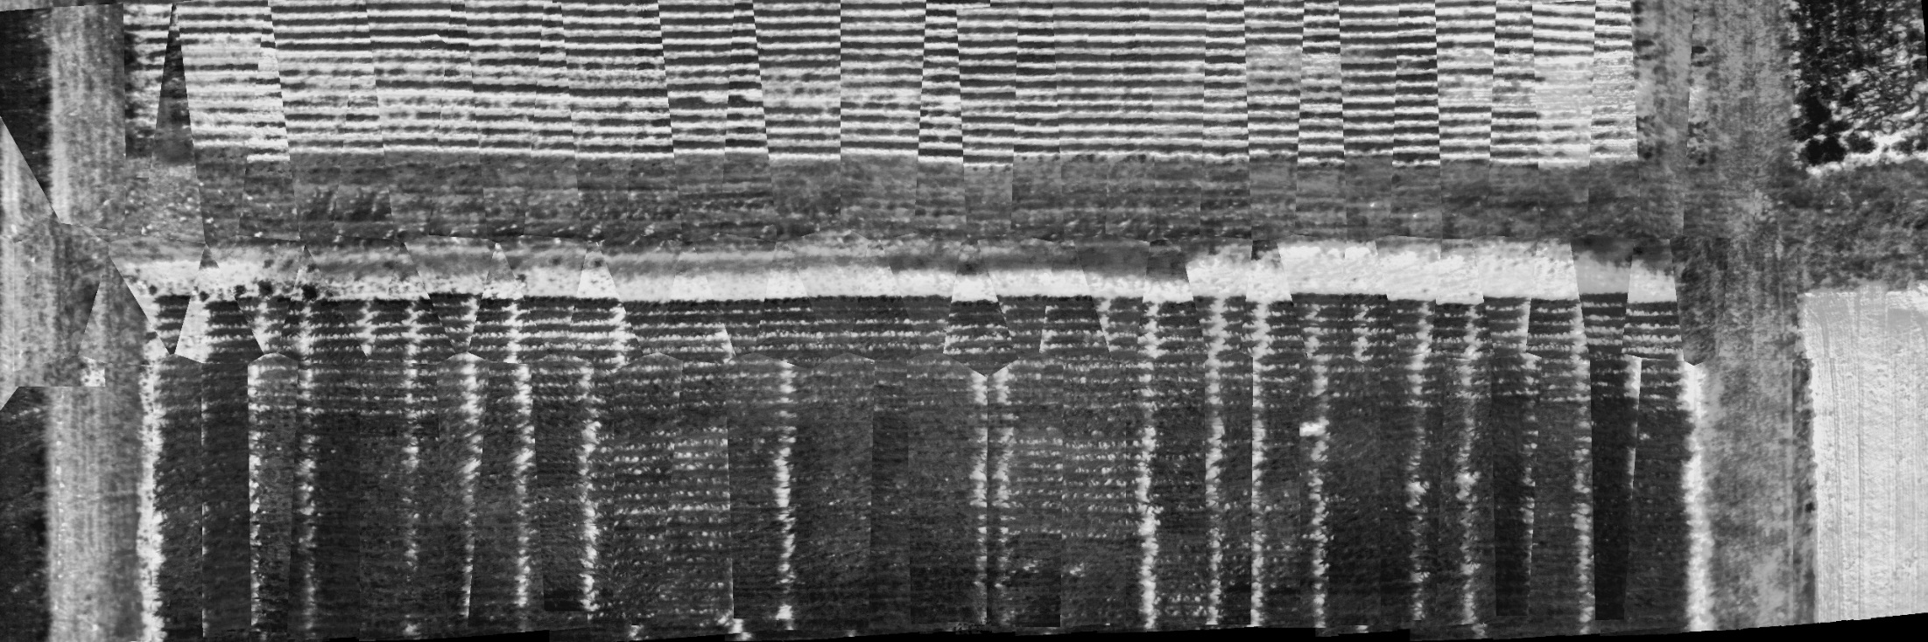

Results: Without Considering Time Delay
July 25th Thermal Dataset
Generated orthophoto with 1cm resolution
GSD $≅$ 0.03 m
Trajectory | System Parameters | DSM
Original | Estimated Boresight Angles Estimated Lever Arm | SfM-based
* Check targets could not be identified in the generated orthophoto.

Slide 16
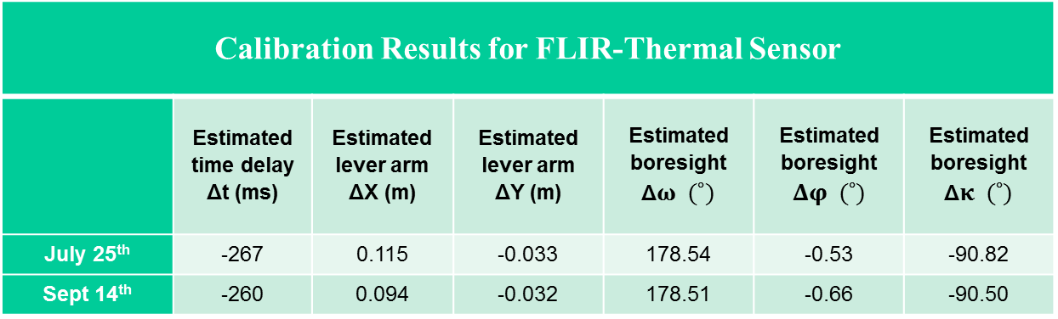
Calibration Results: Thermal Camera
Ground targets are considers as tie points.
Estimated system parameters: boresight angles, lever arm, time delay
Calibration Results for FLIR-Thermal Sensor
 | Estimated time delay Δt (ms) | Estimated lever arm ΔX (m) | Estimated lever arm ΔY (m) | Estimated boresight Δ$ω (˚)$ | Estimated boresight $Δφ (˚)$ | Estimated boresight Δ$κ (˚)$
July 25th | -267 | 0.115 | -0.033 | 178.54 | -0.53 | -90.82
Sept 14th | -260 | 0.094 | -0.032 | 178.51 | -0.66 | -90.50
Statistics on five check points on orthophoto for FLIR-thermal sensor
 | Mean-X/Y (m) | Standard Deviation- X/Y (m) | RMSE- X/Y (m)
July 25th | -0.03/ -0.07 | ±0.08/ 0.02 | 0.08/ 0.08
Sept 14th | -0.05/ -0.03 | ±0.06/ 0.02 | 0.06/ 0.04

Slide 17
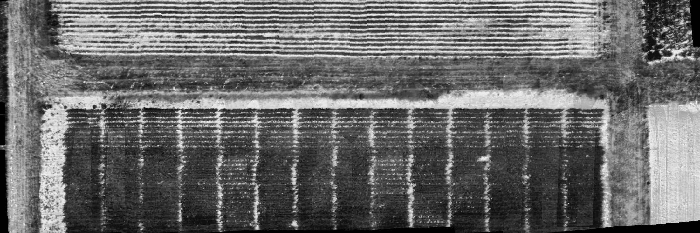
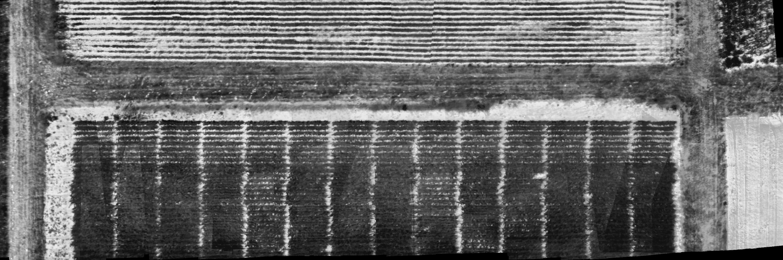
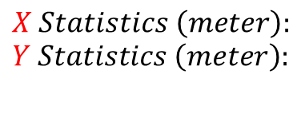
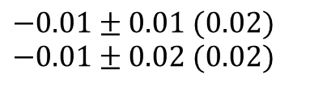


Results: July 25th Thermal Dataset
$$X Statistics \left(meter\right):$$
$$Y Statistics \left(meter\right):$$
$$−0.01±0.01 (0.02)$$
$$−0.01±0.02 (0.02)$$
$$−0.03±0.08 (0.08)$$
$$−0.07±0. 02 (0.08)$$
Red boxes show the targets
Generated orthophoto with 1cm resolution
GSD $≅$ 0.03 m
Trajectory | System Parameters | DSM
Original | Estimated Boresight Angles Estimated Lever Arm Estimated Time Delay | SfM-based
Trajectory | System Parameters | DSM
SfM-based | Estimated Boresight Angles Estimated Lever Arm Estimated Time Delay | SfM-based

Slide 18
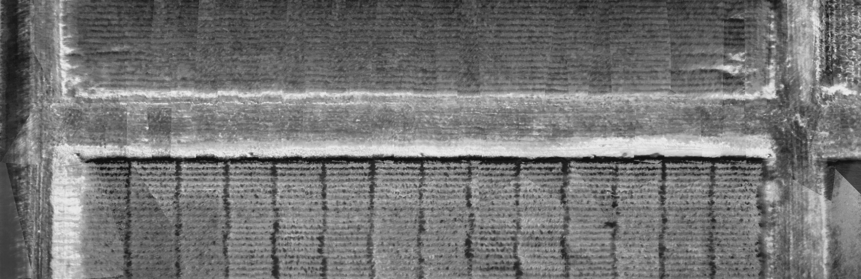
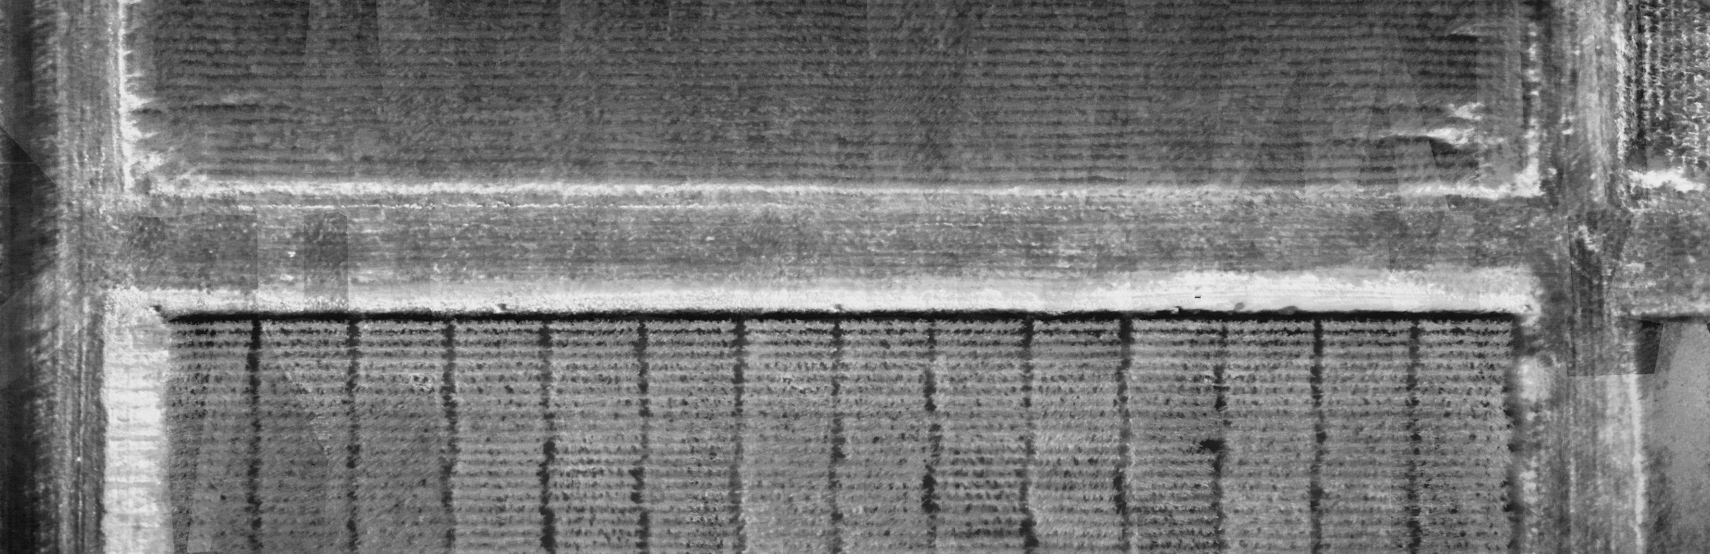
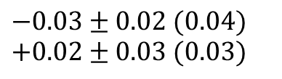
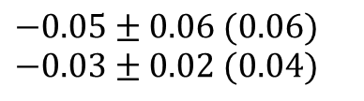
Results: September 14th Thermal Dataset
$$X Statistics \left(meter\right):$$
$$Y Statistics \left(meter\right):$$
$$−0.03±0.02 (0.04)$$
$$+0.02±0.03 (0.03)$$
$$−0.05±0.06 (0.06)$$
$$−0.03±0.02 (0.04)$$
Red boxes show the targets
Generated orthophoto with 1cm resolution
GSD $≅$ 0.03 m
Trajectory | System Parameters | DSM
Original | Estimated Boresight Angles Estimated Lever Arm Estimated Time Delay | SfM-based
Trajectory | System Parameters | DSM
SfM-based | Estimated Boresight Angles Estimated Lever Arm Estimated Time Delay | SfM-based

Slide 19
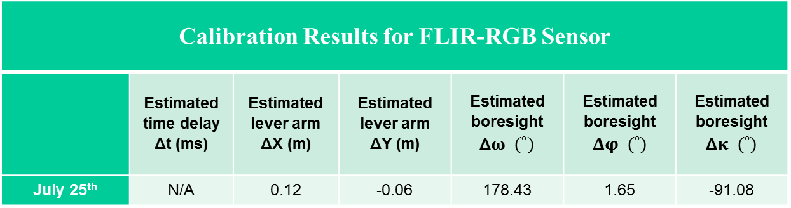
Calibration Results: RGB Camera
Ground targets are considers as tie points.
Estimated system parameters: boresight angles, lever arm
Calibration Results for FLIR-RGB Sensor
 | Estimated time delay Δt (ms) | Estimated lever arm ΔX (m) | Estimated lever arm ΔY (m) | Estimated boresight Δ$ω (˚)$ | Estimated boresight $Δφ (˚)$ | Estimated boresight Δ$κ (˚)$
July 25th | N/A | 0.12 | -0.06 | 178.43 | 1.65 | -91.08
Statistics on five check points on orthophoto for FLIR-RGB sensor*
 | Mean-X/Y (m) | Standard Deviation- X/Y (m) | RMSE- X/Y (m)
July 25th | N/A | N/A | N/A
* Check targets could not be identified in the generated orthophoto.

Slide 20
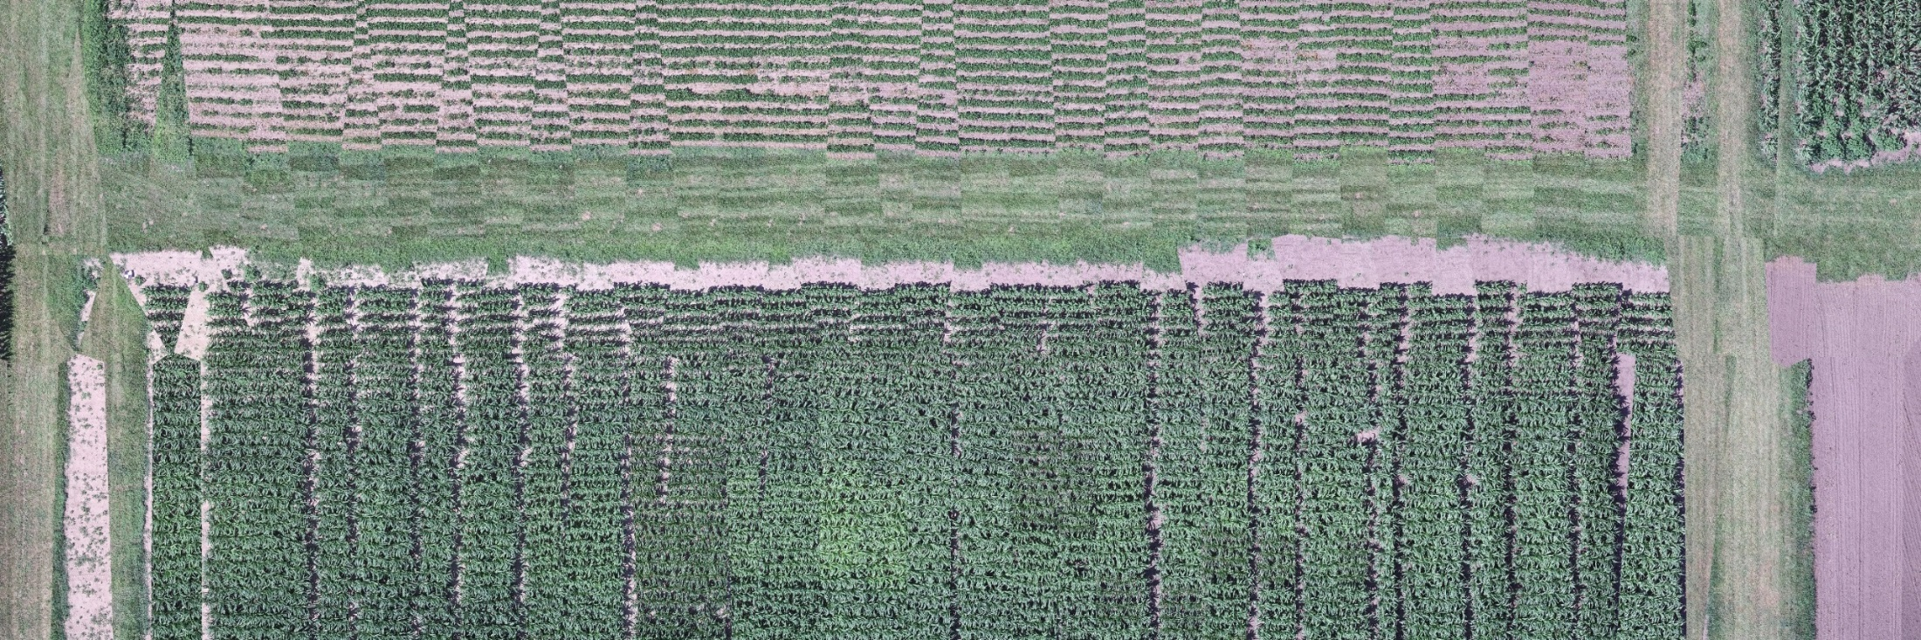

Results: Without Considering Time Delay
July 25th RGB Dataset
Generated orthophoto with 1cm resolution
GSD $≅$ 0.01 m
Trajectory | System Parameters | DSM
Original | Estimated Boresight Angles Estimated Lever Arm | SfM-based
* Check targets could not be identified in the generated orthophoto.

Slide 21

Calibration Results: RGB Camera
Ground targets are considers as tie points.
Estimated system parameters: boresight angles, lever arm, time delay
Calibration Results for FLIR-Thermal Sensor
 | Estimated time delay Δt (ms) | Estimated lever arm ΔX (m) | Estimated lever arm ΔY (m) | Estimated boresight Δ$ω (˚)$ | Estimated boresight $Δφ (˚)$ | Estimated boresight Δ$κ (˚)$
July 25th | -205 | 0.068 | 0.005 | 178.47 | 0.06 | -90.92
Sept 14th | -203 | 0.072 | 0.009 | 178.48 | 0.11 | -90.84
Statistics on five check points on orthophoto for FLIR-thermal sensor
 | Mean-X/Y (m) | Standard Deviation- X/Y(m) | RMSE- X/Y (m)
July 25th | -0.04/ -0.06 | ±0.04/ 0.02 | 0.05/ 0.06
Sept 14th | -0.01/ 0.02 | ±0.02/ 0.03 | 0.03/ 0.03

Slide 22
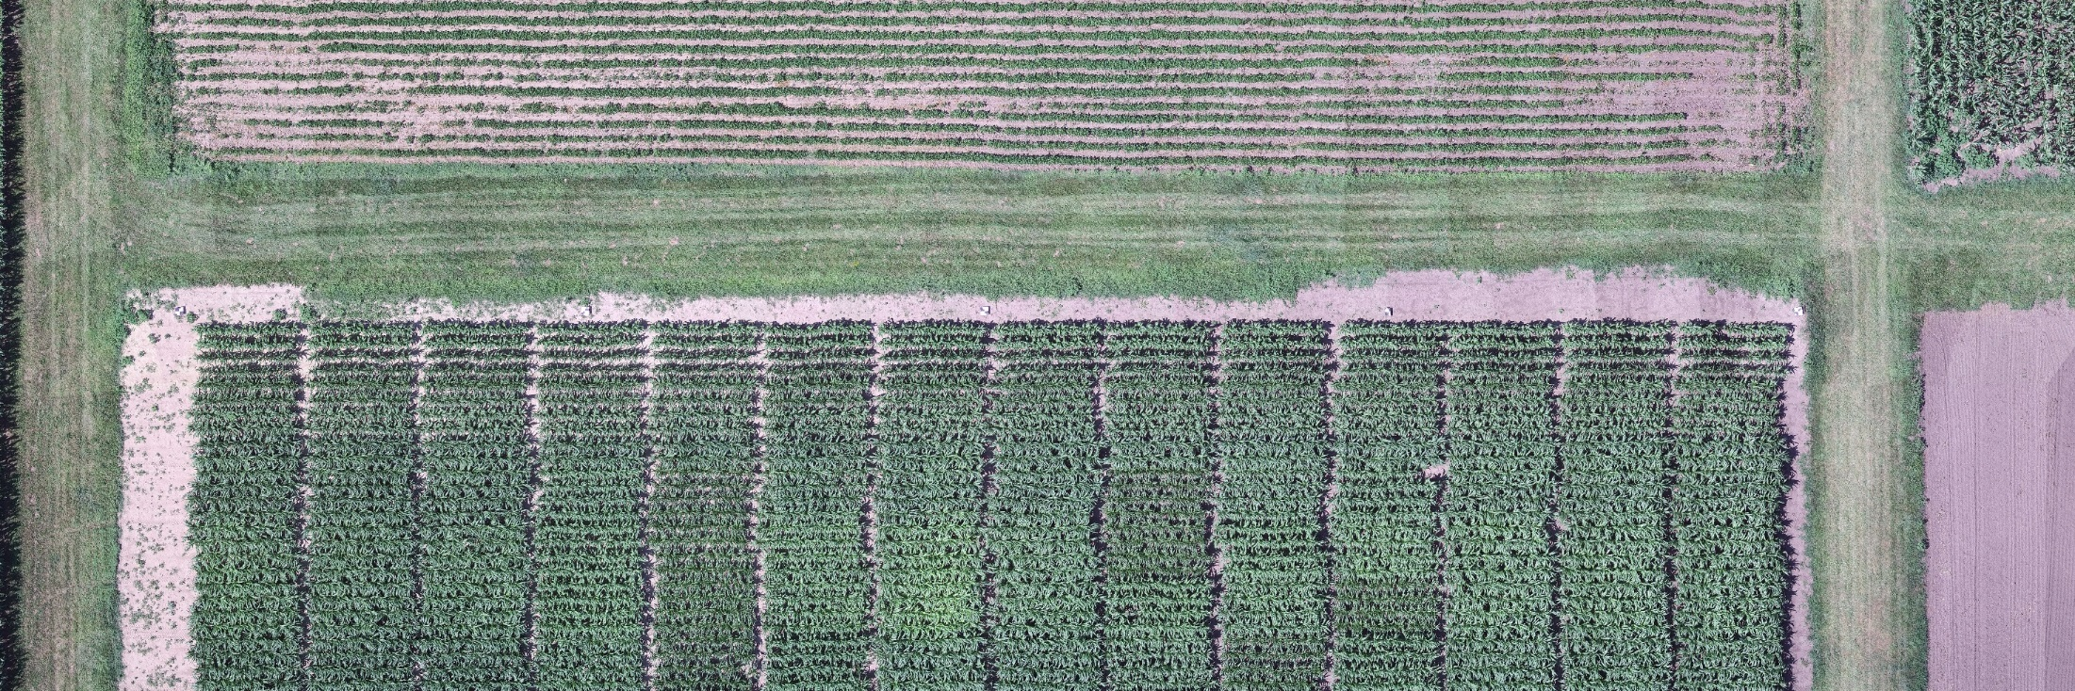
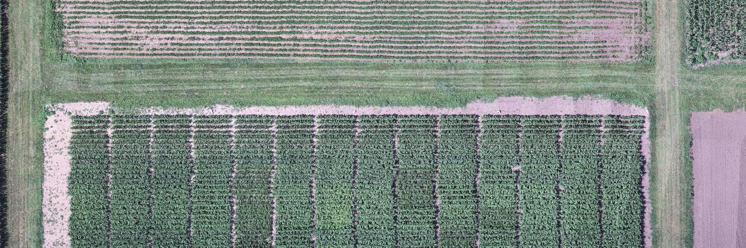
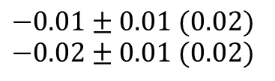


Results: July 25th RGB Dataset
$$X Statistics \left(meter\right):$$
$$Y Statistics \left(meter\right):$$
$$−0.01±0.01 (0.02)$$
$$−0.02±0.01 (0.02)$$
$$−0.04±0.04 (0.05)$$
$$−0.06±0.02 (0.06)$$
Red boxes show the targets
Generated orthophoto with 1cm resolution
GSD $≅$ 0.01 m
Trajectory | System Parameters | DSM
Original | Estimated Boresight Angles Estimated Lever Arm Estimated Time Delay | SfM-based
Trajectory | System Parameters | DSM
SfM-based | Estimated Boresight Angles Estimated Lever Arm Estimated Time Delay | SfM-based

Slide 23




Results: September 14th RGB Dataset
$$X Statistics \left(meter\right):$$
$$Y Statistics \left(meter\right):$$
$$−0.01±0.02 (0.03)$$
$$+0.02±0.03 (0.03)$$
$$+0.01±0.01 (0.02)$$
$$+0.01±0.02 (0.02)$$
Red boxes show the targets
Generated orthophoto with 1cm resolution
GSD $≅$ 0.01 m
Trajectory | System Parameters | DSM
Original | Estimated Boresight Angles Estimated Lever Arm Estimated Time Delay | SfM-based
Trajectory | System Parameters | DSM
SfM-based | Estimated Boresight Angles Estimated Lever Arm Estimated Time Delay | SfM-based

Slide 24
Conclusions & Future Work
GNSS/INS-assisted SfM has been shown as a simple and robust approach for 3D reconstruction of thermal imagery.
With consumer-grade systems, a time delay between the GNSS/INS and the actual exposure time may exist.
The proposed time delay estimation approach leads to accurate 3D reconstruction and 2D orthophotos.
Based on the results, we can conclude that the time delay for the used sensor is consistent throughout the time but is different for Thermal and RGB sensors
Time delay estimation in Multi-Camera systems for indoor mapping applications is the focus of current and future work.

Slide 25


Thank you!
Acknowledgement
The information, data, or work presented herein was funded in part by the Advanced Research Projects Agency-Energy (ARPA-E), U.S. Department of Energy, under Award Number DE-AR0000593. The views and opinions of authors expressed herein do not necessarily state or reflect those of the U.S. Government or any agency thereof.

