Slide 1
Digital Imagery Spatial Resolution and Radiometry: Metrics and Assessments
Mary Pagnutti
Kara Holekamp
Robert E. Ryan
Innovative Imaging and Research
Building 1103 Suite 140 C
Stennis Space Center, MS 39529
ASPRS 2012 Annual Conference
Sacramento, California
March 22, 2012

Slide 2
Introduction
Mapping and remote sensing systems are becoming indistinguishable
High spatial resolution satellites are designed and specified to do both

Slide 3
Introduction (Continued)
Aerial and satellite digital imaging systems are very similar with the following exceptions
  Differ in the amount of atmosphere and collection geometries
  Typically not as extensively characterized
    Radiometry and spatial resolution specifications not emphasized
    Spatial resolutions depends on altitude (satellites altitudes are typically fixed)
    Both radiometry and spatial resolution are not simple to validate (Part of the reason limited specification)

Slide 4
Introduction (Continued)
Aerial and satellite digital imaging systems are very similar with the following exceptions
  Differ in the amount of atmosphere and collection geometries
  Typically not as extensively characterized
    Radiometry and spatial resolution specifications not emphasized
    Spatial resolutions depends on altitude (satellites altitudes are fixed)
    Both are not the simple to validate (Part of the reason limited specification)

Slide 5
Spatial Resolution

Slide 6
Spatial Resolution
Depends on:
  Pixel size, measured by:
    Ground Sample Distance (GSD)
  Point Spread Function (PSF) - the response that an electro-optical system has to a point source
    The sharper the function, the sharper the object will appear in the system output image
    Difficult to directly measure
  Flight operations/installation
Values are determined in a laboratory and then validated in flight

Slide 7
Common Spatial Resolution Metrics
Spatial Domain
Relative Edge Response (RER)
Frequency Domain
Modulation Transfer Function (MTF)
  MTF at Nyquist typical parameter
Ringing Overshoot
1.0
Region where mean slope is estimated
1.0
Edge Response
MTF
MTF @ Nyquist
0
Ringing Undershoot
-2.0
-1.0
0.0
1.0
2.0
Spatial frequency
Pixels
Cut-off frequency

Slide 8
Modulation Transfer Function-MTF
MTF is a parameter described in the spatial frequency domain
  Mathematically allows you to model the imaging process by multiplication instead of convolution
  Not physically intuitive
  Evaluated in two separate orthogonal directions consistent with the along track and cross track of the image
MTF is defined as the magnitude of the OTF (Optical Transfer Function)
  OTF is defined as the Fourier Transform of the PSF

Slide 9
General Image Quality Equation (GIQE)
Predicts NIIRS as a function of scale, imagery sharpness, contrast, SNR and image enhancement
Used to predict performance apriori
  Design of systems
  Insight on processing
  NIIRS = 10.251 – a log₁₀ GSD_{GM} + b log₁₀ RER_{GM} – 0.656 H_{GM} – 0.344*G/SNR
  Where:
  GSD_{GM} is the geometric mean of the ground sampled distance
  RER_{GM} is the geometric mean of the normalized edge response
  H_{GM} is the geometric mean-height overshoot caused by MTFC
  G is the noise gain associated with MTFC.
  If the RER >0.9, a=0.32 and b =0.559; otherwise, a=3.16 and b=2.817

Slide 10
MTF and RER Relationships /Estimation
1
Measured point
1000
Best fit
Line Spread Funcation
DN
0.5
FWHM
500
-15
-10
-5
0
5
10
15
0
-
5
-
4
-
3
-
2
-
1
0
1
2
3
4
5
Distance / GSD
Distance / GSD
Measured edge response along “tilted edge”
Derivative of edge response or line spread function
Fourier transform of line spread function or MTF
Nyquist frequency is 0.5 * sampling frequency or (1/(2GSD))
1
Nyquist frequency
MTF
0.5
MTF @
Nyquist frequency
0
0
0.5
1
Normalized spatial frequency

Slide 11
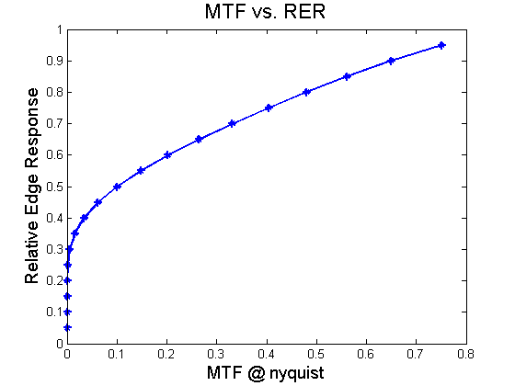
MTF@ Nyquist vs. RER (Gaussian PSF)
MTF and RER can be related to each other through Fourier analysis

Slide 12
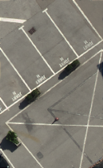
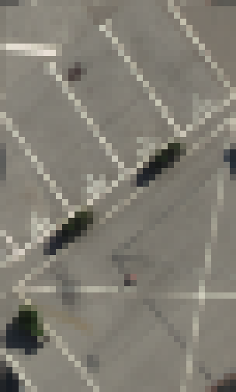


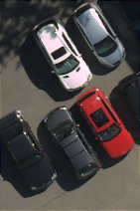



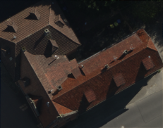
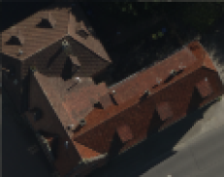


Effect of GSD on Image Quality
(Constant MTF = 0.7)
GSD = 1.5 in/4 cm
GSD = 6 in/15 cm
GSD = 1 ft/30 cm
GSD = 2 ft/60 cm

Slide 13

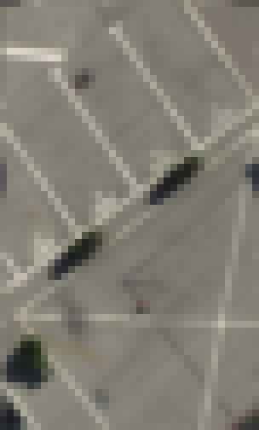




Effect of MTF on Image Quality
(Constant GSD = 16 cm/~6 in)
MTF = 0.05
MTF = 0.4
MTF = 0.7

Slide 14






Effect of MTF on Image Quality
(Constant GSD = 30 cm/~12 in)
MTF = 0.05
MTF = 0.4
MTF = 0.7

Slide 15
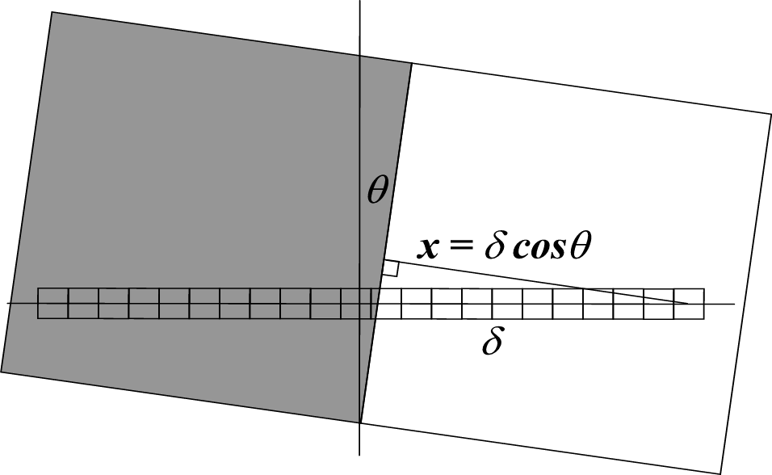
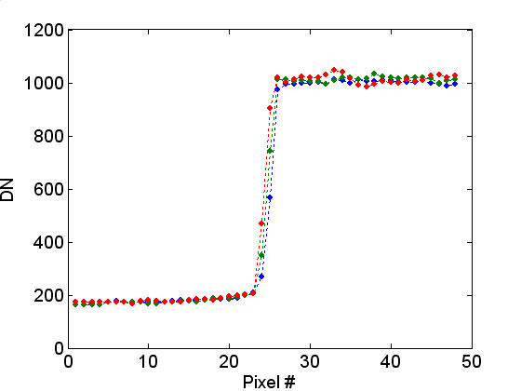
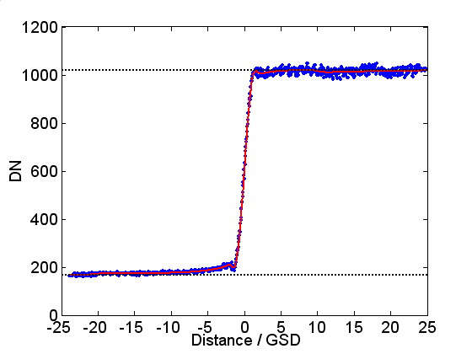
Estimating MTF/RER Tilted Edge Technique
3 examples of undersampled edge responses measured across the tilted edge
DN
θ – edge tilt angle
δ – pixel index
x – pixel’s distance from edge (in GSD)
Pixels
Problem: Digital cameras undersample edge target
Solution: Image tilted edge to improve sampling
Superposition of 24 edge responses shifted to compensate for the tilt
DN
Distance/GSD

Slide 16
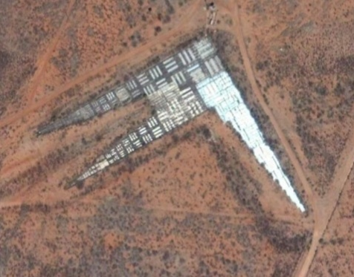
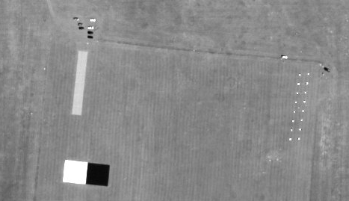
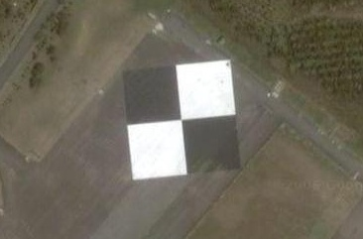
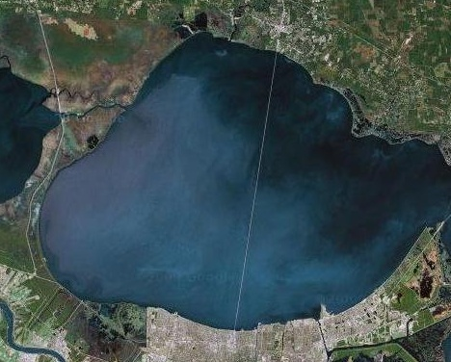
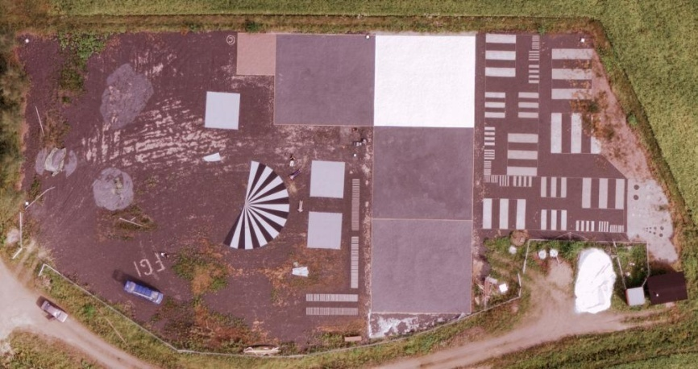
Traditional Engineered Spatial Resolution Targets
These types of targets however, will not generally be available in the imagery to validate spatial resolution
Deployable targets at South Dakota State University
Pong Hu, Taiwan
Fort Huachuka
tri-bar target
Causeway bridge over Lake Pontchartrain
Finnish Geodetic Institute Sjökulla Site
Digital Globe provided satellite imagery

Slide 17
Problem…
Most commonly used spatial resolution estimation techniques require engineered targets (deployed or fixed), which are not always available or convenient
Target size scales with GSD
  Edge targets are typically uniform edges 10-20 pixels long and ~10 pixels tilted a few degrees relative to pixel grid (improve sampling)
  Increasing GSD increases difficulty
    Moderate resolution systems such as Landsat use pulse targets

Slide 18
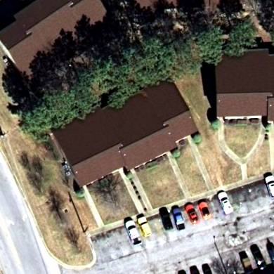
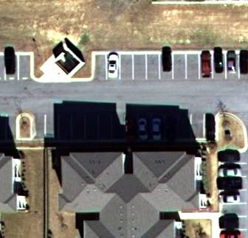
Spatial Resolution Estimation Using In-Scene Edges
Exploit edge features in nominal imagery
  Edge response estimation is performed without dedicated engineered targets
Appropriate for high spatial resolution Imagery
Automated processes exist that can
  Identify edges and screen them
  Construct resulting edge response
  Calculate MTF and RER
Rooflines
Building Shadows

Slide 19
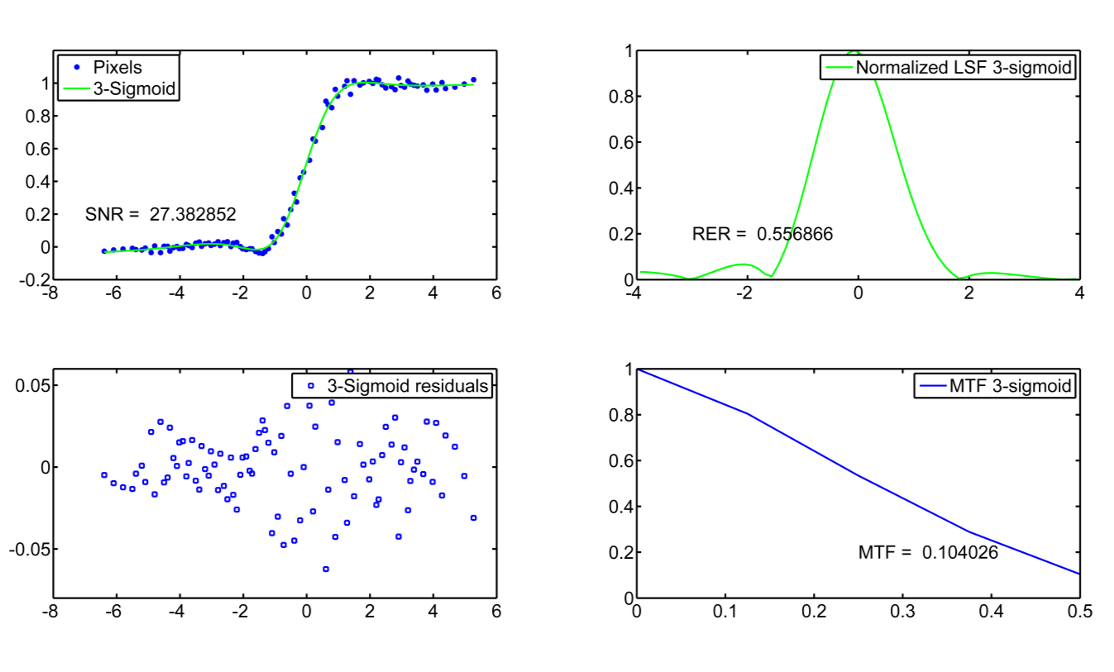
MTF/RER with Natural Edges

Slide 20
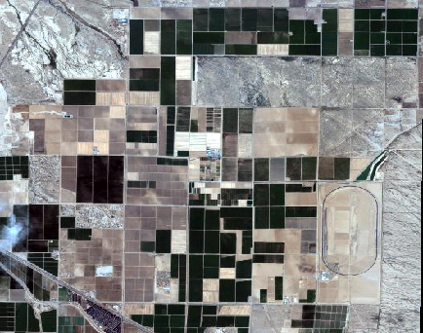
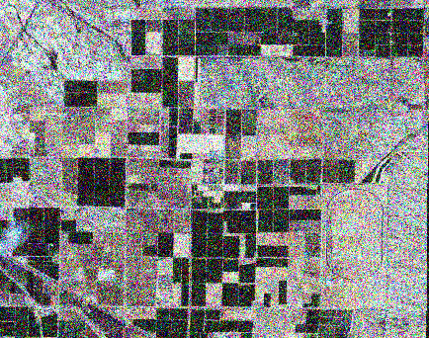
Effect of SNR on Image Quality
IKONOS Imagery
SNR ~ 100
IKONOS Imagery
with noise added
SNR ~ 2
Includes material © Space Imaging LLC

Slide 21
Radiometry

Slide 22
Relative Radiometry
Digital Number (DN) functional relationship with brightness (radiance), aperture and integration time (Linearity/Dynamic Range)
Quantization (Typical for Aerial Data Spec)
Pixel-to-pixel (image normalization or flat fielding)
Band-to-band (spectrum) (Colorimetry)
Typical remote sensing industry goal <1%

Slide 23
Absolute Radiometry /Colorimetry
Absolute Radiometry
  Conversion of DN to engineering units of radiance (remote sensing)
  Typical remote sensing goal is <5% difference from a National Standard (Landsat Data Continuity Mission (LDCM) Data Specification, March 2000)
Colorimetry
  Ability to produce true colors from sensor intrinsic RGB
In general if a system has good relative radiometry then good color balancing can be achieved. Similarly systems that have good absolute radiometry have good color balance

Slide 24
Absolute Radiometric Calibration
Integrating Sphere In-band Radiance
Calibration Integration Time
Maximum Reference DN
Calibration F#
Using the spectral response and integrating sphere radiance both
normalization and absolute calibration can be accomplished simultaneously

Slide 25
Why Have An Absolute Radiometry Imaging System?
Predicts the performance of the multispectral imager a priori
For aerial systems simulates satellite performance
Supports the ability to atmospherically correct products to surface reflectance
  Change detection and time series analysis

Slide 26
Calibration/Validation Model of Operation
Provide NIST-traceable standards
Cal/Val foundation
Instrument Calibrations
Laboratory-based Verification & Validation
In-Flight Verification & Validation
Baseline sensor performance in a controlled environment
Cal/Val critical sensors
Cal/Val installed sensors
Cross-validate systems
Temporal degradations

Slide 27
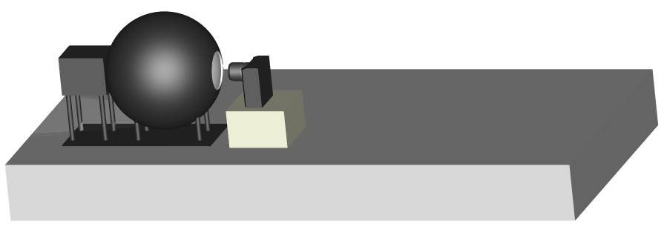
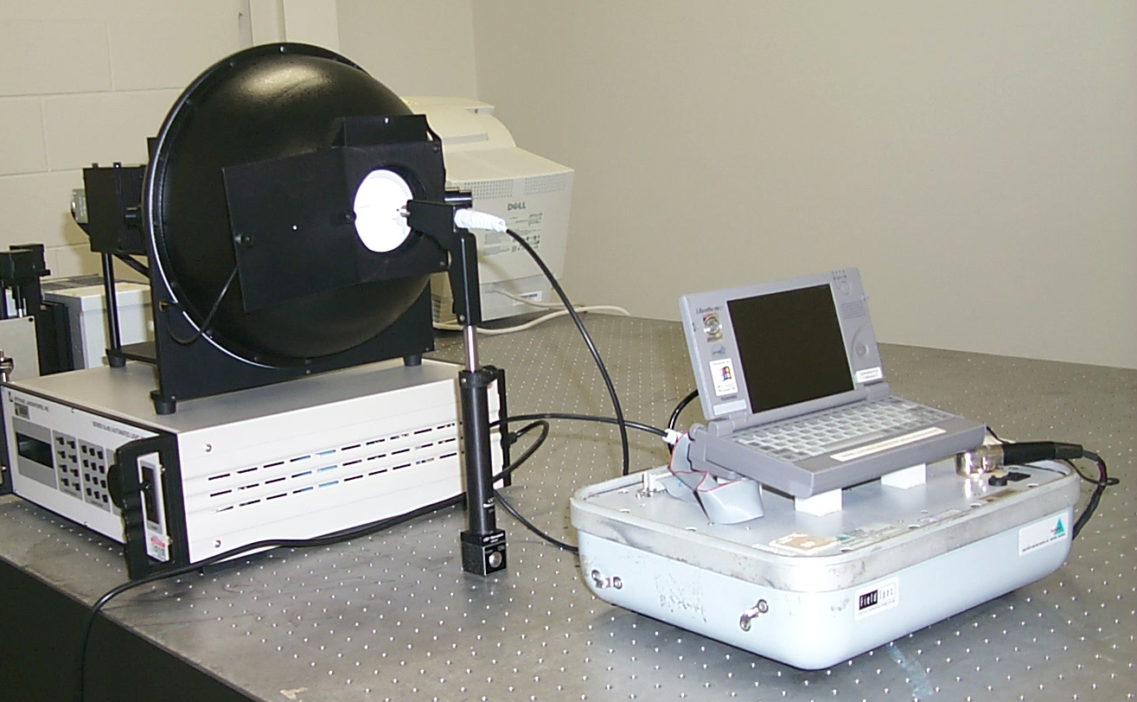
Camera Radiometric Characterization
Radiometric calibration and linearity measured with integrating sphere source
Integrating Sphere
CCD Camera
Radiance Setup
300
300
250
250
DN
200
DN
200
150
150
100
100
50
50
Characterization of Radiance Sources
0
-2
0
2
4
6
8
10
0
-2
0
2
4
6
8
10
12
14
16
Linearity
Measurements
Radiance
Radiance
300
300
250
250
DN
200
200
150
DN
150
100
100
50
50
0
-5
0
5
10
15
20
25
30
35
40
0
-5
0
5
10
15
20
25
30
35
Radiance
Radiance

Slide 28
Camera Spectral Response
Monochromatic Uniform Source
Multispectral CCD Camera Response

Slide 29
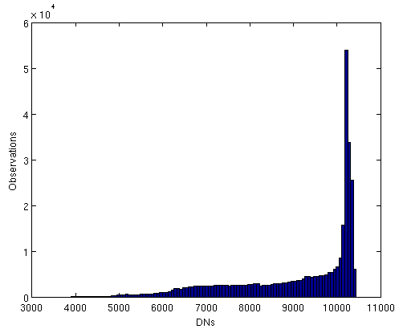
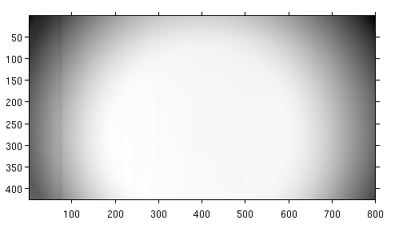
Sample Integrating Sphere Raw Image and Corresponding Histogram
560 nm Wavelength
Signal changes by more than a factor of 2
29

Slide 30
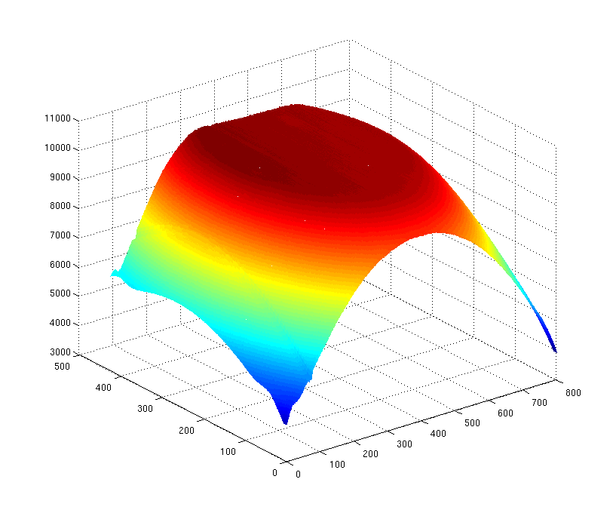
Vignetting Image of Integrating Sphere

Slide 31
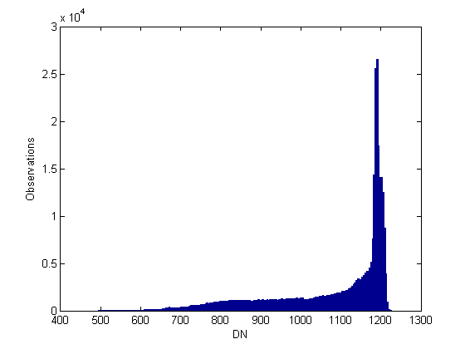
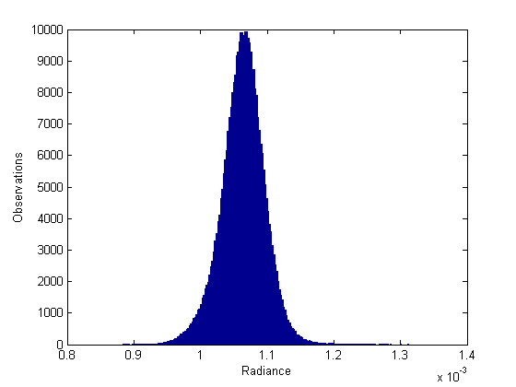


Before and After (430.1 nm)

Slide 32
Integrating Sphere Image

Slide 33
Corrected Integrating Sphere Image

Slide 34
Corrected vs Uncorrected (Water)

Slide 35
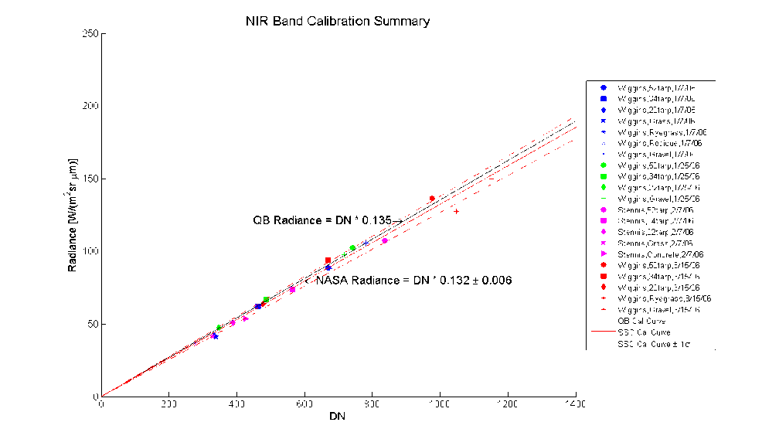
In-Flight Absolute Radiometric Accuracy
Requires knowledge of
  System spectral response Illumination as a function of wavelength and viewing geometry
  Target properties (reflectance)
  Atmosphere (in-flight assessments)
Outcome is a calibration coefficient
  Shown as a slope
Radiance
DN

Slide 36
Summary
In addition to geopositional accuracy, image quality is determined by:
  Spatial resolution
  Radiometric accuracy
Typical measures of merit are:
  Spatial resolution – GSD, MTF at Nyquist and RER, SNR
  Radiometric accuracy - Calibration coefficient
Each of these must be determined in the laboratory prior to operation and then validated in-field
Required values are highly dependant on application

Slide 37
Backup

Slide 38
Data Product Specification Terms Recommendation
Spatial Resolution
  GSD
  RERx, RERy (across the sensor) or MTF@Nyquist
Spectral
  Spectral response (Center Wavelength, FWHM)
Radiometry
  Quantization
  SNR at different radiances or part of dynamic range
  Relative (Linearity, pixel-to-pixel, band-to-band)
  Absolute (Only for science projects)

Slide 39
Data Product Specification Terms Recommendation
Gepositional
  CE90, LE90

Slide 40
Summary
Both the aerial and satellite MS remote sensing communities would benefit from common terms
Interoperability will require much more extensively characterized systems
  Surface reflectance is highly desired for environmental studies
Automated in-field techniques needed

Slide 41
Electro-Optical Image Quality
Sensor calibration and data product validation is more than just metric calibration…
Spatial Resolution
  A measure of the smallest feature that can be resolved or identified within an image
Radiometric Accuracy
  A measure of how well an image DN can be related to a physical engineering unit
  Engineering units are required to perform atmospheric correction to pull out surface reflectance or temperature values from within a scene.

Slide 42
Relative Edge Response-RER
Another measure of spatial resolution is a difference of normalized edge response values at points distanced from the edge by -0.5 and 0.5 GSD
Relative Edge Response is one of the engineering parameters used in the General Image Quality Equation to provide predictions of imaging system performance expressed in terms of the National Imagery Interpretability Rating Scale
Ringing Overshoot
1.0
Region where mean slope is estimated
Edge Response
0
Ringing Undershoot
-2.0
-1.0
0.0
1.0
2.0
Pixels

Slide 43
Meaning of RER in Remote Sensing
Radiance measured for each pixel is assumed to come from the Earth’s surface area represented by that pixel. However, because of many factors, actual measurements integrate radiance L from the entire surface with a weighting function provided by a system’s point spread function (PSF):
A simple example:
Box PSF
Width = 2 GSD
ER(0.5) - ER(-0.5) =
0.75 - 0.25 = 0.50
RER = 0.50
Part of radiance that originates in the pixel area is given by:
Relative Edge Response squared (RER²) can be used to assess the percentage of the measured pixel radiance that actually originates from the Earth’s surface area represented by the pixel:
RER² = 0.25 means that 25% of information collected with the pixel PSF (blue square) comes from the actual pixel area (shadowed square)
GSD
Source: Blonski, S., 2005. Spatial resolution characterization for QuickBird image products: 2003-2004 season. In Proceedings of the 2004 High Spatial Resolution Commercial Imagery Workshop, USGS, Reston, VA, Nov 8–10, 2004

Slide 44
Radiometric Accuracy
Absolute radiometric calibration
  DN values are related physical units on an absolute scale using national standards
Relative radiometric calibration
  DN values are related to each other
    Image-to-image
    Pixel-to-pixel within a single image
Determined in a laboratory prior to sensor operation and validated in flight

Slide 45
Why Have An Absolute Radiometrically Calibrated Aerial Imaging System?
Predicts the performance of the multispectral imager a priori
Simulates satellite remote sensing systems
Supports the ability to atmospherically correct products to surface reflectance
Improves quality control in manufacturing process by measuring camera sensitivities during laboratory calibration
Reduces need to color balance with post processing software

Slide 46
Absolute Calibration Accuracy
Absolute radiometric calibration accuracy depends on knowledge of measurements
  Using current methods, accuracy can only be validated to within 2-5%
  In-field calibration accuracy also depends on knowledge of solar irradiance models
Required accuracy depends on application

Slide 47
Absolute Radiometric Calibration Coefficient
Where: DN | Digital Number for a pixel
L | Spectral radiance of Integrating sphere [W/(m² sr μm)]
S | System spectral response
C | Calibration coefficient [(W/(m² sr μm))/DN]

Slide 48
Absolute Radiometry Enables Atmospheric Correction
Atmospherically corrected imagery (reflectance maps) enable:
  Change detection with reduced influence of atmosphere and solar illumination variations
  Spectral library-based classifiers
  Improved comparisons between different instruments and acquisitions
  Derived products such as Normalized Difference Vegetation Index (NDVI)

Slide 49
Importance of Atmospheric Correction
Radiance, Wm⁻²sr⁻¹microns⁻¹
Wavelength, microns

Slide 50
Relative Radiometric Accuracy
Laboratory measurements are performed using uniform illuminated targets
  Flat fielding
    Focal plane roll-off is measured and corrected for so that each pixel yields the same DN across the focal plane
  Focal plane artifact removal
    Artifacts such as focal plane seams and bad pixels are removed and replaced with either adjacent pixel values or an average of adjacent pixel values
Typical remote sensing goal is <1%

Slide 51
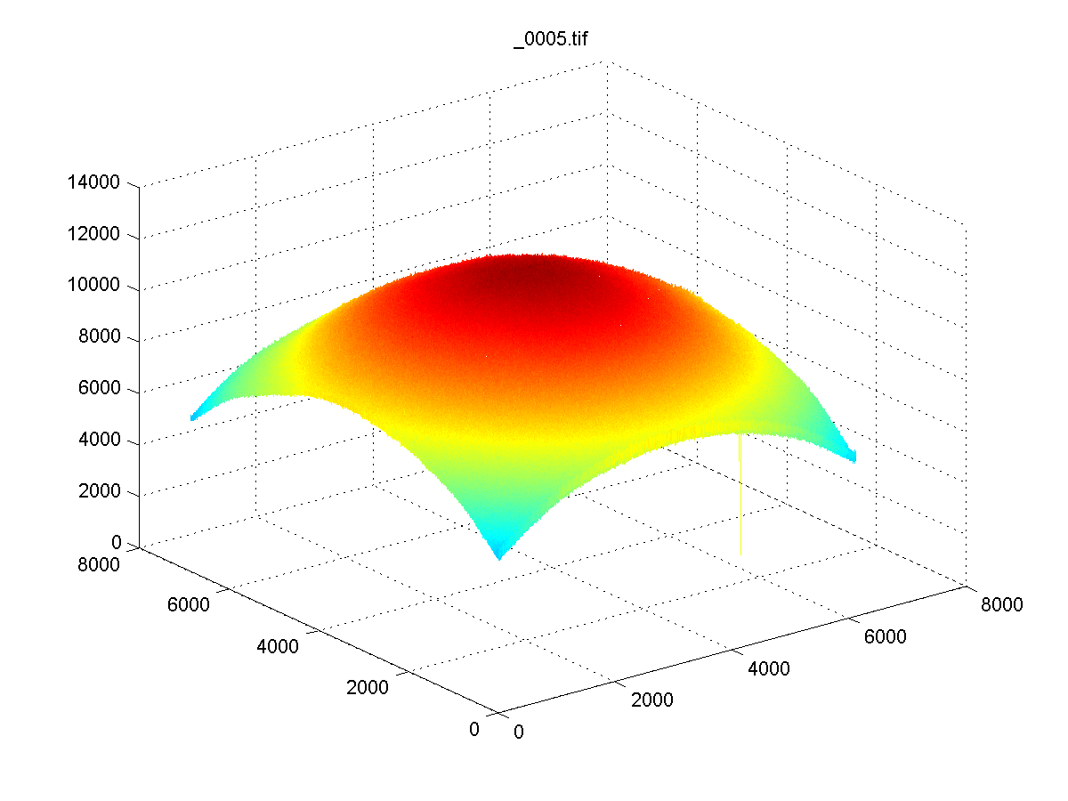
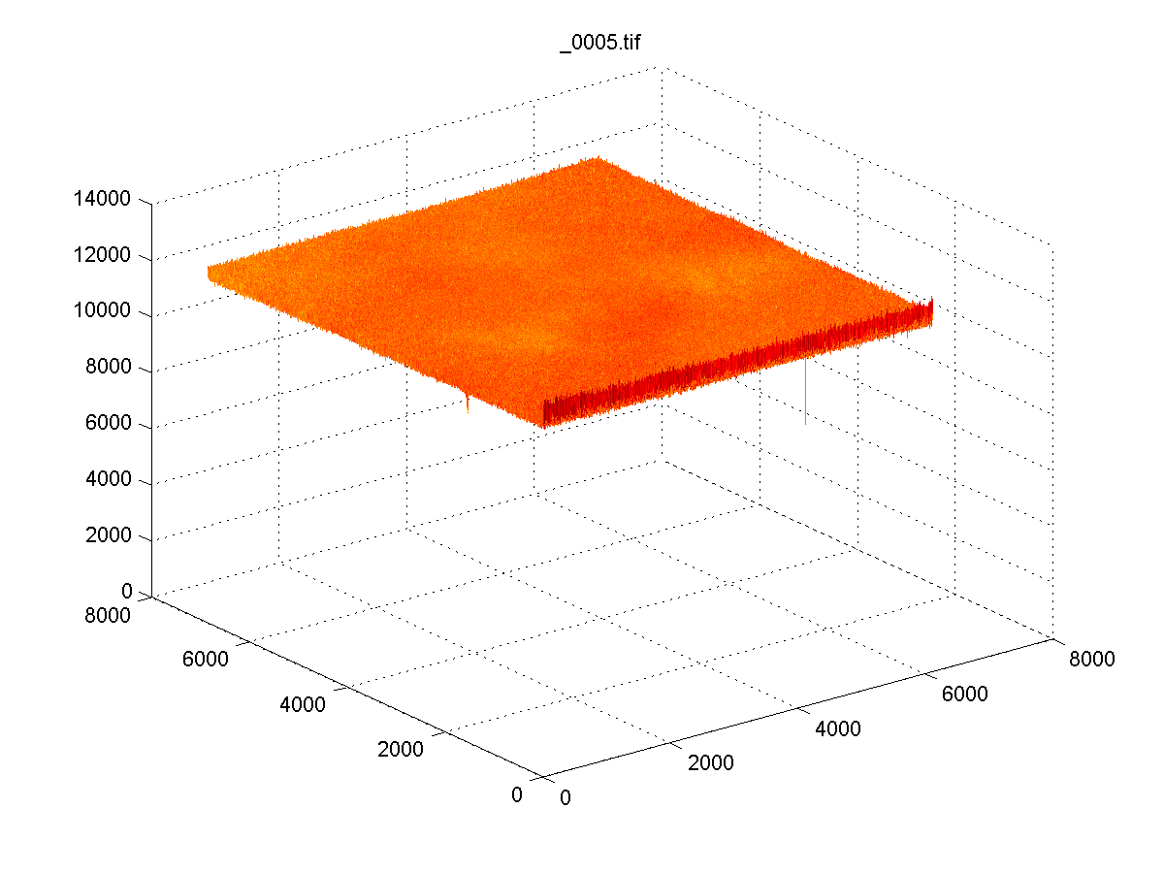
Sample Flat Fielding Correction

Slide 52
Flat Fielding
Flat Fielded Dark Frame Subtracted Image
Normalized to Reference Condition DN
Raw DN
Mean Dark Image
Maximum DN
Integrating Sphere Bright Image at Reference F#

