Slide 1
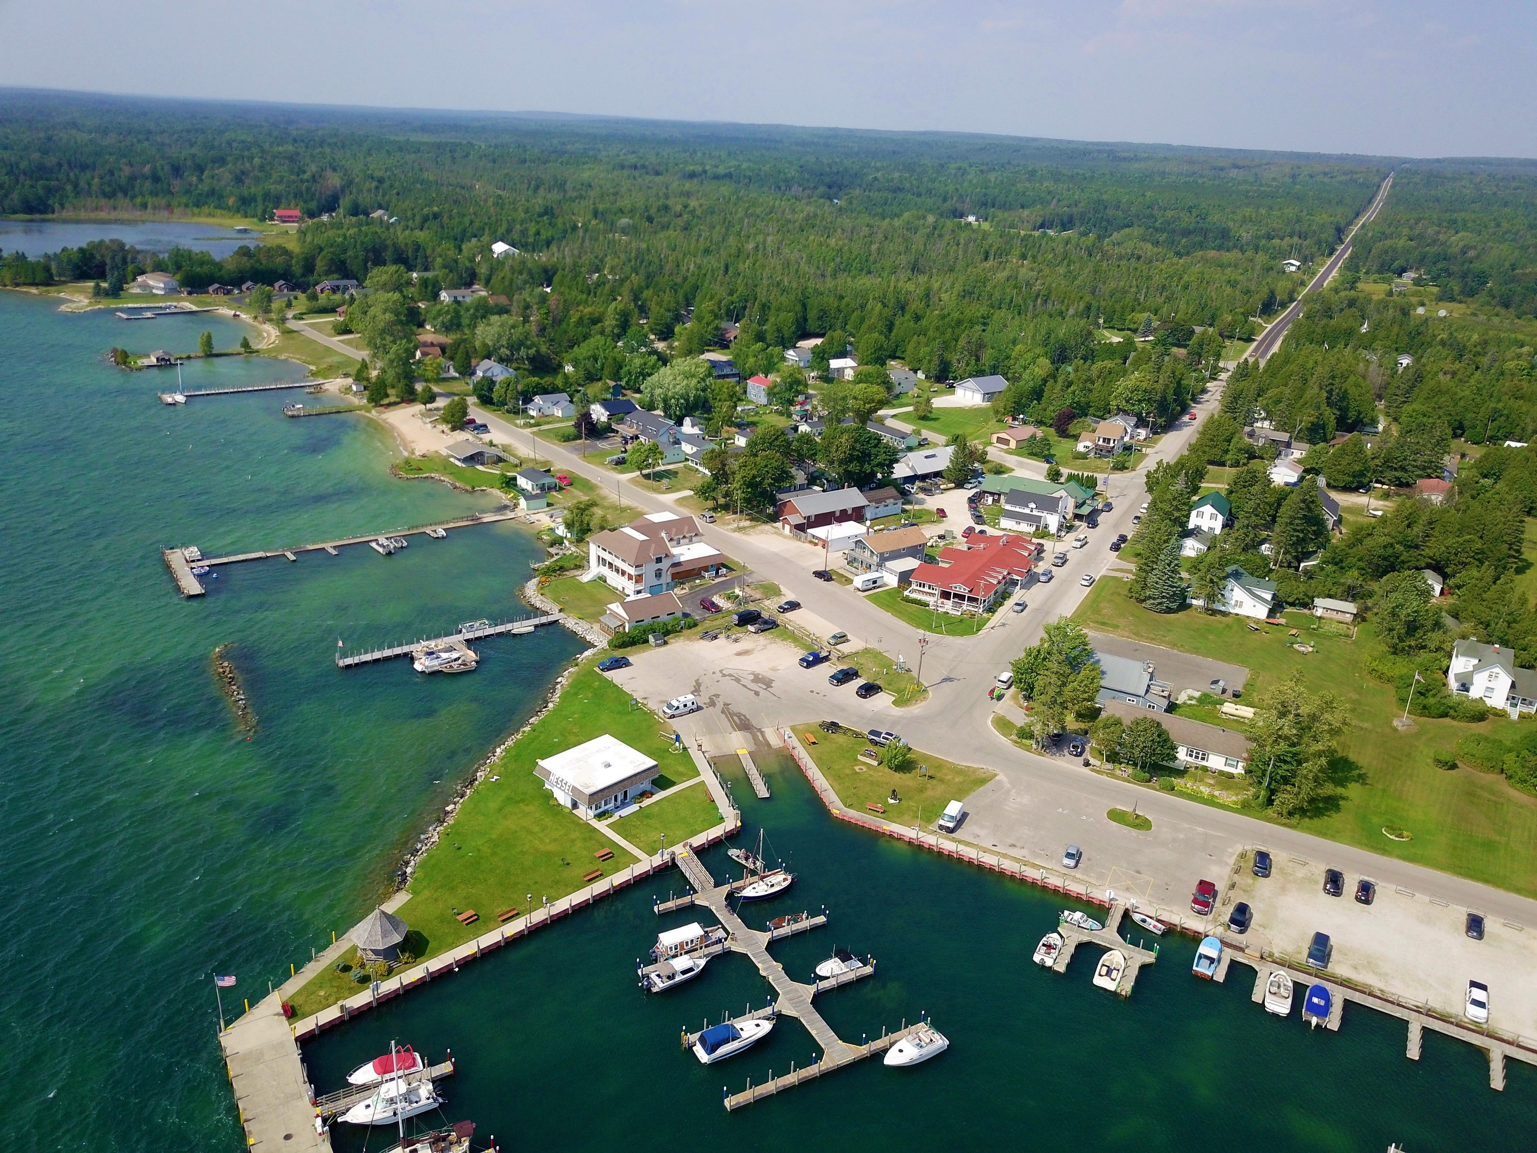
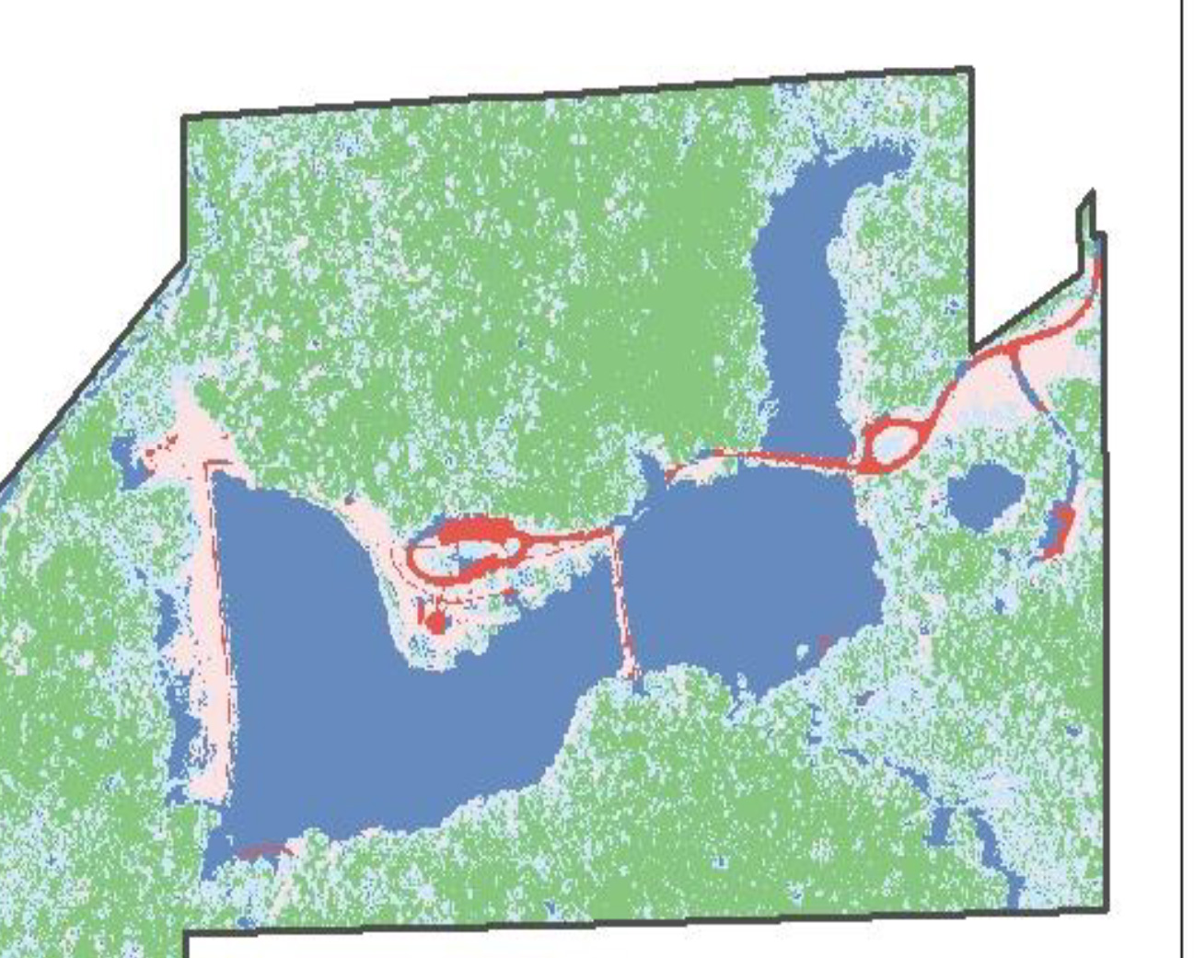
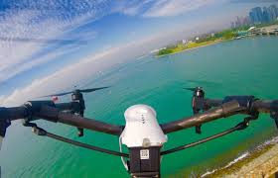
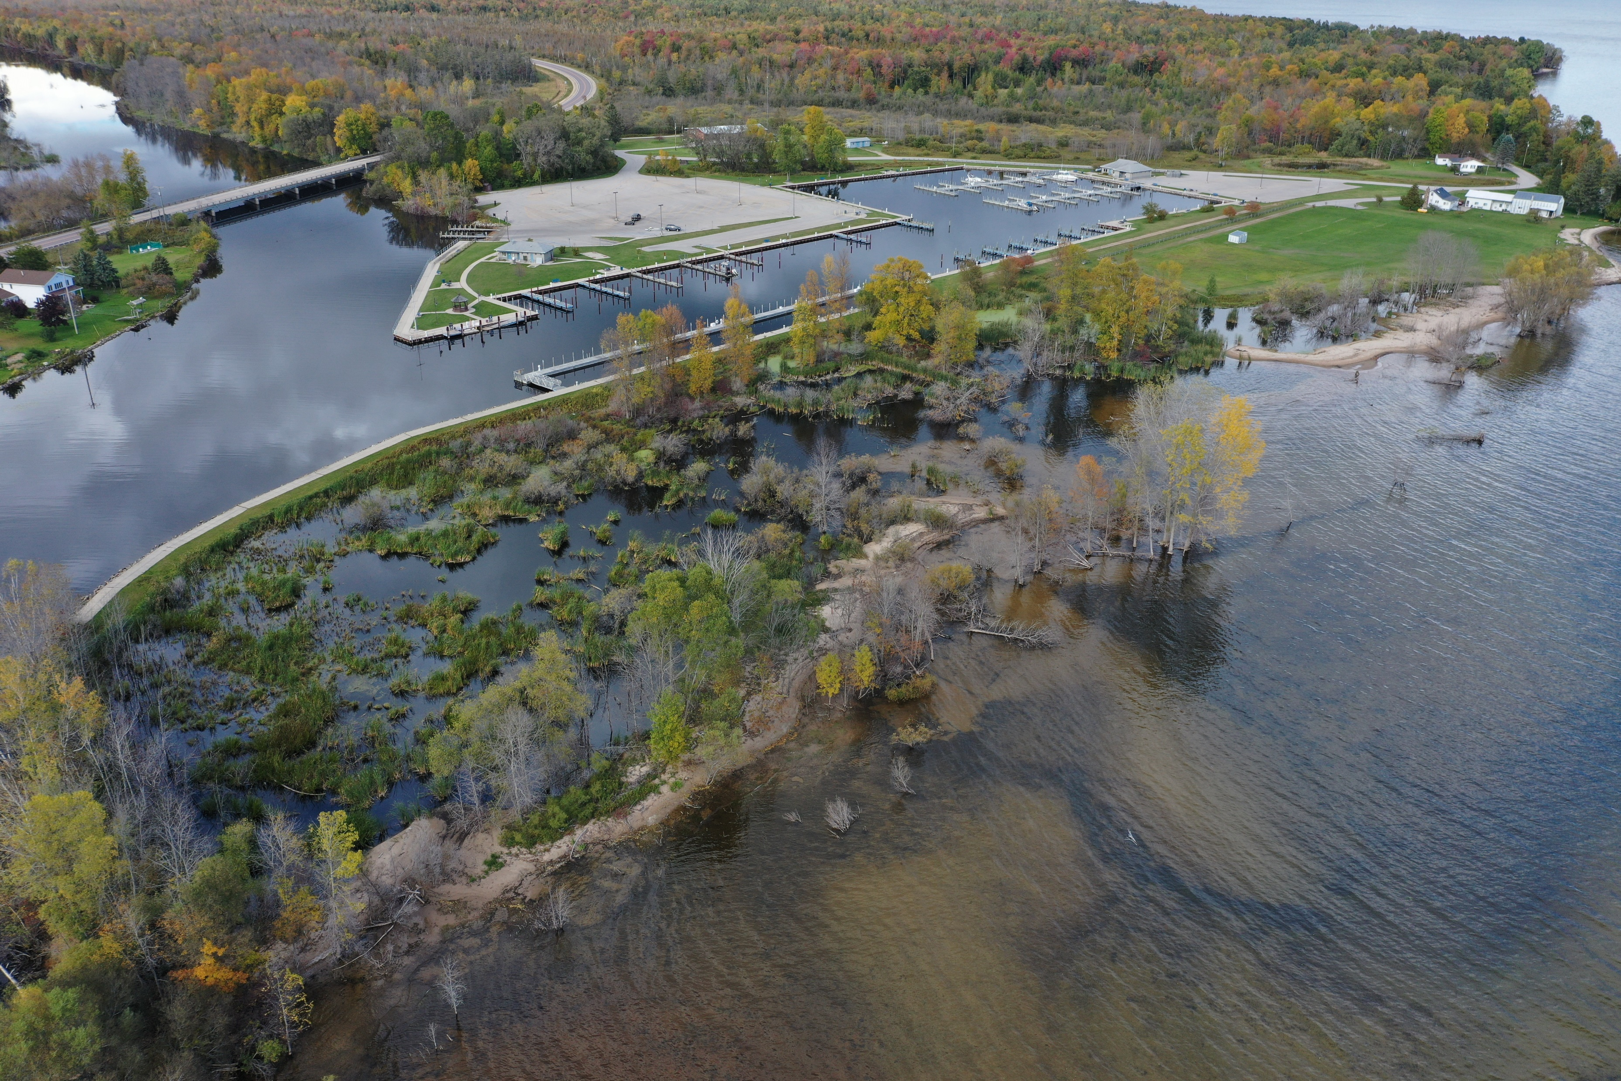
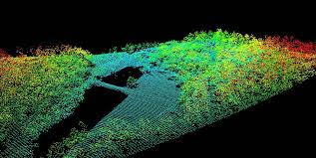


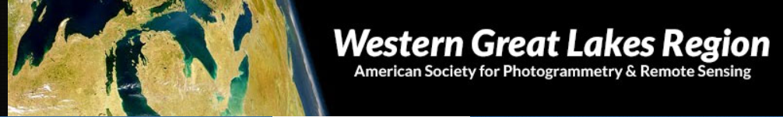
The American Society for Photogrammetry and Remote Sensing
Eastern Great Lakes and Western Great Lakes Regions
Are Proud to Present a Joint Summer Technical Meeting:
GEOSPATIAL IN THE GREAT LAKES
August 19, 2021
Hosted by: Michigan Tech Research Institute
Q

